Slide 1

UST-KAMENOGORSK TITANIUM AND MAGNESIUM PLANT
2013/2014 INVESTMENTS

Slide 2
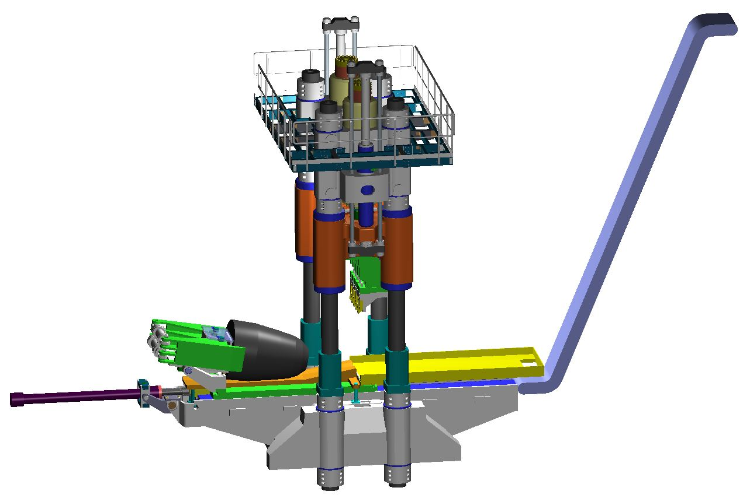
NEW TITANIUM SPONGE SHEARER
manufactured by Siempelkamp, Germany
value of ivestment 5 M USD
will be commissioned in Q2 2014

Slide 3
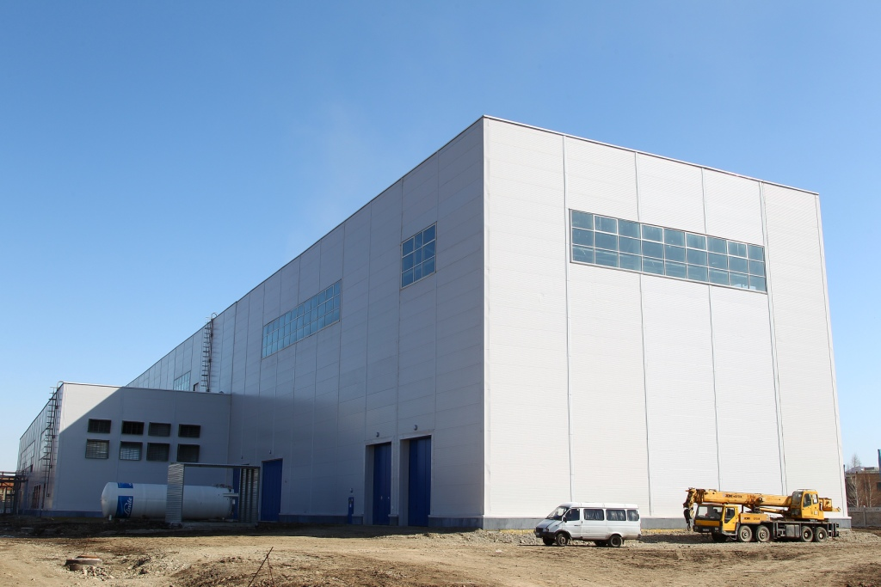
PRODUCTION OF TITANIUM SLABS
Inauguration scheduled in Q3 2014
value of investment 72 M USD

Slide 4
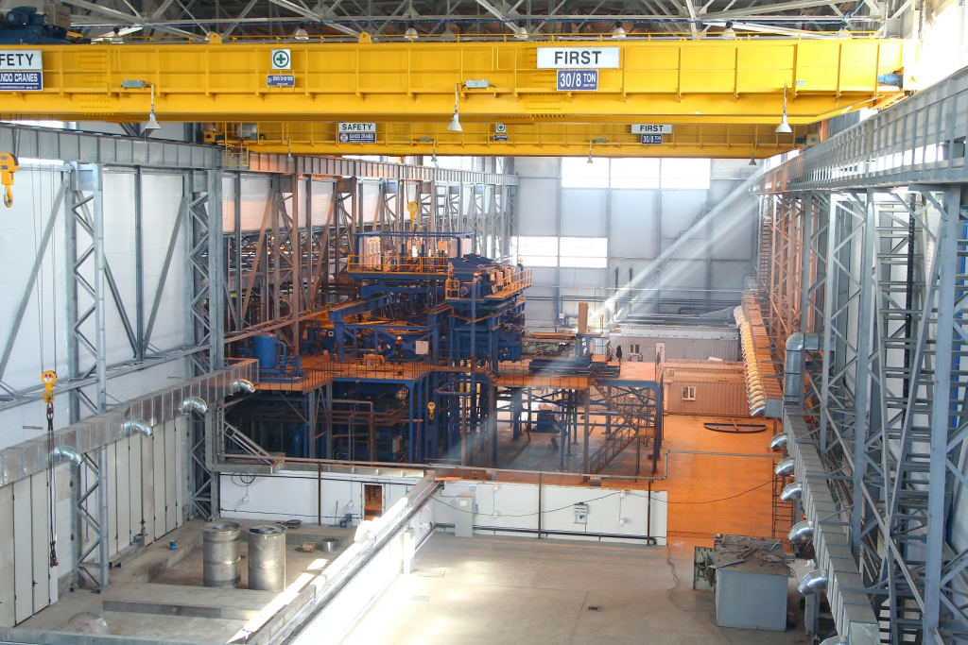
PRODUCTION OF TITANIUM SLABS
EB furnace, manufactured by Retech, USA
will be commissioned in Q2 2014

Slide 5
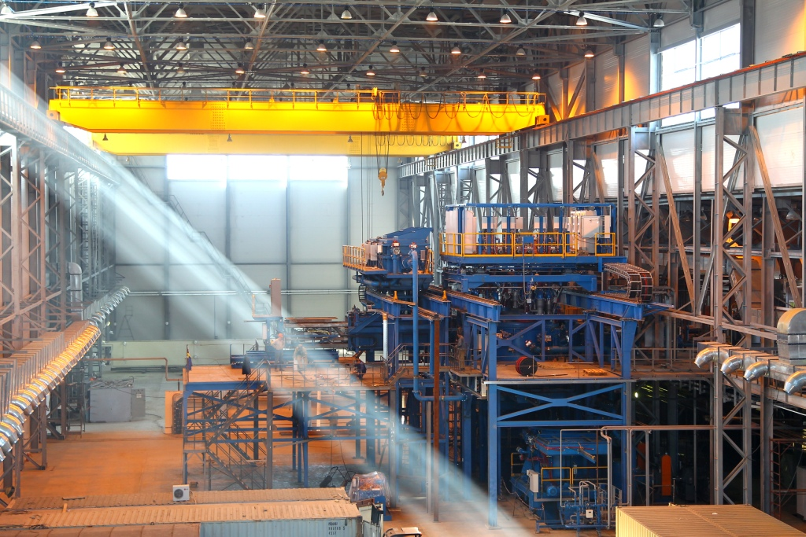
PRODUCTION OF TITANIUM SLABS
EB furnace, manufactured by Retech, USA
will be commissioned in Q2 2014

Slide 6
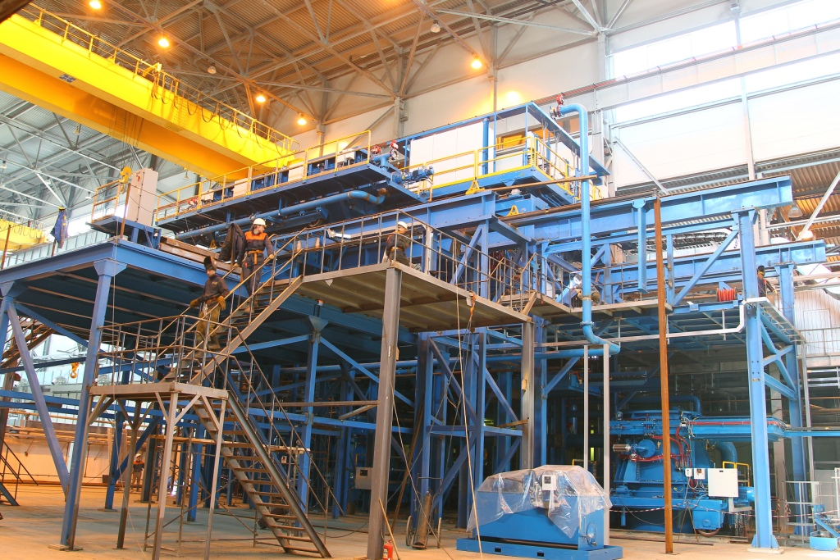
PRODUCTION OF TITANIUM SLABS
EB furnace, manufactured by Retech, USA
will be commissioned in Q2 2014

Slide 7
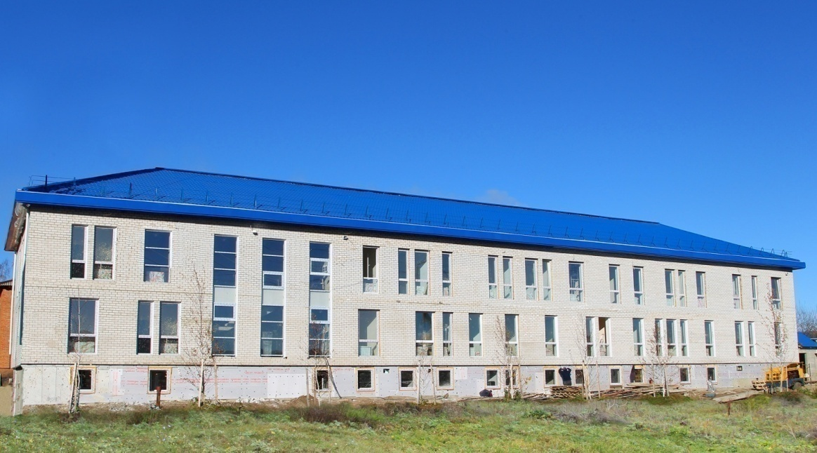
DAY CLINIC
inaugurated March 27, 2014
value of investment 5 M USD

