Slide 1
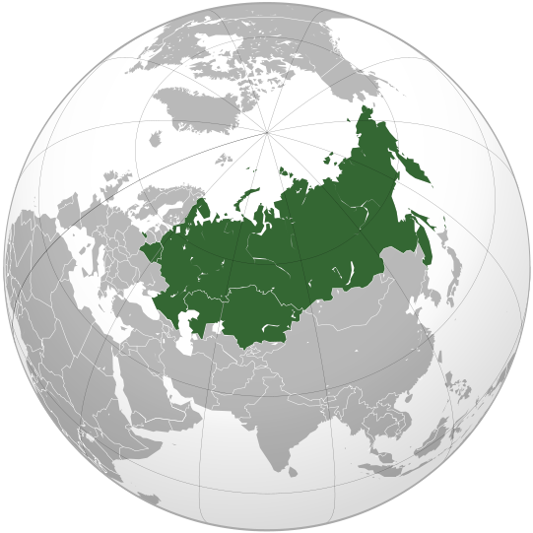
CUSTOMS UNION between Russia, Belarus and Kazakhstan
Russia
Belarus
Kazakhstan

Slide 2
KEY FIGURES AND DATA
Created: January 1, 2010
Current member states: Russian Federation, Republic of Belarus, Republic of Kazakhstan
Candidate states: Republic of Kyrgyzstan (applied for full membership in May 2013), Republic of Armenia (membership intention declared in September 2013)
Purpose: integration of economies of member states by creation of a unique customs space, intra-union trade free of customs duties and other economic barriers
Unique customs tariffs and other regulations of trade with third countries, common technical and sanitary regulations (expected to be fully harmonized by 2015)

Slide 3
KEY FIGURES AND DATA
Imported goods are customs cleared at the first entry point of the Union and afterwards can move freely inside.
Import duties are distributed between member states as follows: Russia 87.95%, Kazakhstan 7.35%, Belarus 4.7%
Sharp increase of intra-Union trade in 2010-2011, especially in cross-border areas (more than 40%).
UKTMP has changed port of entry for all its imports and has switched either to Russian Black Sea ports, St. Petersburg or Vladivostok as customs clearing point instead of Kazakhstan.
All titanium raw materials coming from Ukraine are being shipped without delay currently to Russia and Kazakhstan.
Allowed a creation in Kazakhstan of 25,000 new jobs at foreign cars assembly plants.

Slide 4
POTENTIAL DISRUPTION DUE TO SANCTIONS
Sanctions target specifically companies rather than countries. Therefore the Customs Union should not be targeted.
If more sanctions are introduced, goods coming out of the Customs Union will be thoroughly checked by customs of importing countries.
EU and US will look at Russian content of the imported goods.
UKTMP has no Russian content in its products.
Sanctions will especially target producers who are supplying Russian defence industry. UKTMP has no sales to defence industry within the F.S.U.
VSMPO shareholding: 25%+1 share owned by Rostec (formerly, «Rostekhnologii», Russian state corporation promoting development, production and export of hi-tech industrial products for civil and defense sectors); 65% - Business Alliance Company (a JV between VSMPO management (75%+1) and Gazprombank (25%-1), remaining shares – free float.

