Slide 1

UST-KAMENOGORSK TITANIUM AND MAGNESIUM PLANT
FULLY INTEGRATED TITANIUM PRODUCER

Slide 2
UST-KAMENOGORSK TITANIUM AND MAGNESIUM PLANT
UKTMP has been in operation for almost 50 years
It is the youngest of the 3 Former Soviet Union Titanium sponge producers
During Soviet time 100% of UKTMP sponge went to VSMPO, mainly, for defense and aerospace applications
Kazakhstan became an independent republic in December 1991, UKTMP was privatized in 1996-1997
Specialty Metals Company became its major shareholder

Slide 3
UST-KAMENOGORSK TITANIUM AND MAGNESIUM PLANT
UKTMP is the only fully integrated Titanium producer in the world:
Ilmenite mining operation
Titanium slag production
Titanium tetrachloride and magnesium production
Titanium sponge production
Titanium melting facility
Titanium slabs production (to be commissioned in 2014)

Slide 4
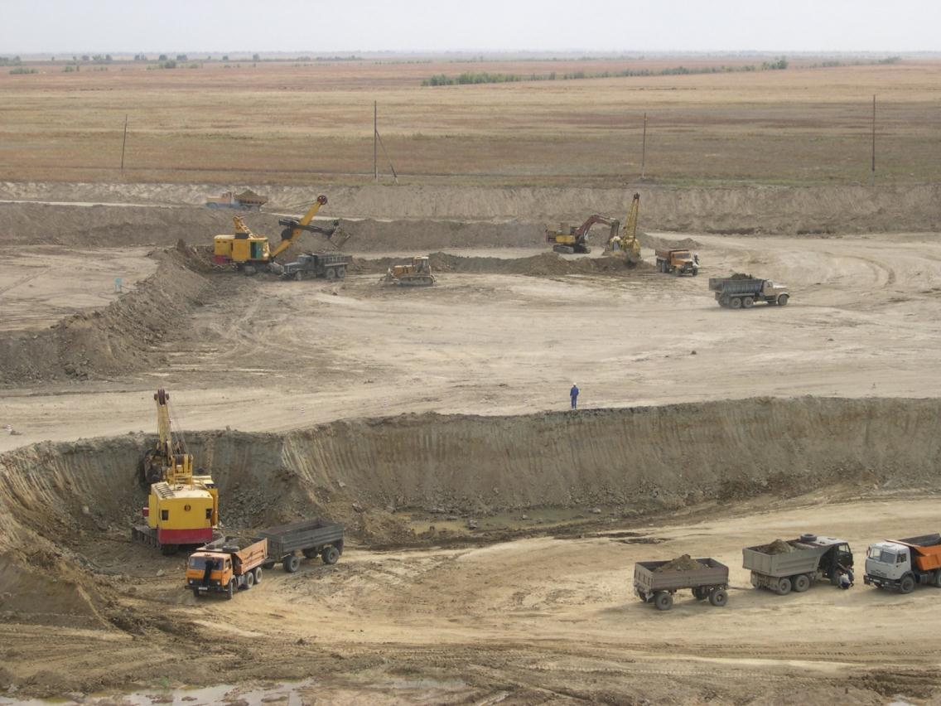
SATPAYEVSK ILMENITE MINE

Slide 5
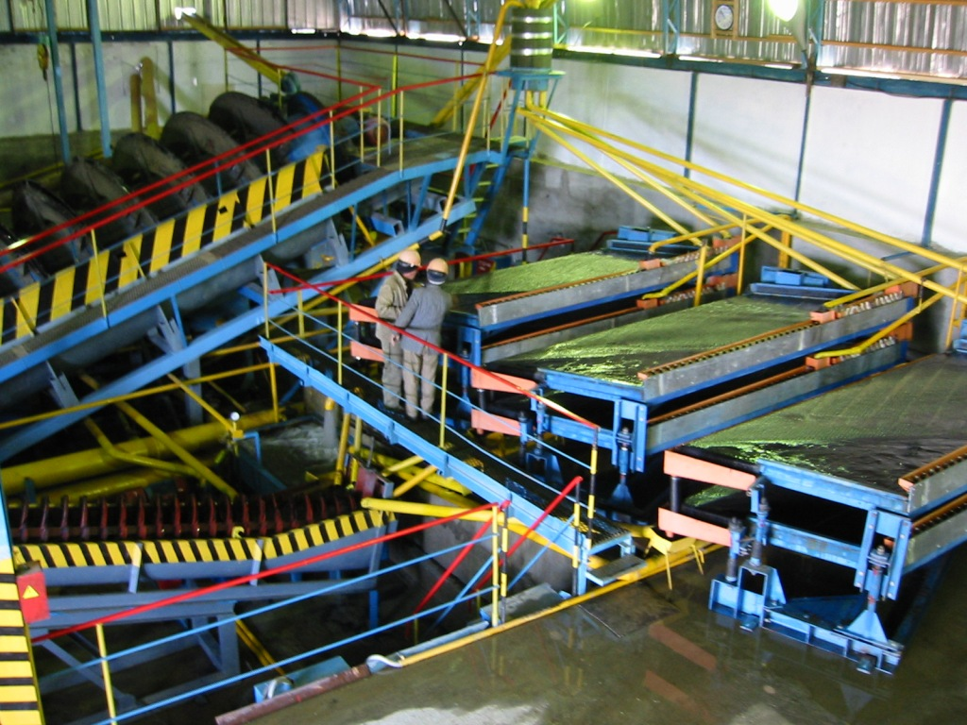
ILMENITE CONCENTRATE PRODUCTION

Slide 6

TITANIUM SLAG PLANT

Slide 7

TITANIUM TETRACHLORIDE PLANT

Slide 8
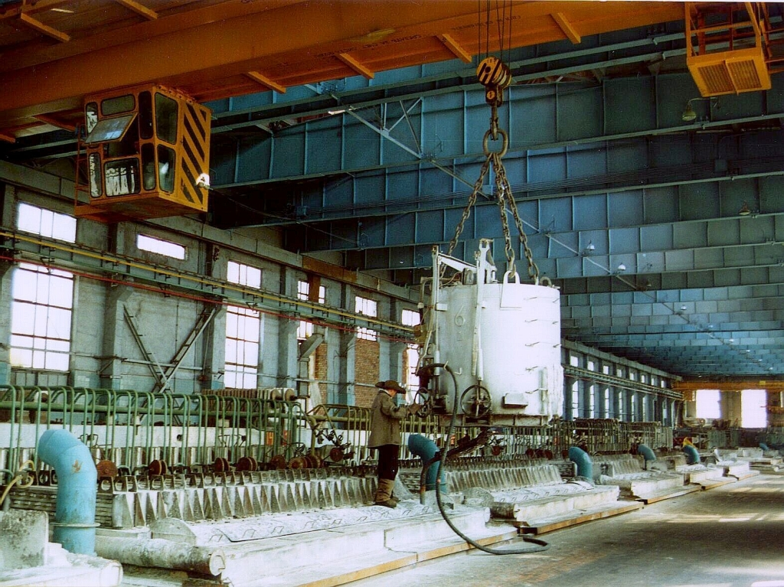
MAGNESIUM PRODUCTION
ELECTROLYSIS

Slide 9

TITANIUM SPONGE PRODUCTION
VACCUUM DISTILLATION

Slide 10
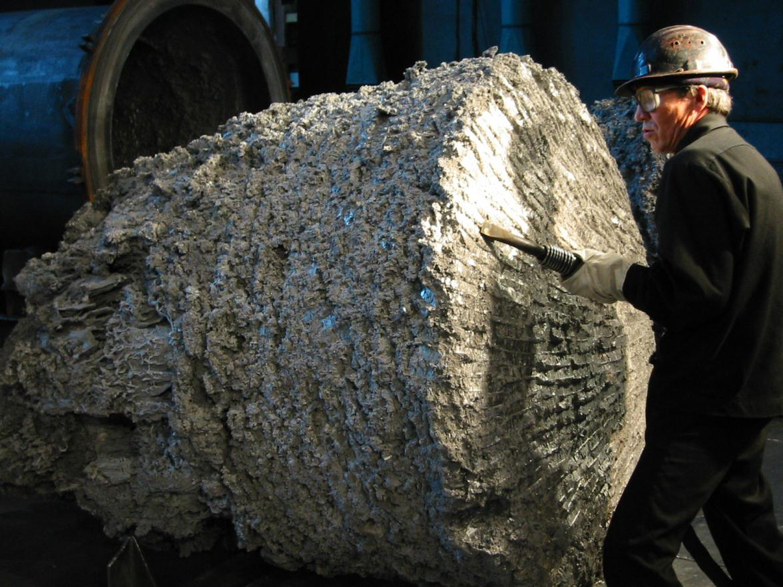
TITANIUM SPONGE PRODUCTION
TITANIUM SPONGE CAKE

Slide 11

TITANIUM SPONGE PRODUCTION
CRUSHING, SCREENING

Slide 12

TITANIUM SPONGE PRODUCTION
100% VISUAL CONTROL

Slide 13
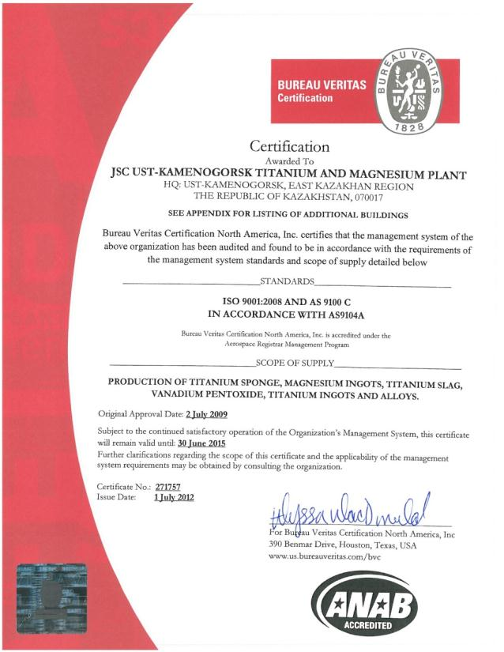
UST-KAMENOGORSK TITANIUM AND MAGNESIUM PLANT
UKTMP is ISO 9001, AS9100, and ISO14001 certified.
UKTMP is certified by all aero engines manufacturers and OEMs

Slide 14
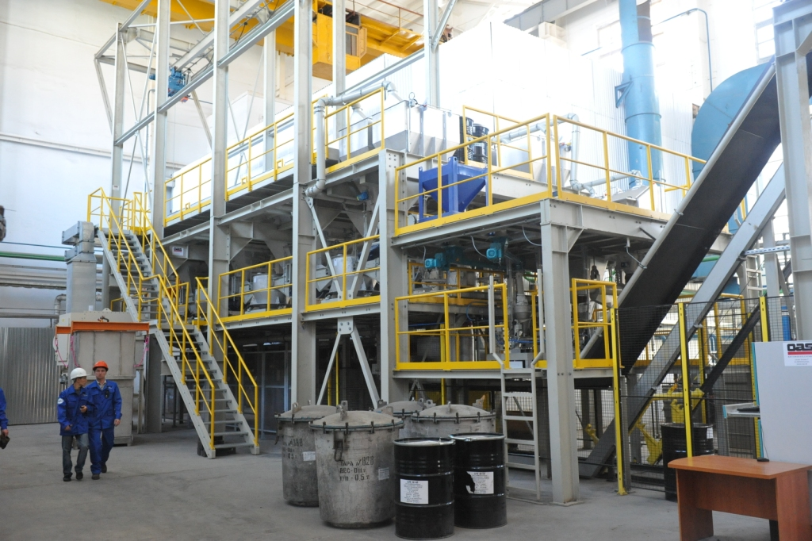
TITANIUM INGOTS PRODUCTION
WEIGHING AND BLENDING UNIT (WBU)

Slide 15

TITANIUM INGOTS PRODUCTION
8,000 T COMPACTING PRESS

Slide 16

TITANIUM INGOTS PRODUCTION
COMPACTING PRESS / ELECTRODES SEGMENTS

Slide 17
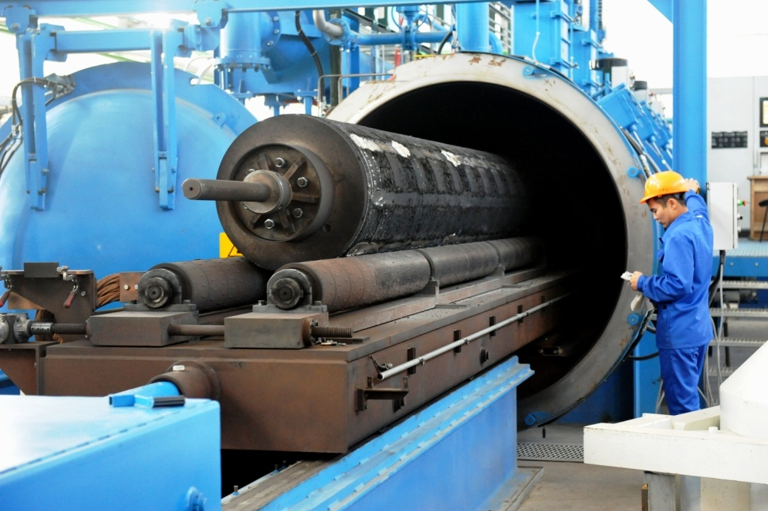
TITANIUM INGOTS PRODUCTION
PLASMA WELDER

Slide 18

TITANIUM INGOTS PRODUCTION
VACCUUM-ARC REMELT FURNACES (VAR)

Slide 19

TITANIUM INGOTS PRODUCTION
TITANIUM INGOT

Slide 20
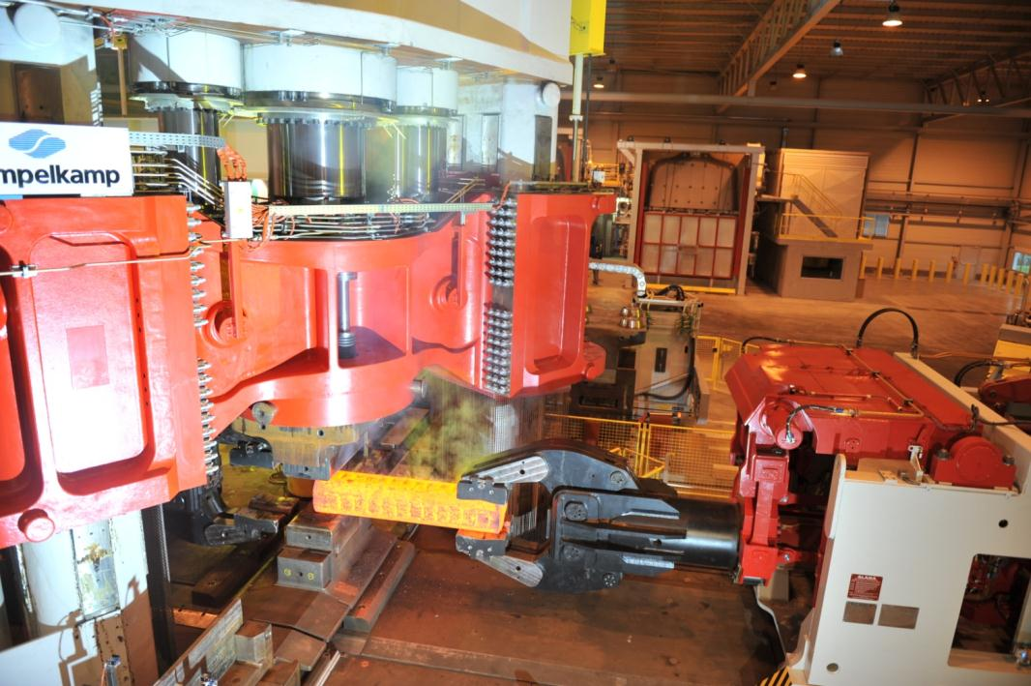
In September 2011 UKTMP and Eramet-Aubert & Duval inaugurated their Joint Venture – Titanium forging plant UKAD located in France

Slide 21
2013/2014 INVESTMENTS

Slide 22
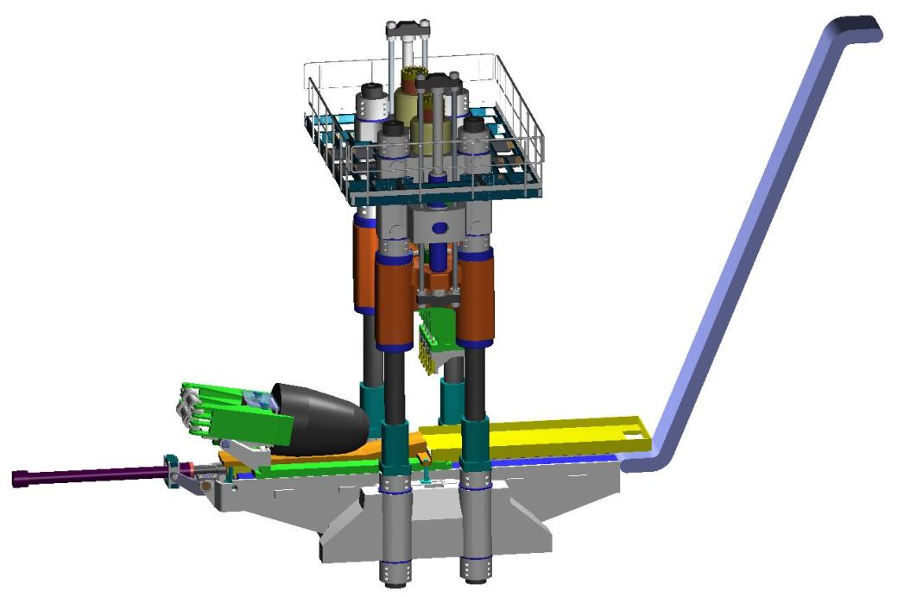
NEW TITANIUM SPONGE SHEARER
manufactured by Siempelkamp, Germany
value of ivestment 5 M USD
will be commissioned in Q2 2014

Slide 23
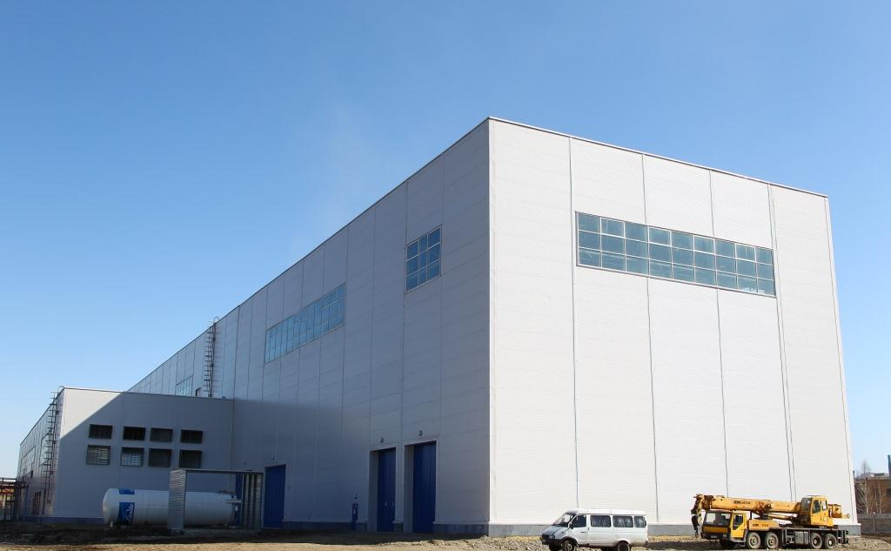
PRODUCTION OF TITANIUM SLABS
Inauguration scheduled in Q3 2014
value of investment 72 M USD

Slide 24
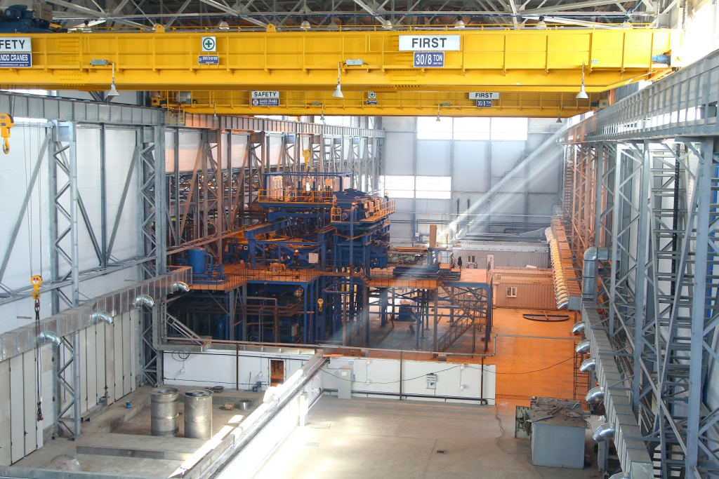
PRODUCTION OF TITANIUM SLABS
EB furnace, manufactured by Retech, USA
will be commissioned in Q2 2014

Slide 25
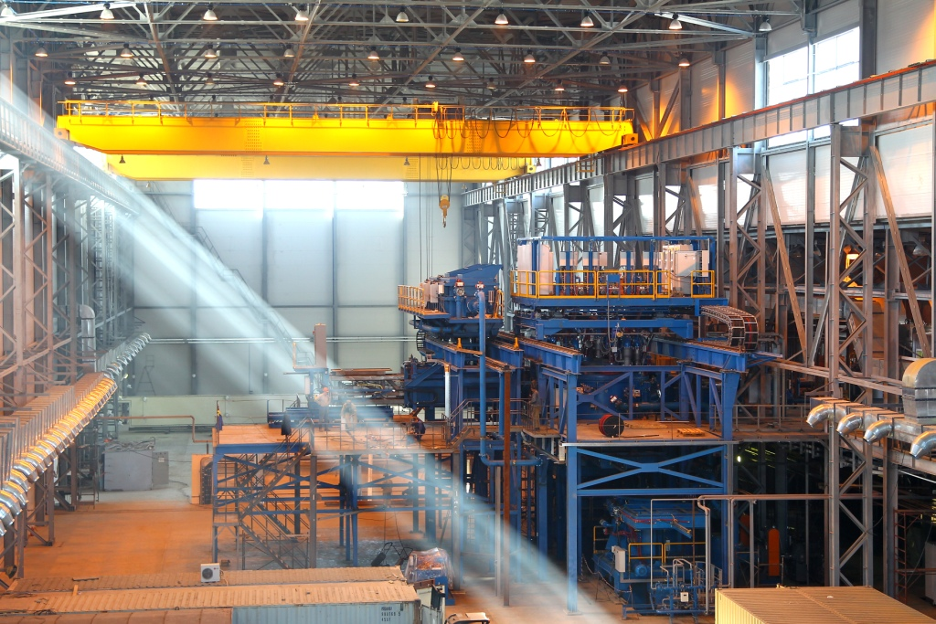
PRODUCTION OF TITANIUM SLABS
EB furnace, manufactured by Retech, USA
will be commissioned in Q2 2014

Slide 26
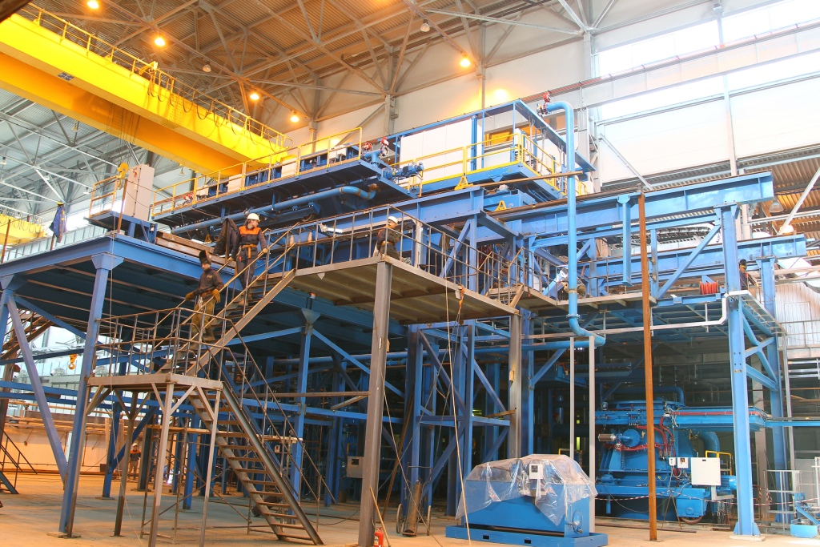
PRODUCTION OF TITANIUM SLABS
EB furnace, manufactured by Retech, USA
will be commissioned in Q2 2014

Slide 27
UKTMP Development Program for 2012-2022
Modernization of operating concentration plant Ltd SP «Satpayevsk Titanium Mines LTD»
Construction of the second concentration plant Ltd SP «Satpayevsk Titanium Mines LTD»
Construction of the second ore heat-treating furnace in the shop of Ti slag production.
Improvement of process of magnesium electrolysis due to introduction of leak tight construction of electrolysis cells.
Purchasing and installation of a new VAR furnace in the Shop No.14 (the 6th) for producing of Ti ingots and alloys.
Implementation and extension of automatic control system of Ti ingots and alloys production processes.
Commissioning of electron beam furnace. Titanium scrap processing.
Reconstruction of the shearer for slicing Ti sponge cake and installation of a new conveyer for transferring sponge to the crushing area.
Engineering and building a new Ti sponge production facility with bigger vessels (up to 10 tons).
Recycling of residues from TiCl4 production including extraction of rare metals (Scandium, Vanadium Pentoxide, etc.).

