Slide 1
Global Titanium LTA 2021- 2025
UKAD 1st phase feedback
09th November 2018
Richard Lindley, GCM Titanium
Carl Maitland, Titanium Buyer

Slide 2
Opening
01
02
Commercial Terms
03
Pricing feedback
04
Next steps

Slide 3
01
Opening & Welcome
Welcome
Reminder of context
Statement

Slide 4
t
Reminder of Context
Supply chain USA, Europe & Asia
Contract opportunities from 2021+
Globally competitive
Approval to MSRR/RRMS specification range
  Ingot, bar, billet, plate, sheet
Focus for UKAD is SQ Ingot/ Bingot/ Billet
01

Slide 5
Statement
Strategically we see high potential and opportunity with UKAD on the 2021 LTA, however there are several items that need to be addressed and agreed before we move forward.
This meeting is an opportunity to discuss commercial terms and pricing.
We have highlighted high focus terms, market pricing and target to allow focus beyond this phase.
01

Slide 6
02
Commercial Terms

Slide 7
Commercial Terms
Insurance, Warranty and Liability - Eramet Group Insurance to be submitted and reviewed.
Revert – Please provide UKAD specification of Revert.
Cost transparency –Collaborative working is required – Why has the clause been rejected?
Supplier Stock – To clarify “Buyer: means any R-R Party or Affiliate of a R-R Party which is a Deliverables Agreement Party.” This does not mean any member of the supply chain.
Levels of stock and buffer to be managed by UKAD in conjunction with R-R supply chain to a 10% level. UKAD will receive annual directed buy letters, providing guidance on the supply chain. It is UKADS sole responsibility to ensure maintenance of stock.
Termination – What other causes of Termination would you like to add?
Late Deliveries - 41.1 provides a modest remedy and is limited to four (4) weeks of delay. The % is set at an amount which generally compensates Rolls-Royce for the operational disruption and work arounds caused by such delays. It is not set at a level which can fully compensate Rolls-Royce for all of its potential losses. So all elements of clause 41 need to be agreed by UKAD.
02

Slide 8
03
Pricing feedback

Slide 9
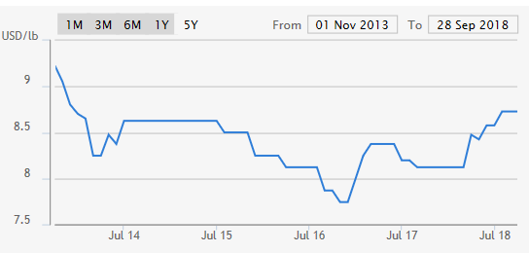
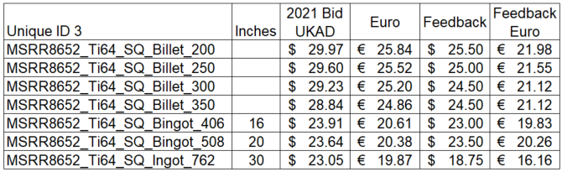
Pricing
Billet Improvement is needed of 10-15% – Target prices are provided below along with
Ti64 index industry data on 5 year average detailing $8.50/lb Ingot
03

Slide 10
04
Conclusion
Next steps

Slide 11
Next steps
Commercial terms to be update and provided
  Eramet Group Insurance
  Insurance clause proposal (12.2 A,B,C)
  Termination clause proposal
  Cost transparency proposal
  Revert proposal
Pricing to re-submitted 23rd November
  2 routes to be investigated
Revert specification to be provided
  New facility detail and proposal
Bingot definition to be provided – R-R
04

Slide 12
Thank you!

