Slide 1
UKAD Presentation

Slide 2
1
General presentation

Slide 3
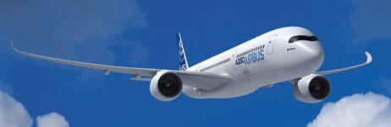

The Genesis of UKAD
The creation of UKAD was allowed by :
  The increase of Ti material in airplane structures
  The UKTMP strategy with Ti downstream development,
  The Aubert et Duval strategy with Ti upstream development,
  The support Airbus with a 10 years sales agreement,
  The French local authorities support,

Slide 4



The Genesis of UKAD
UKAD is a joint-venture which combines, in the titanium market, the strengths of 2 companies :
  Aubert & Duval
  UKTMP
UKTMP is a Kazakh registered company. Well known for its high level of Titanium sponge quality :
Ilmenite mining operation
Titanium slag production
Titanium tetrachloride and magnesium production
Titanium sponge production
Titanium melting facility
UKTMP plant in Kazakhstan

Slide 5












UKTMP in pictures

Slide 6
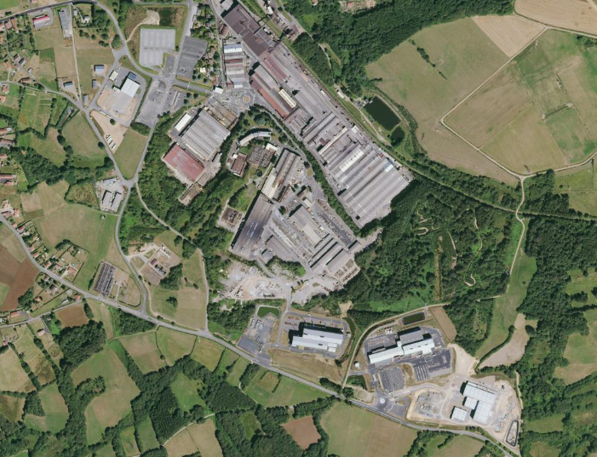
Location
AUBERT & DUVAL
UKAD
IV30
EcoTitanium

Slide 7


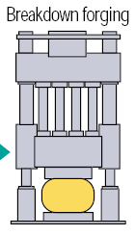




The Genesis of UKAD
Lingots
C
U
S
T
O
M
E
R
S
forging press
4,500 t.
N
D
T
*
or
Operations subcontracted to Aubert & Duval
➔ UKAD :
  Ingots from 7 (titanium) to 18 t
  Blooms and billets from 85 to 450 mm in Ø and 4 to 6 m long
  Bars from 55 to 85 mm.

Slide 8


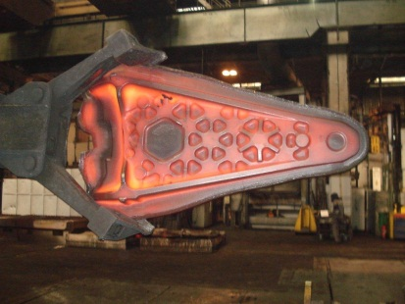




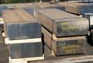
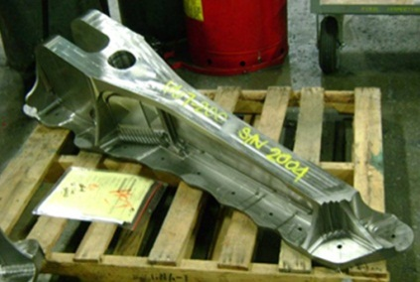




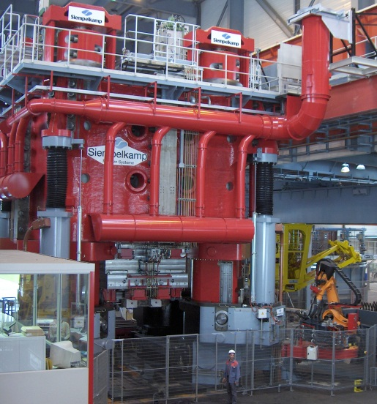


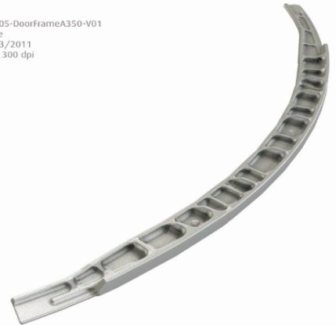

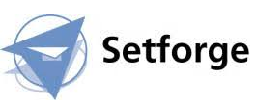







Worldwide Aeronautical Market
CUSTOMERS
UKTMP
Billets
Ti Alloy Ingot

Slide 9



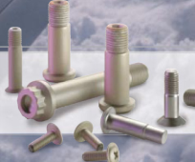
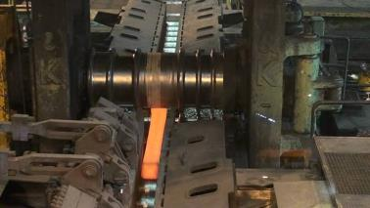





Fasteners and Medical Market
Aeronautical fastening market
UKTMP
Ingot ➔ Blooms ➔ Bars
CUSTOMERS
Orthopedic Implants
Ti Alloy Ingot
Knee
Hip

Slide 10
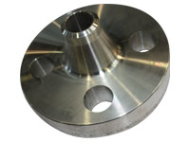
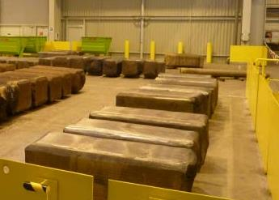
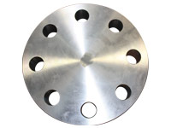
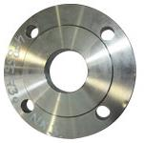
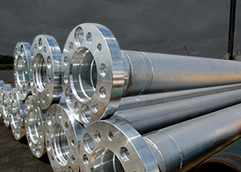

Oil and Gas, Industrial Market
UKTMP
CUSTOMERS
Ingot ➔ Blooms, Billettes
Welding Neck
Ti CP or Ti Alloy Ingot
Covers and flanges

Slide 11
Key Figures
Impact of the build-up of a strategic stock for our main customer.
Tons

Slide 12
UKAD certifications
ISO 9001 and AS 9100, last approval Feb 2018
ISO 14 001 and OHSAS 18001, last approval Feb 2018
Ultra Sonic Nadcap Certification in Dec 2014, confirmed in 2015, 2016 and in April 2018.
Airbus :
  IPCA Jan 2013 « C »➔ IPCA+ 28 Jan 2016 « B »
UKAD delivers billets and bars in accordance with AMS 4928 and Ultra Sonic tested in accordance with AMS 2631.

Slide 13

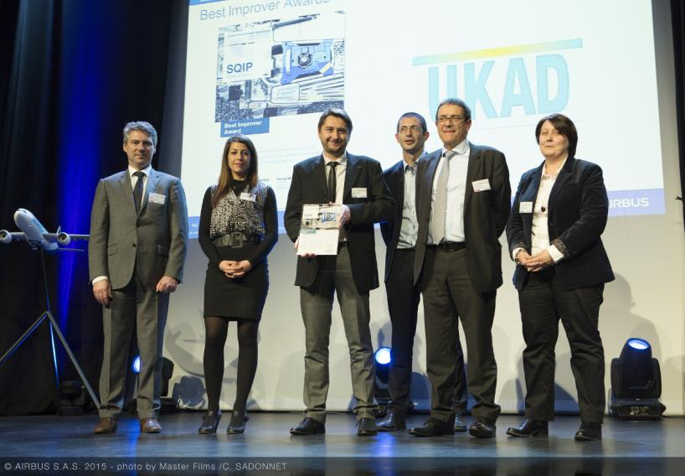
UKAD Awards
For the second year UKAD was awarded by Airbus :
Best Improver Award 2015 .

Slide 14
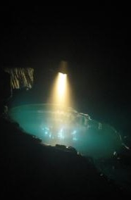
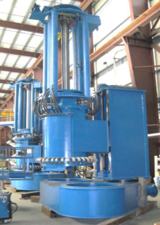
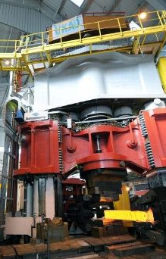
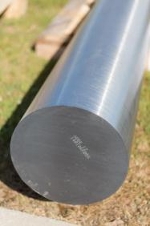
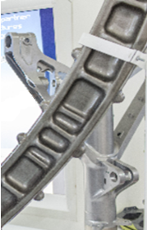
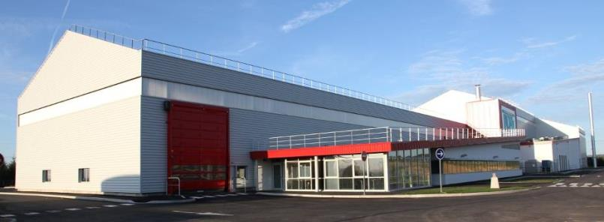
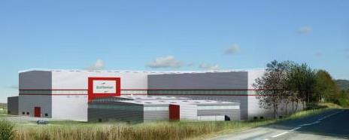
Thank you for your attention

Slide 15
Patrick DELABORDE
patrick.delaborde@eramte-aubertduval.com

