Slide 1
2018, June 5
ROLLS ROYCE Meeting
Raymond ALLIER
Plant manager

Slide 2
1
PROJECT DESCRIPTION
2
QUALIFICATIONS

Slide 3
1
PROJECT DESCRIPTION

Slide 4



Why EcoTitanium
Production generates significant volume of scrap:
Example : Door Frame - AIRBUS A350
Billet 200kg
50 kg of solids
Closed die part150kg
Ficished part 20kg
130 kg of turnings
180 kg of scrap
Ratio « Buy to Fly » : 10

Slide 5


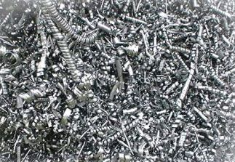

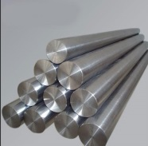
Why EcoTitanium
Scrap generated in Europe is a key for competitiveness of US titanium melters:
European titanium scrap is mainly exported to USA : :
* 10500 tons en 2016
* 17000 tons en 2017.
Europe
USA
US ingots were mainly produced from titanium scrap in 2014 and 2015, 63 % of the total consumption Scrap + Sponge.

Slide 6





SHAREHOLDERS
Committed shareholders in EcoTitanium
43.5 %
First facility in Europe for melting new Titanium Ingots by recycling, dedicated to aeronautical and high demanding markets in concept of Circular Economy.
49 M€ investment for the first step.
63 direct employees
7 100 m²
41.3 %
15.2 %

Slide 7

Integrated solution for titanium
An open Solution for all UKAD Customers: The revert loop will be available for all UKAD’s customers (forgers, extruders), based on circular Economy.

Slide 8
Project description
EcoTitanium project is composed of 3 parts:
  New European organization for collecting of Ti 6-4 scrap.
  Processing of scrap.
  New production plant in France for melting with PAMCHR and VAR remelting.
  The first two points will be made in collaboration with external partner companies which already manage that kind of process.

Slide 9
Project description
EcoTitanium will elaborate aeronautic quality ingots for following markets:
  Aeronautic parts:
    structure,
    Landing gear,
    Fix and rotary parts for motors,
    Fasteners.
  Medical,
  Defence,
  Distributors/stockists.

Slide 10
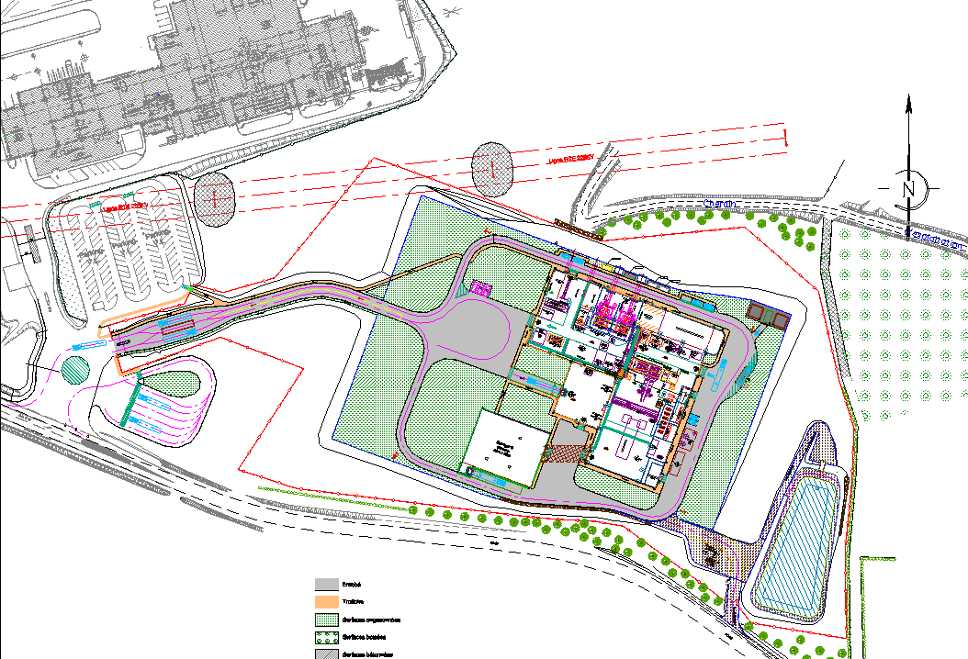
Layout & flow process
UKAD
Machining
Locaux techniques
VAR
Bureaux
Lingotières
Stock MP
Plasma
Stock MP
Locaux techniques
Charge preparation
Key points :
Sponges / turnings storage in a separated workshop ➔ fire risk management.
Lean manufacturing

Slide 11
Process studies
FMEA process: we had realized a FMEA (Failure Mode Effects Analysis) on all the process, in order to anticipate main issues.
METAFENSCH pilot: for increasing our knowledge in titanium melting technologies and process :
  Impact of scrap processing on ingot quality,
  Optimization of plasma process parameters,
  Development of New Titanium grades.
Assistance of experts : discussion with external experts for benchmark the best practices.
Internal R&D program based on different thematic as :
  Impact of different scrap preparations,
  Optimization of pattern torches and residence time,
  PAM and VAR modelling,
  Seeding tests.

Slide 12
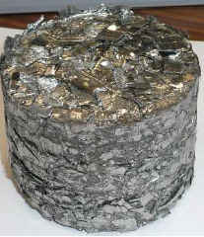
Process
Scrap preparation to build the charge
Melting in the plasma furnace : obtaining an electrode
Remelting in a VAR furnace
Finishing, sampling and shipping in UKAD
Ø = 830 mm
Ø = 915 mm

Slide 13
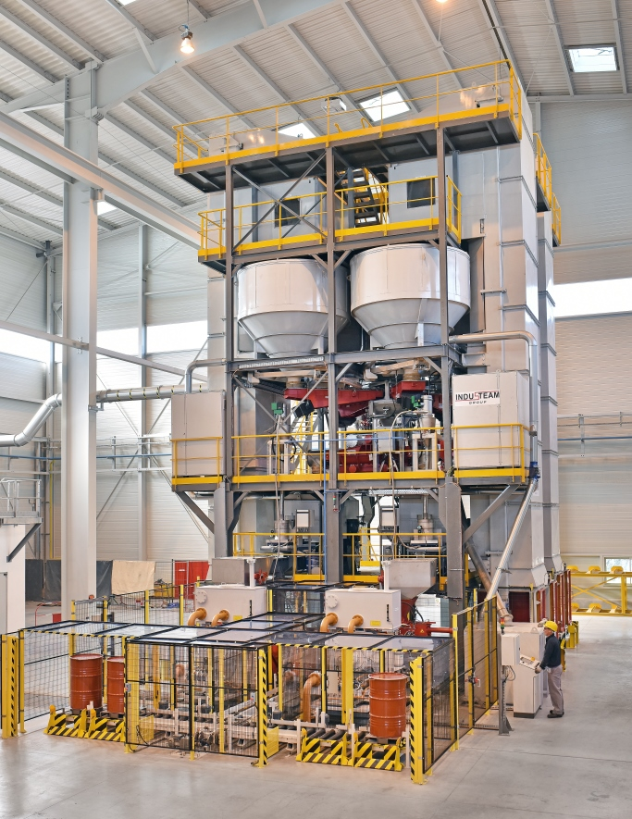
Process: charge make up
Turnings charge
Briquettes :
Ø = 95 mm
Briquettes are transferred in barrels
Key points :
Traceability with RFID or bar-code
All equipment are with cover to avoid cross contamination
Chemical homogeneity ➔ charge divided in batches of 200 kg, then divided in mini-batches of 25 kg.

Slide 14
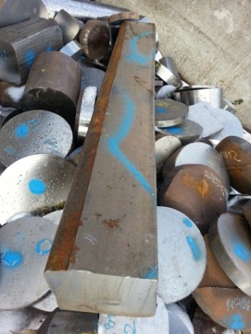
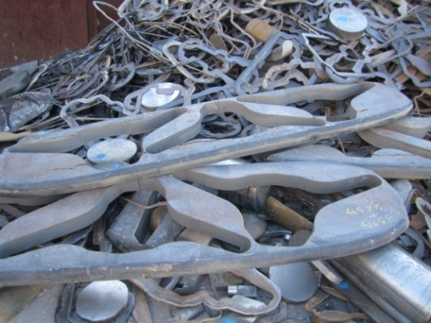
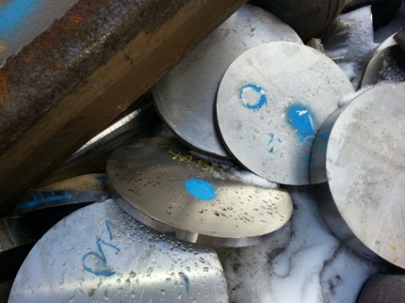
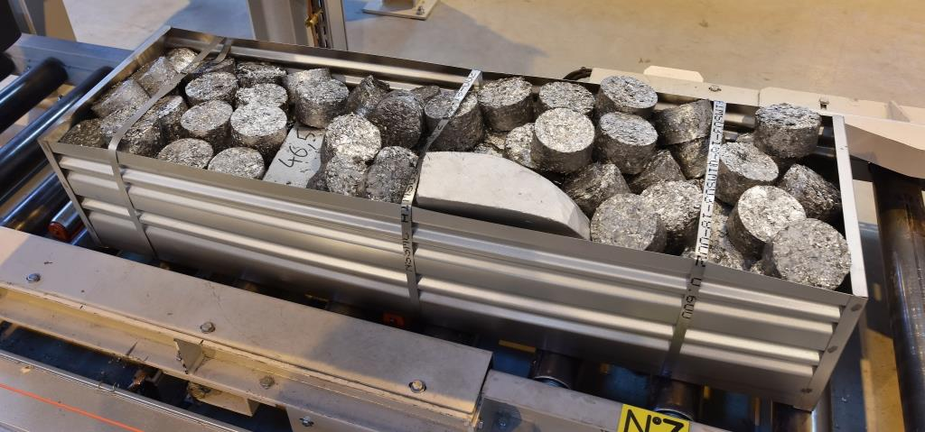
Process: charge make up
Solids charge
Key points :
Solids are placed in consumable Titanium CP boxes.
Traceability with RFID or bar-code.
No crane in this shop to avoid cross contamination.
Chemical analysis ensure by addition of briquettes.

Slide 15
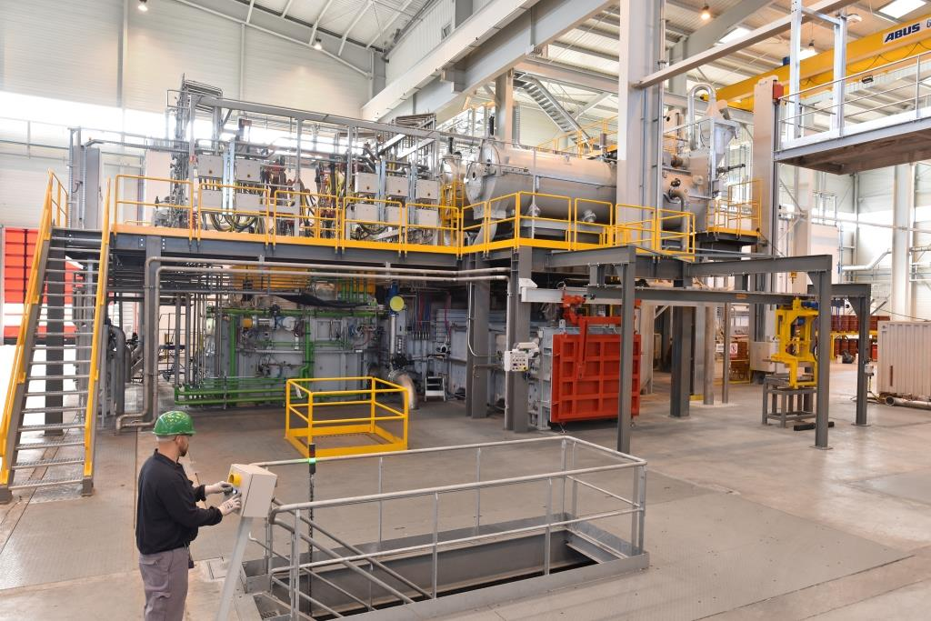
Process: plasma furnace
The plasma furnace represents 800 t of material and equipment, established on an area of 25 m x 20 m
RETECH furnace
Key points :
Low helium pressure ➔ thermal efficiency
Cold hearth on a cart ➔ easy cleaning.
No water pipes disconnection when opening furnace ➔ no risk of water leak

Slide 16
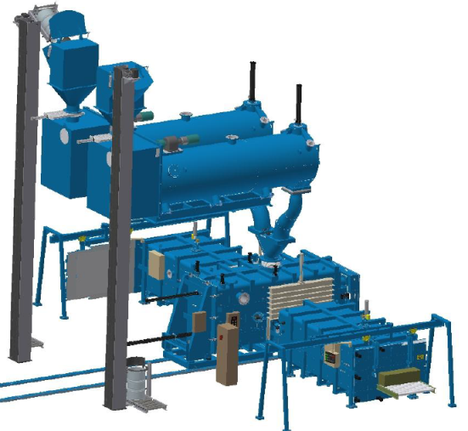
Process: plasma furnace
Briquettes charge :
Key points :
RFID readers for barrels ➔ cross checking of order during loading.
Protection against contamination during loading.
Drum feeders
Vibratory feeder to transport the briquettes in the melt chamber
Drums elevator

Slide 17
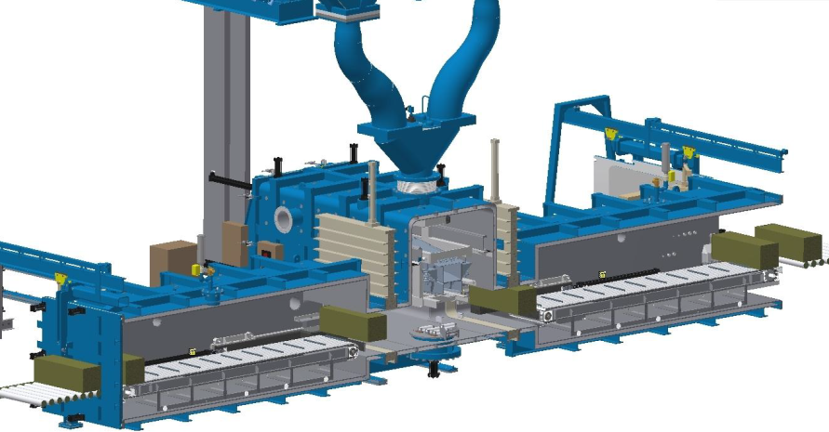
Process: plasma furnace
Solids charge :
Key points :
RFID reader for boxes ➔ cross checking of order.
Quick change between 2 boxes.
Isolating valves
Loading chamber
One cylinder to push boxes in melt chamber

Slide 18
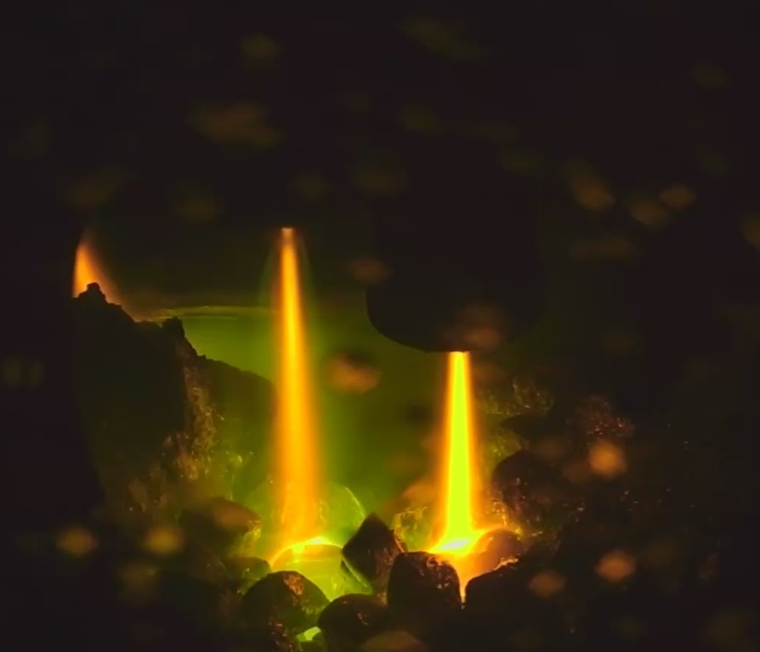
Process: plasma furnace
Scrap melting in a water cooled copper hearth:
Key points :
5 torches with high power ➔ better for inclusions dissolution
Furnace steering with a recipe transferred by IT system

Slide 19
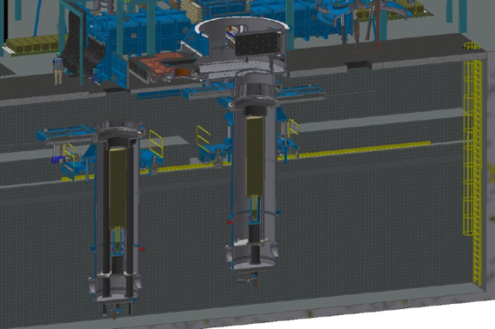
Process: plasma furnace
Withdrawal chambers: VAR stub installed in the withdrawal base plate, before the plasma melting ➔ at the beginning of the casting the first liquid metal is welded with the stub. Stub welding in VAR is thus avoided. A&D applied a patent for this method.
Key points :
Good concentricity between stub and electrode ➔ better centring in VAR.
No stub welding in VAR ➔ no risk of quality.
STUB
Electrodes

Slide 20
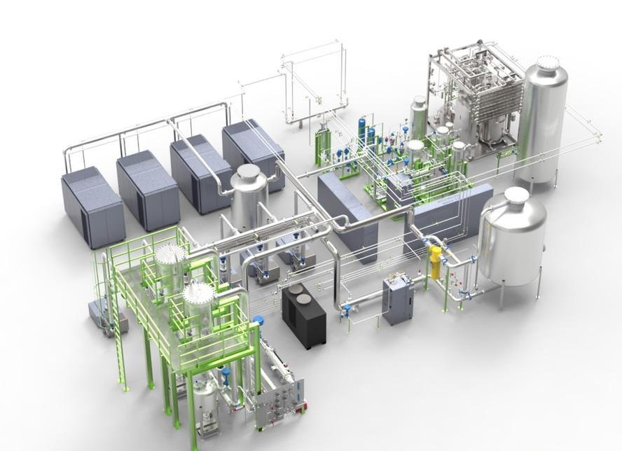
Process: plasma furnace
Helium recycling unit: coupled with the plasma furnace, a unit to process the helium gas guarantees the gas purification :
  Removal of the undesirable gases (O2, H2, N2) and moisture.
  Removal of dusts and chlorine from sponges.
Key points :
Chlorine removal ➔ no corrosion.
High level of supervision.

Slide 21
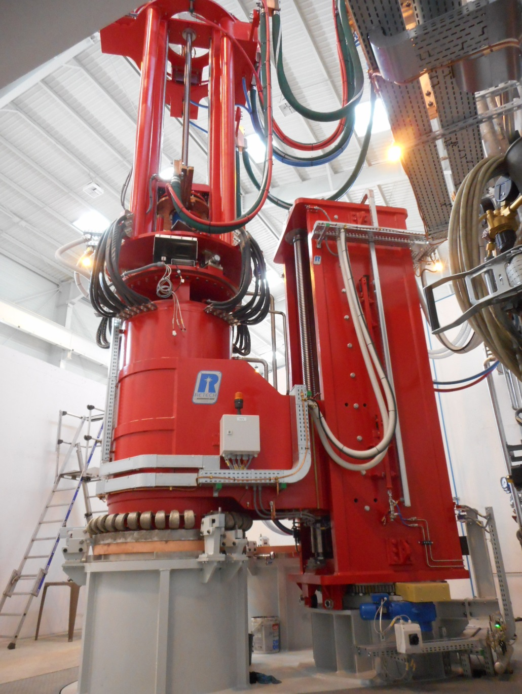
VAR melting
2 VAR furnaces:
Key points :
Robust conception.
A&D requirements (easy cleaning…)

Slide 22
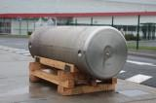



General schedule
2010 : Reflection and project structuring
2015 :
Building construction
2017 :
Production and qualification start-up.
2022
Full maturity

Slide 23
2
QUALIFICATIONS

Slide 24
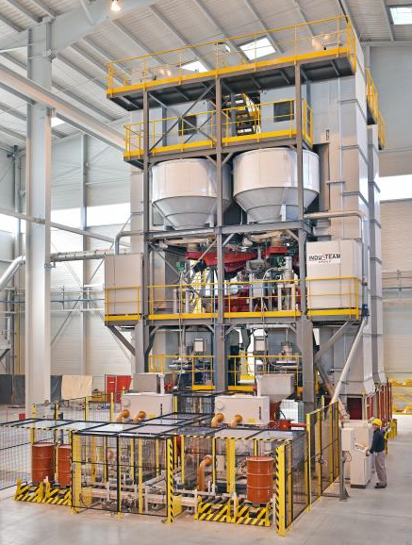
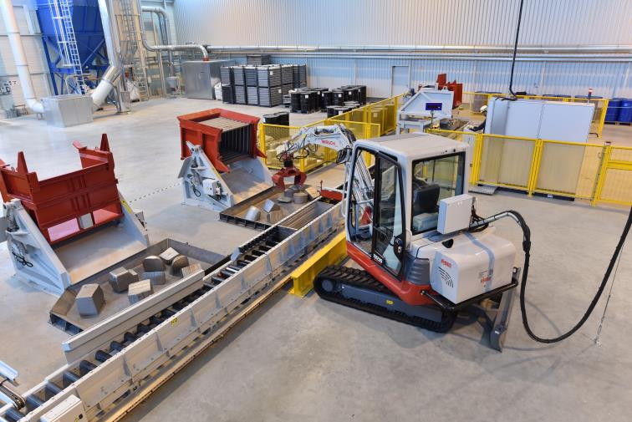
ETAT D’AVANCEMENT
Tous les équipements sont installés et opérationnels.
Ligne de préparation des massifs - LPM
Unité de préparation des briquettes - UPB

Slide 25
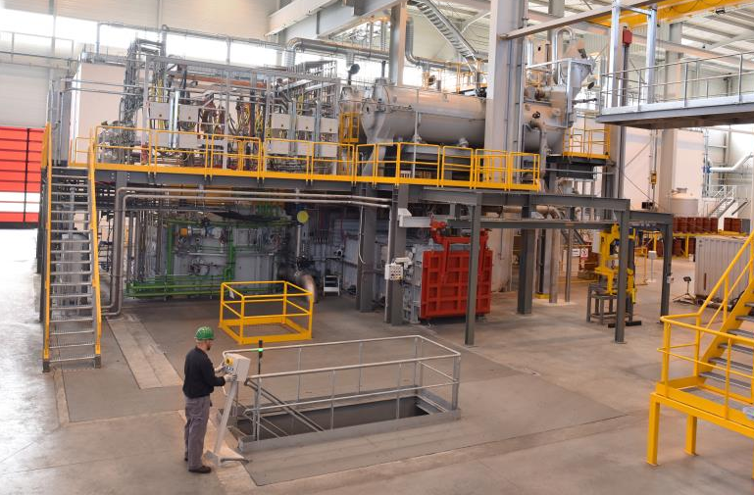
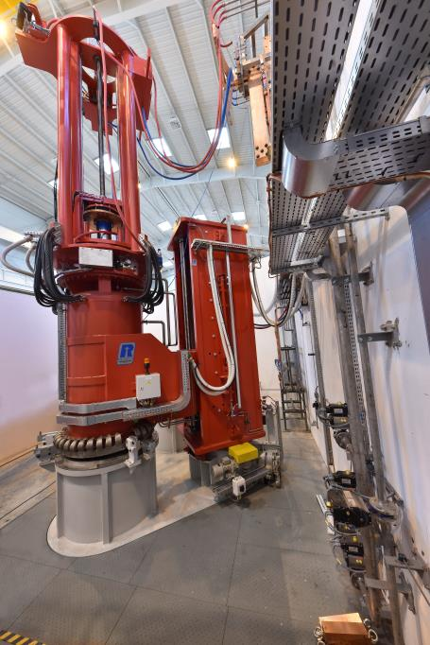
ETAT D’AVANCEMENT
Four PLASMA
Four VAR

Slide 26
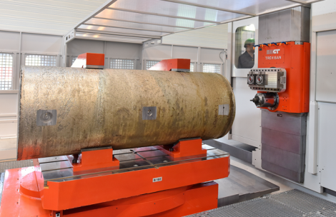
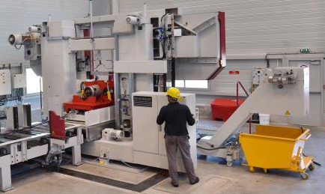
ETAT D’AVANCEMENT
Scie
Aléseuse

Slide 27

PREMIERE CAMPAGNE DE PRODUCTION
  En octobre et novembre 2017, EcoTitanium a réalisé une campagne de 6 lingots pour la certification aéronautique AMS 4928.
    Les charges élaborées :
      3 lingots réalisés à partir de briquettes,
      3 lingots réalisés à partir de chutes massives + briquettes pour ajustement nuance

Slide 28
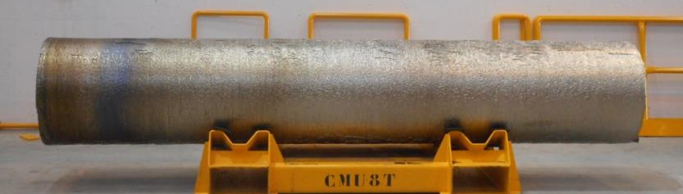
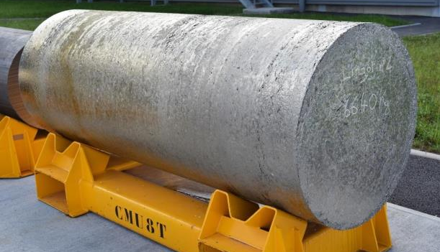
PREMIERE CAMPAGNE DE PRODUCTION
    Electrode :
    Lingot :
    Chimie : l’analyse chimique des 6 lingots est conforme.

Slide 29
AMS 4928 certification
End 2017, campaign of 6 ingots:
  Charges:
  4 ingots forged and rolled in RD150 mm,
  1 ingot forged in RD 240 mm,
  1 ingot forged in RD 330 mm.

Slide 30
AMS 4928 certification
Metallurgical results (example for 1 ingot in R 150 mm):
  Chemical Analysis: compliant according AMS 4928.
  Ultrasonic Inspection phased array and US contact by UKAD (dead zone 3 mm): compliant with AMS 2631 Class A1.
  Beta transus compliant according to EN 3684 (Beta transus by micrography).
 | C | Al | V | Ti | Fe | Y | H2 | N2 | O2 | Total other | Other
 | C01R | TI10F | TI10F | TI10F | TI10F | TI15F | TI01N | TI01N | TI01N | TIQ1I | TIQ1I
% | 0/0.08 | 5.50/6.75 | 3.50/4.50 | Balance | 0/0.30 | 0/0.005 | 0/0.0125 | 0/0.05 | 0/0.20 | <0.40 | <0.10
TOP | 0.020 | 6.43 | 3.99 | Balance | 0.14 | <0,005 | 0.0029 | 0.0043 | 0.19 | <0.40 | <0.10
MIDDLE | 0.024 | 6,43 | 4.05 | Balance | 0.15 | <0,005 | 0.0021 | 0.0042 | 0.18 | <0.40 | <0.10
BOTTOM | 0.025 | 6.31 | 4.07 | Balance | 0.15 | <0,005 | 0.0014 | 0.0048 | 0.18 | <0.40 | <0.10
Position Slices | Beta transus (°C) | Difference between minimum and maximum (°C)
Top | 1010 | 0
Middle | 1010
Bottom | 1010

Slide 31
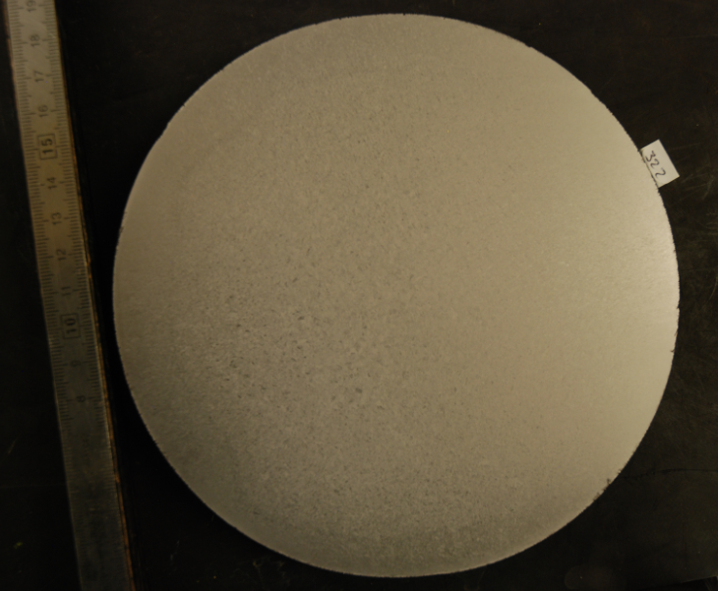
AMS 4928 certification
Metallurgical results (example for 1 ingot in R 150 mm):
  Macrography according to AMS 2380 : level 20 / 30

Slide 32
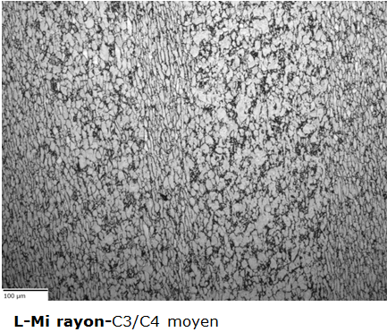
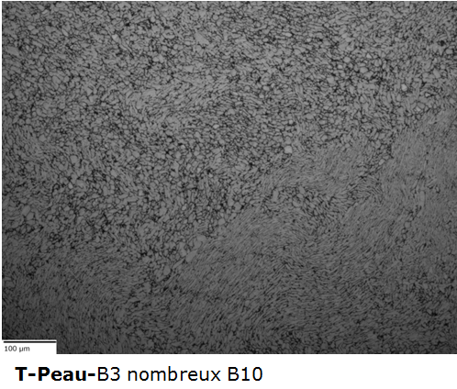
AMS 4928 certification
Metallurgical results :
  Micrography: According to AMS 4928 : Equiaxed and elongated primary alpha in a transformed beta matrix with no continuous network of alpha at prior beta grain boundaries
  LONGITUDINAL TRANSVERSE
  Tensile tests: Compliant AMS4928
 |  |  |  |  | Rm (Mpa) ≥ 896 | Rp0.2 (Mpa) ≥ 827 | A4d (%) ≥ 10 | Z (%) ≥ 20
TOP |  |  |  |  | 960 | 890 | 14 | 25
BOTTOM |  |  |  |  | 970 | 905 | 14 | 30

Slide 33
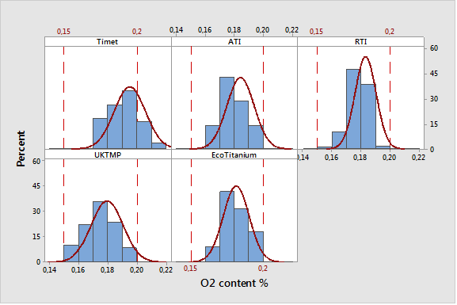
AMS 4928 certification
Metallurgical results : focus on O2
 | Lingot | # | Mean (%) | Standard deviation (ppm) | Minimum (%) | Maximum (%) | Etendue (ppm)
Timet | 49 | 109 | 0.20 | 110 | 0.17 | 0.22 | 500
ATI | 14 | 14 | 0.18 | 90 | 0.17 | 0.20 | 300
RTI | 150 | 170 | 0.18 | 70 | 0.16 | 0.20 | 400
UKTMP | 974 | 1946 | 0.18 | 110 | 0.15 | 0.20 | 500
EcoTitanium | 6 | 79 | 0.18 | 90 | 0.16 | 0.20 | 400
The comparison with our competitors shows a homogeneity in the target and the distribution of the oxygen level

Slide 34
Others qualifications in progress
SAFRAN:
  First time for standard applications,
  Then for PQ and DQ applications.
  For Ti 10.2.3
AIRBUS: for structural parts.
BOMBARDIER: for structural parts.

Slide 35
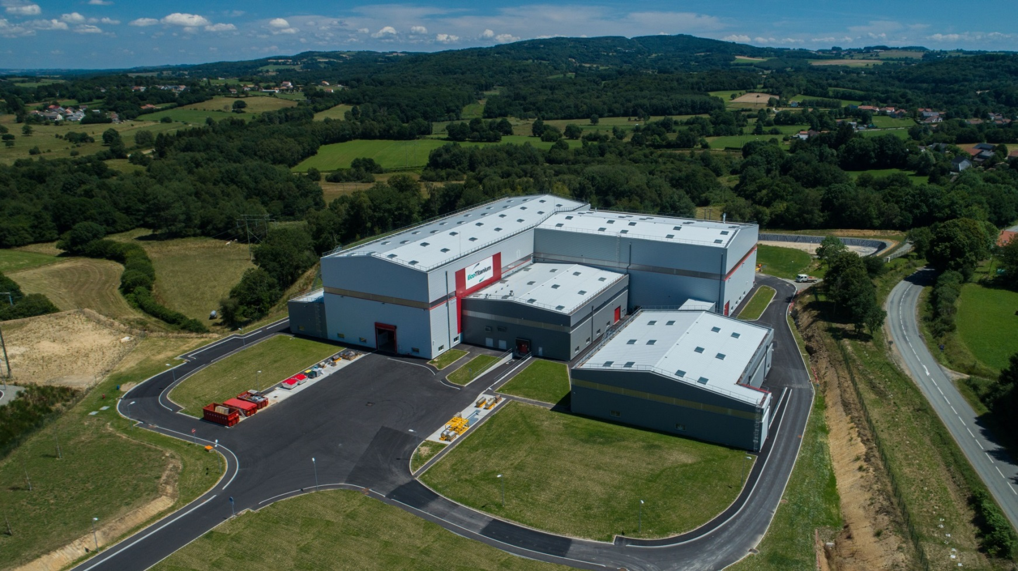
EUROPE’S FIRST AERONAUTIC TITANIUM GRADES RECYCLING PLANT
Located in Saint‐Georges-de‐Mons, Puy-de-Dôme, France, EcoTitanium is the first plant in Europe to melt aeronautic titanium grades by recycling.
EcoTitanium produces alloys from titanium solid scrap and cuttings collected from the major aeronautic companies and their subcontractors.

Slide 36
Raymond ALLIER
Raymond.allier@eramet-ecotitanium.com

