Slide 1
03/05/2018
UKAD ECOTITANIUM
Presentation

Slide 2
1
Titanium stream
2
UKAD
3
EcoTitanium
5

Slide 3
1
TITANIUM
STREAM

Slide 4
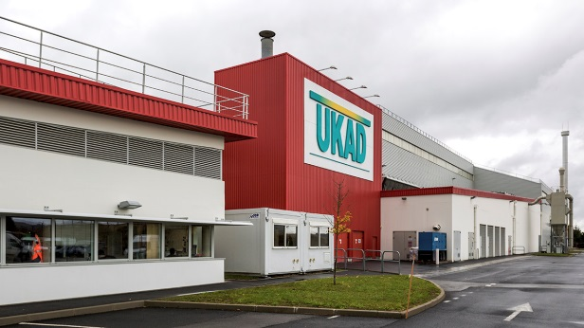
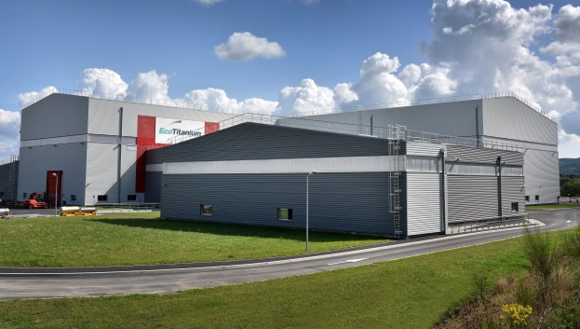



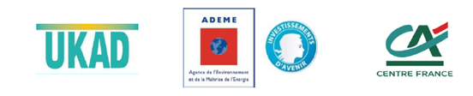
GENESIS AND STAKES
Over the 2012/2020 period, global titanium demand is set to grow by more than 50% to total 100 Kt of ingots, mainly to meet the needs of the industry and aviation sectors.
The aeronautic market but also the medical, energy and defense markets should grow by 5% per year.
2011
2016
2017
UKAD, ADEME and Crédit Agricole Centre France inaugurated EcoTitanium, the first plant in Europe to produce aviation-grade titanium by recycling
ERAMET Group, its subsidiary Aubert & Duval and its partner UKTMP inaugurated UKAD forging plant
MECACHROME and
Aubert & Duval inaugurated MKAD, a joint venture specialised in finishing aviation-grade titanium parts

Slide 5





SHAREHOLDERS
Aubert & Duval, an ERAMET Group subsidiary, specialized in high value added metallurgy is a world leader in high performance steels, superalloys, titanium and aluminum.
Aubert & Duval designs and makes cutting-edge metallurgical solutions for aerospace, energy, motor racing, nuclear and medical sectors.
UKTMP is listed on the Kazakhstan stock market. UKTMP produces high quality Titanium sponge from Kroll process and Titanium ingots using VAR furnaces since 2010.
It’s one of the world leaders in titanium sponge production.
43,5%
41,3%
15,2%

Slide 6
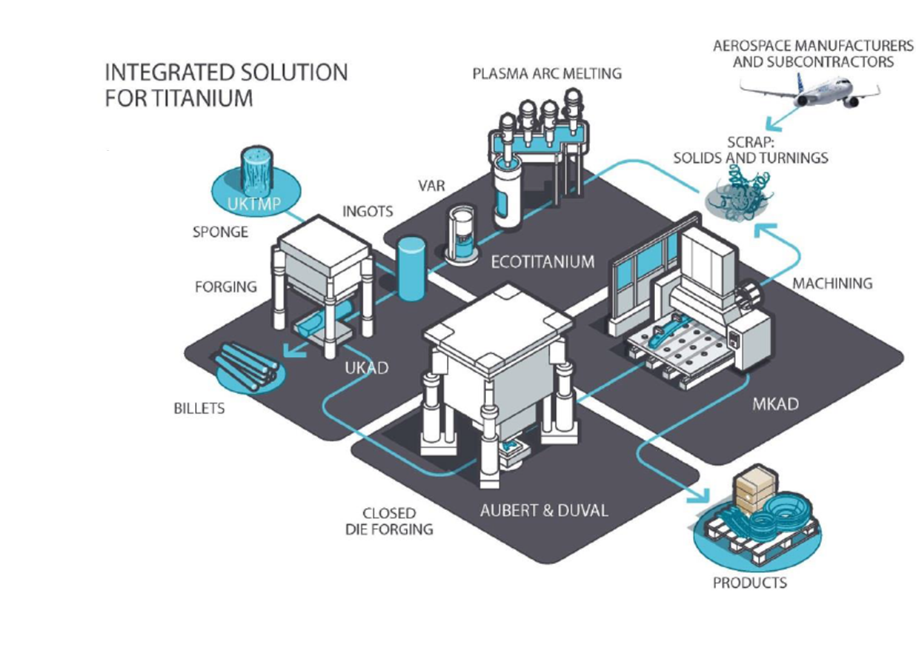
TITANIUM STREAM

Slide 7
2
UKAD

Slide 8
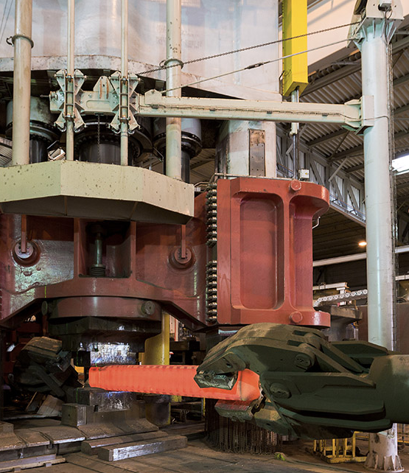


UKAD ACTIVITY
UKAD is a semi-product forging plant, equipped with a 4,500 tons press, a finishing line and an ultrasonic inspection equipment.
The main activity is the conversion of Titanium ingots into semi-products : blooms, billets and bars.
UKAD is able to forge 7-18 tons ingots
85
€47M
employees
Investment

Slide 9



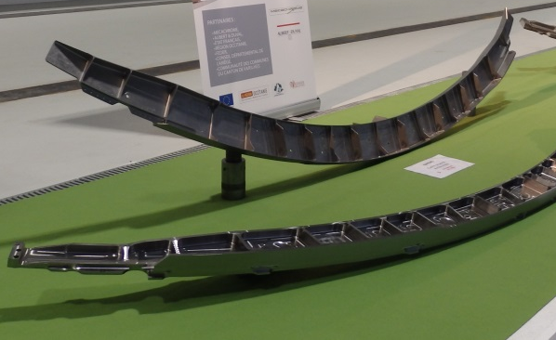




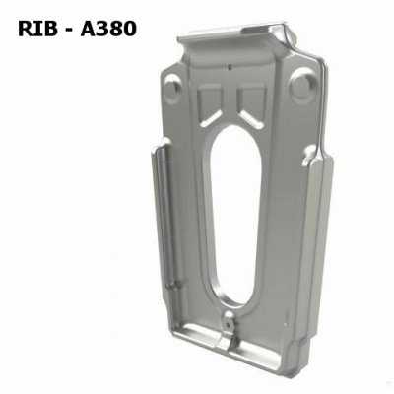
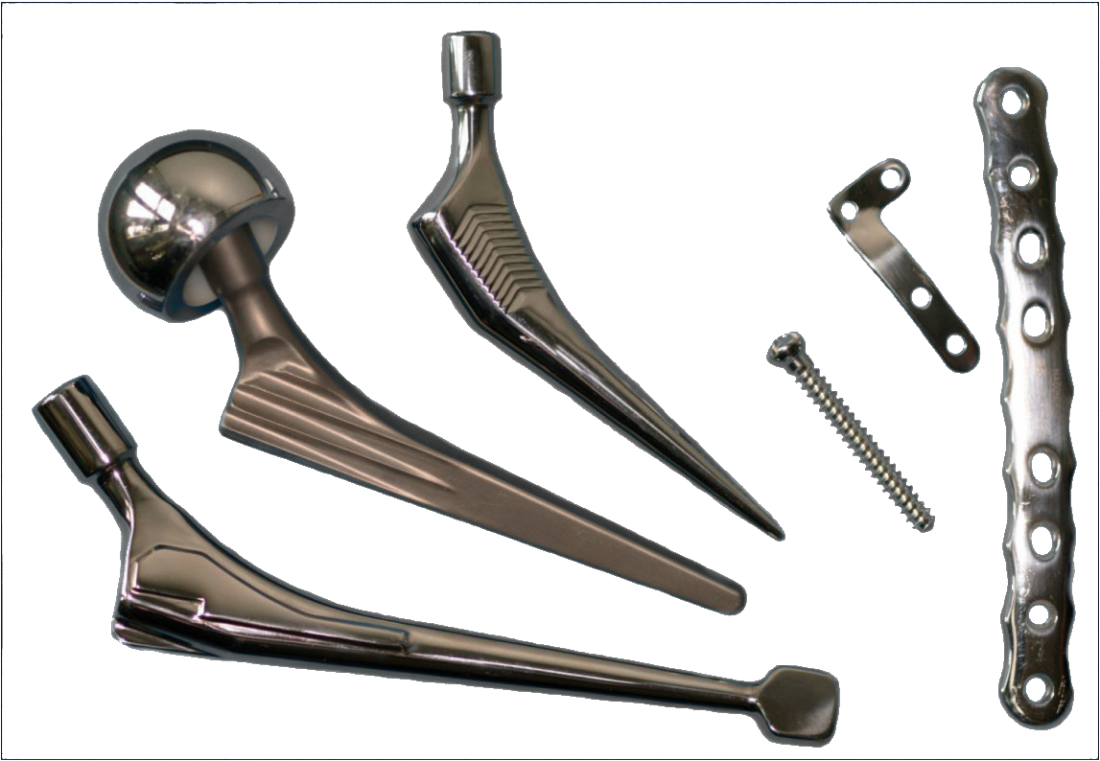



UKAD PRODUCTS AND MARKETS
OUR PRODUCTS
  Ingots
  from 7 to 18 tons
  Blooms and billets
  Bars
  Closed die-forged products
OUR MARKETS AND SOME FINAL PRODUCTS
AEROSPACE
OIL & GAS
DEFENCE
MEDICAL

Slide 10
3
EcoTitanium

Slide 11
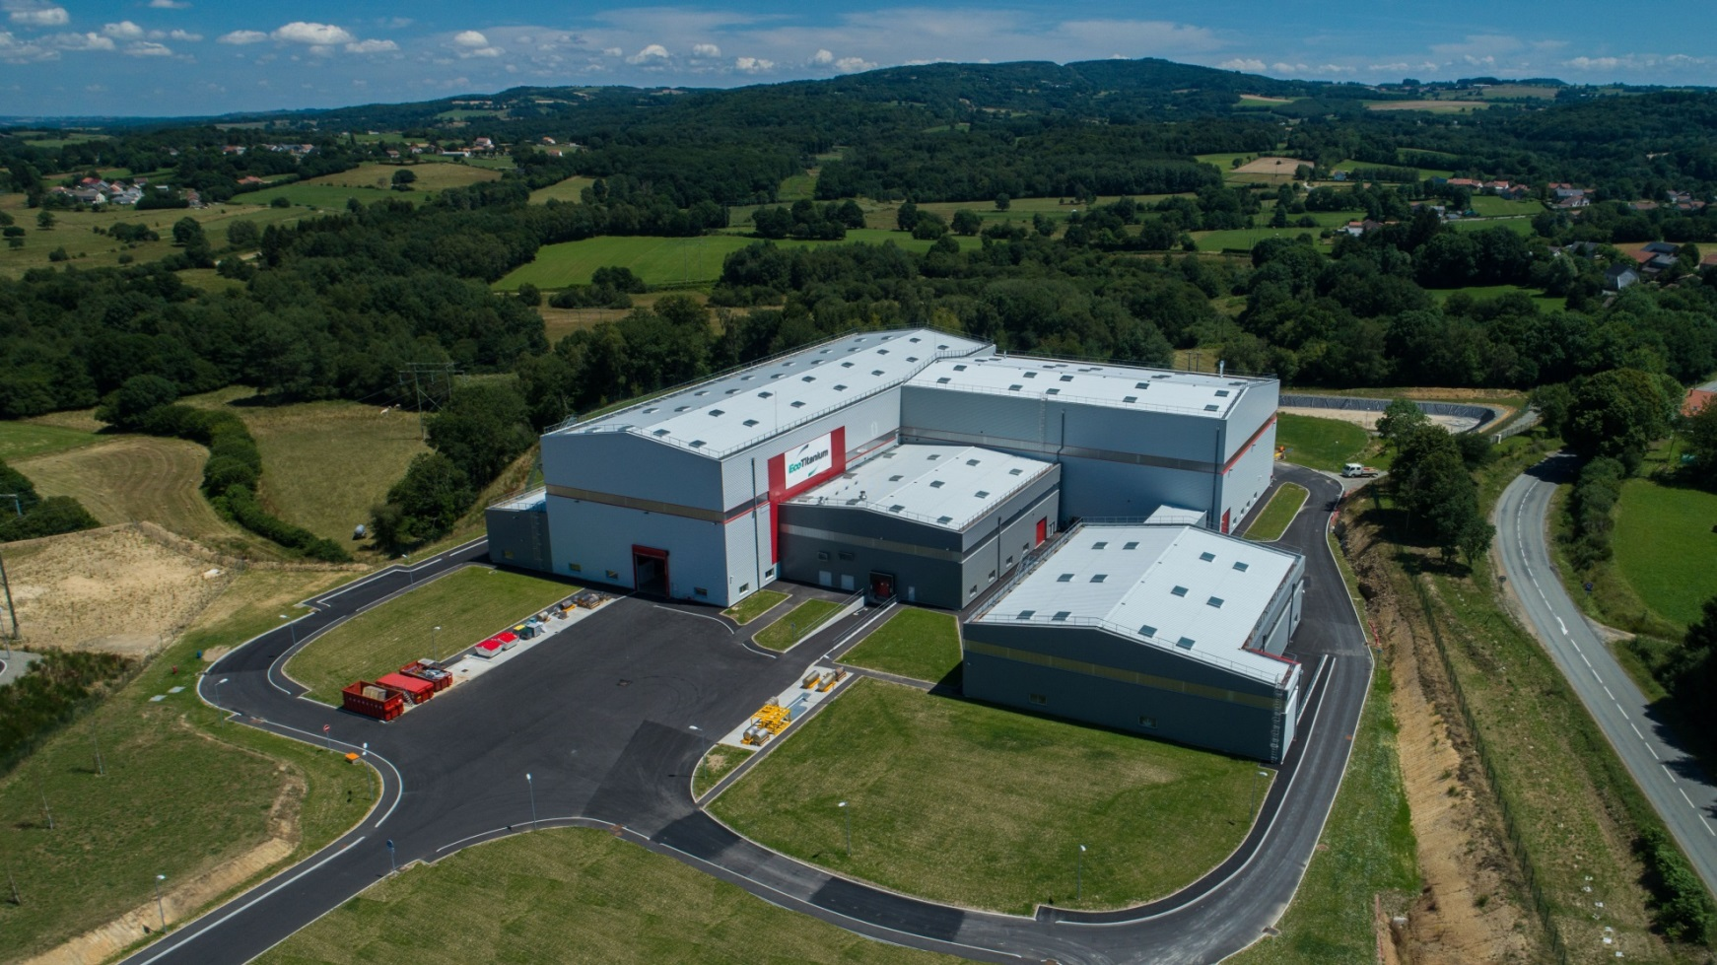

EUROPE’S FIRST AERONAUTIC TITANIUM GRADES RECYCLING PLANT
Located in Saint‐Georges-de‐Mons, Puy-de-Dôme, France, EcoTitanium is the first plant in Europe to melt aeronautic titanium grades by recycling.
EcoTitanium produces alloys from titanium solid scrap and turnings collected from the major aeronautic companies and their subcontractors.
1st
60
€48M
European aviation-grade titanium stream by recycling
Direct highly qualified new jobs, as well as inferred jobs
Investment

Slide 12

GENESIS AND STAKES OF THE PROJECT
EcoTitanium gives to the aeronautic industry a new titanium offer independent from American and Russian suppliers…
Europe is a worldwide leader in aeronautic industry. So far, Europe didn’t have full control of the supply of titanium, a strategic material in a context of high growth of aeronautic markets. Also, Europe didn’t have industrial means to recycle titanium scraps.
So, this situation benefited to U.S. producers who collected and recycled titanium scrap and cutting produced in Europe.
…With a sustainable development process
EcoTitanium’s recycling process will prevent the emission of 100,000 tons of CO2 by consuming 4 times less that the conventional, ore-based production supply chain.
Aeronautic manufacturers and subcontractors return their own Titanium scraps to EcoTitanium.
EcoTitanium produces new titanium ingots with a more competitive price than ingots made from titanium ores.

Slide 13
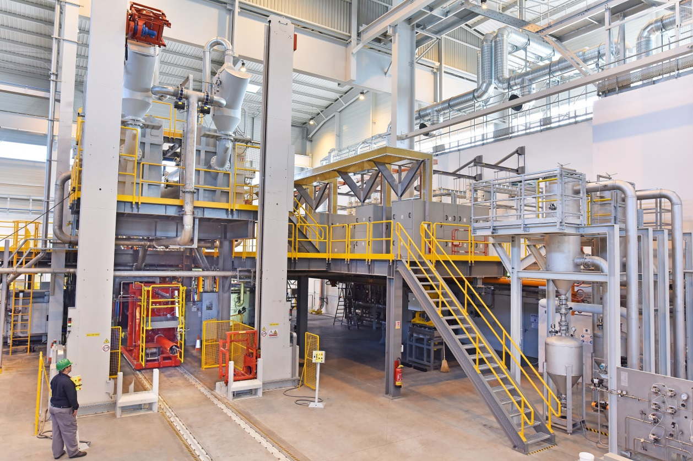
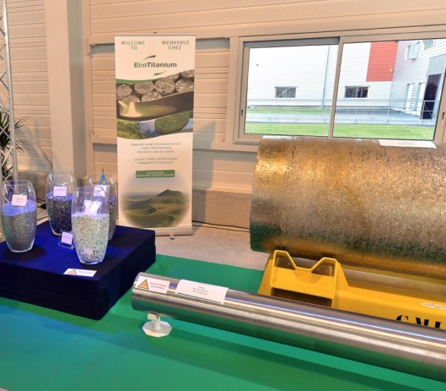
ECOTITANIUM ACTIVITY
EcoTitanium is the first plant in Europe to melt aeronautic titanium grades by recycling. EcoTitanium produces alloys from titanium solid scraps collected from the major aircraft makers and their subcontractors.
To achieve world-class competitiveness, EcoTitanium® uses new technological developments of PAM-CHR plasma melting and vacuum remelting furnaces.
Production is starting in 2018 and will ramp up over 5 years according to the time taken to obtain qualifications, learn the new technologies and win market share. Consequently, EcoTitanium will be at full capacity in 2022.
At full capacity in 2022, the plant will produce several thousand tons of titanium alloy ingot per year.

Slide 14


FINANCIAL PARTNERS
To support the creation of this environmentally responsible project in Europe, the European Investment Bank (EIB) granted a €30 million loan for EcoTitanium funding
EIB funding is guaranteed by the European Fund for Strategic Investments (EFSI), a central pillar of the “Juncker plan” for investment in Europe.
A joint initiative by the EIB Group and the European Commission, the Juncker plan is intended to boost private investment in high value-added projects and strategic sectors for the European Union, such as innovation.
Our financial partners
European Investment Bank (EIB)
European Regional Development Fund (ERDF)
French Commissariat for Equality of Territories
Auvergne-Rhône-Alpes Region
Puy-de-Dôme Departement Council
Loire-Bretagne water Agency
Banque Publique d’Investissement (BPI)
With the support of Saint-Georges de Mons Municipality.
Commune
Saint-Georges de Mons

