Slide 1
Progress Point
SBU AED
18 décembre 2018
Confidential - Restricted internal use

Slide 2
Context
A central quality crisis management cell for :
Reply to customer requests
Canalize and centralize official communication between customers and sites
Copy the unit for any official communication/written request:
quality@eramet-aubertduval.com
Following the various audits carried out, the 3 current crisis topics concern :
Tests not carried out : 121,000
Modified tests : 37,000
Open internal events : 10,147 red including 8,260 for « Top 7 » customers
Confidential - Restricted internal use

Slide 3
Main directions
Customer Contact
  Who ? Provided by a focal point (pair)
  What ? Analyze customer data and present it to them
  How ? Take technical questions, laboratory, metallurgy, SI and transmit them to central cell
Factory Pole
  Who ? Coherent group of teams grouped by business / specialty around process, quality, metallurgy, customer service
  What ? Answer questions raised by customers, explanations, investigations
  How ? Enrich the database with explanations that can serve as a benchmark
Central Cell
  Who ? quality@eramet-aubertduval.com (Christophe P., Olivier D., Amandine C., Mohamed M.)
  What ? Interface role between customer focal points <-> factories ; flow/priorities management
  How ? Securing and sharing information, building a FAQ, dashboards
  Make the link with the central IT department - structure the process over time
IT Support
  Build and enrich databases that best meet the expectations of internal and external customers
Confidential - Restricted internal use

Slide 4

Communication flows
FAQ
76 Focal Points BU
30 Foacl Points Factories
BU Motors
Ancizes
Customers
50
Labo
Metall.
BU Turbine
Central Cell
5
Pamiers
Laminate
Share Point
Forged
BU PND
Imphy
PND
BU TEA
Issoire
Motors
Structure
BU
LP
IT Support
Pardieu
5 Database managers
Dashboard communications follow-up
Confidential - Restricted internal use

Slide 5






Staff Deployed on sites
Altran Reinforcement Team
Les Ancizes
Issoire
Supply Chain
Quality
Supply Chain
Quality
La Pardieu
Customer Service
Laboratory
Customer Service
Imphy
Pamiers
Support SI
Supply Chain
Quality
Supply Chain
Quality
Customer Service
Customer Service
Confidential - Restricted internal use

Slide 6
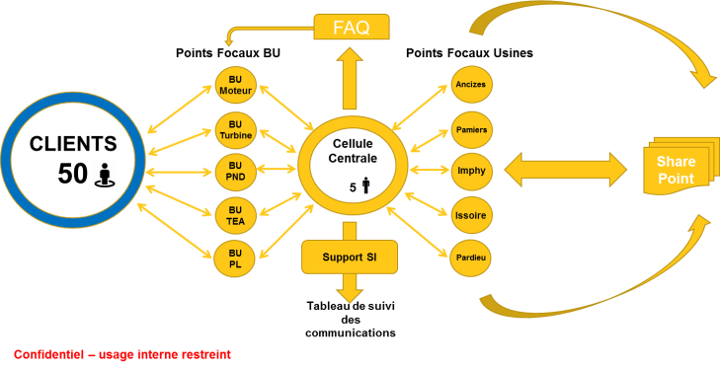
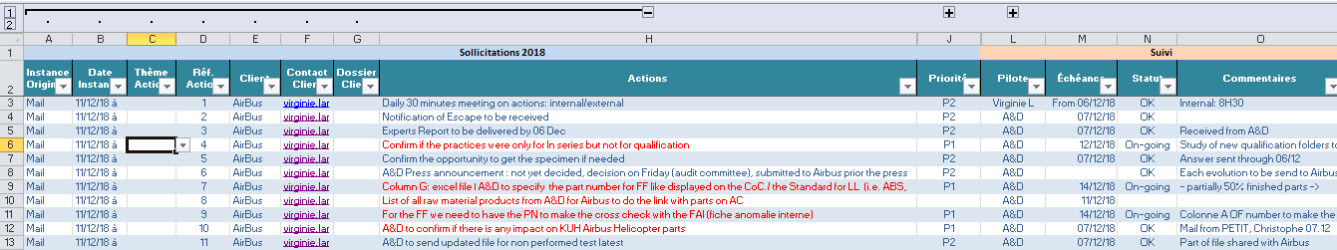
Tools
Deliverables Dashboard
Communication Dashboard
Confidential - Restricted internal use

Slide 7
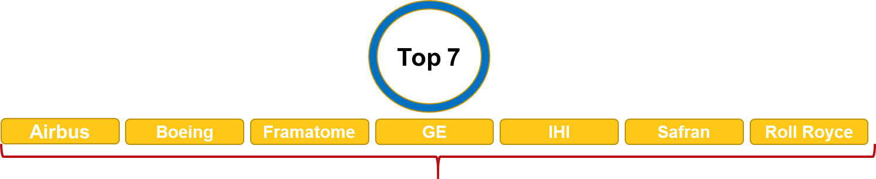
Clients
DG Alloys contacts before Eramet announcement = trust, professionalism; privileged contacts via the BUs but also by the on-site cells with DG coordination;
DG Alloys and A&D commitment: clarity and transparency with customers; standard messages :
      « our teams are in regular contact with yours with regular points under Eramet Alloys central quality management » ;
      « internal analyses are on going in complete transparency with your teams » ;
Particular priority follow-up: daily conf-call, customer visits, quality points, file sharing[PV, archives...], audit...; dedicated cell teams :
Confidential - Restricted internal use

Slide 8
Customers
Rank
2
And others
Customer 1
Customer 2
Customer 3
Customer 4
Customer 5
Customer 6
Customer 7
« Rank 2 » : privileged contact points in "proactive" mode if strategic = Business Unit; strategic BU customers will all be informed by the end of week 51; ongoing
DG Alloys and A&D commitment: clarity and transparency with customers :
      "our teams are in regular contact with the teams of our client clients; analyses are ongoing in complete transparency; to date, no specific alerts have been issued on your products"
Other A&D customers are treated in "reactive" mode because :
  Most depend on "TOP 7" and "Rank 2".
  The majority transform the material and semi-finished products into FP
Keyword :
      « quality analysis process in progress with our experts and the customers concerned; we will keep you informed but to date, your products are not directly concerned »
Confidential - Restricted internal use

Slide 9
Weeks 49 & 50
03/12
Rolls Royce informed
Since
04/12
Safran > Daily scrum
Information to customer
Since
05/12
Airbus > Daily scrum
Daily Scrum / Tehcnical call
07/12
Framatome informed
GE Power informed
Audit / Customer visit on site
10/12 to 12/12
Rolls Royce informed
Valinox informed
Nexter informed
Boeing > Audit on Ancizes
11/12
IHI informed
Spirit informed
Valinox > Meeting
Rolls Royce > Working meeting about FAI
12/12
ITP informed
Subject reviewed with SAE at the Presidents' Meeting
Valinox > Meeting
Airbus > Call with MB
Framatome : call with Quality Manager
13/12
Technicatome > Purchasing manager contacted
GE Aviation informed
SHE > call about labo files
SLS > Meeting
Naval Group > Technical Meeting
14/12
SKF & SNR > informed
CEA informed
Nexter > letter sent
GE Aviation > Technical exchange
Airbus > Meeting about files
Safran > Working day between metallurgists/experts Safran and A&D.
S.A et C.P. > Call EDF
Confidential - Restricted internal use

Slide 10
Week 51
17/12
GE Power > Christophe P. & MB in Baden
Technicatome > Call
R-R Nucléaire > letter sent
18/12
Framatome > meeting with Sandrine A.
Airbus > Exchange between metallurgists and A&D (Ancizes)
18/12 and
19/12
SHE will go to Ancizes for the FAI subject
19/12
Contact between SAE and A&D to Ancizes
Information to customer
20/12
Framatome wil lgo to Ancizes
Daily Scrum / Tehcnical call
Audit / Customer visit on site
21/12
Instruction nuclear file France for EDF > ASN
Confidential - Restricted internal use

