Slide 1

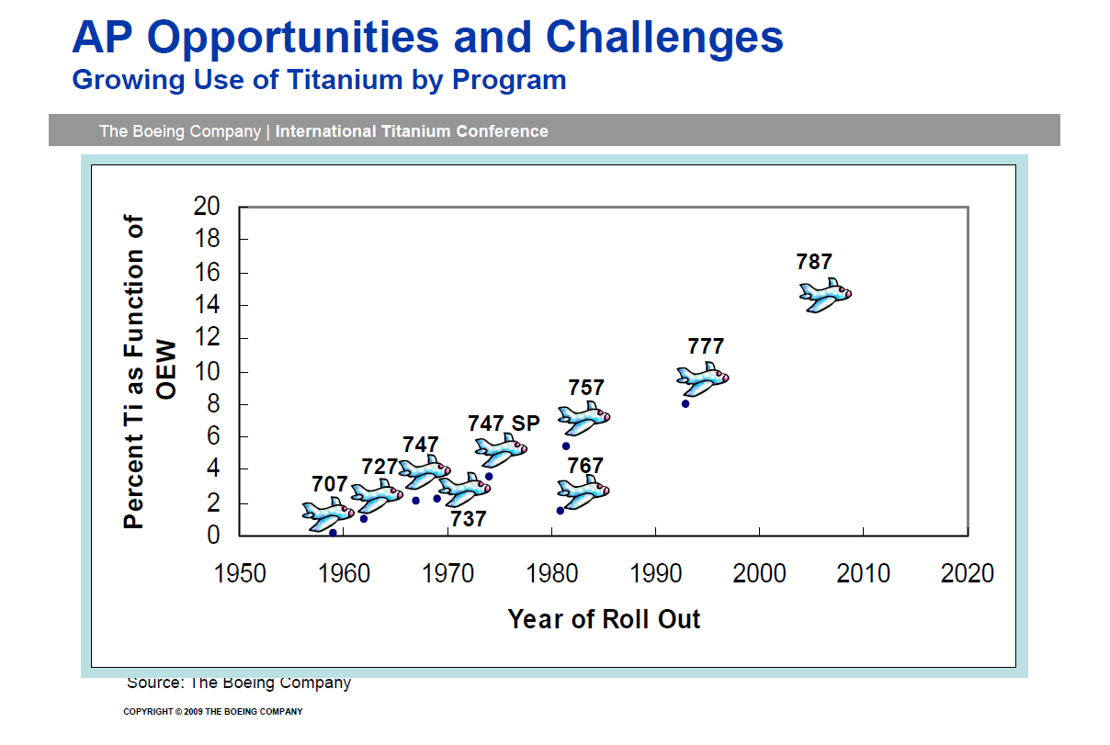


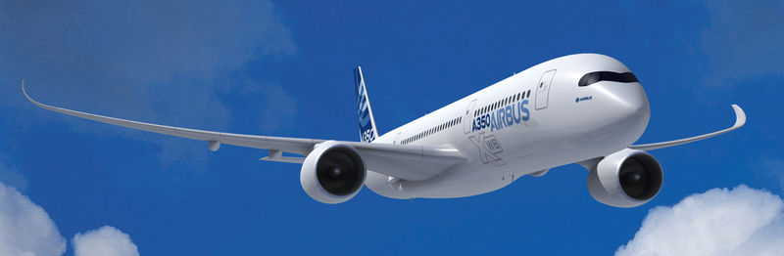
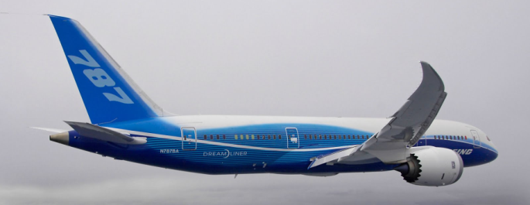
The creation of UKAD
The creation of UKAD was allowed by :
the increase of Ti material in airplane structures

