Slide 1
February 2020
UKAD Presentation

Slide 2
1
TITANIUM
STREAM
UKAD- ECOTITANIUM PROPRIATARY INFORMATION, may not be used or disclosed to third party

Slide 3
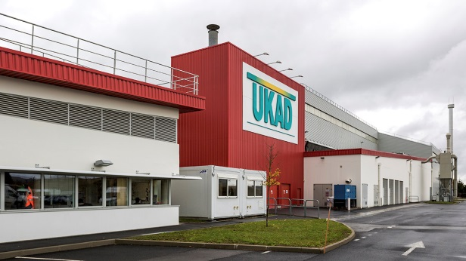
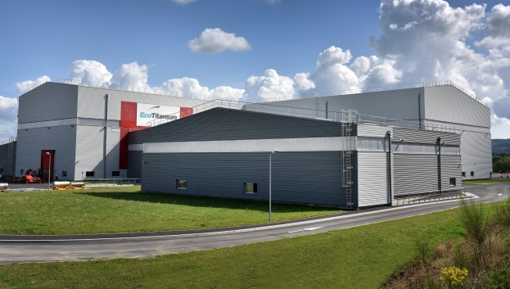



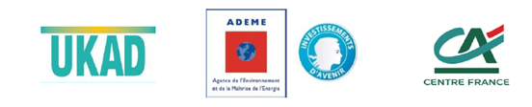
CREATION AND STAKES
Over the 2012/2020 period, global titanium demand is set to grow by more than 50% to total 100 Kt of ingots, mainly to meet the needs of the industry and aviation sectors.
The aeronautic market but also the medical, energy and defense markets should grow by 5% per year.
2011
2016
2017
UKAD, ADEME and Crédit Agricole Centre France inaugurated EcoTitanium, the first plant in Europe to produce aeronautical-grade titanium by recycling
ERAMET Group, its subsidiary Aubert & Duval and its partner UKTMP inaugurated UKAD forging plant
MECACHROME and
Aubert & Duval inaugurated MKAD, a joint venture specialised in machining and finishing aeronautical-grade titanium parts
UKAD- ECOTITANIUM PROPRIATARY INFORMATION, may not be used or disclosed to third party

Slide 4


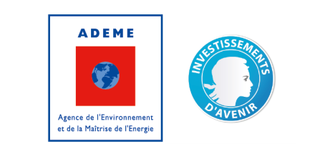


SHAREHOLDERS committed in UKAD and EcoTitanium
UKTMP is listed on the Kazakhstan stock market. UKTMP produces high quality Titanium sponge from Kroll process and Titanium ingots using VAR furnaces since 2010.
It’s one of the world leaders in titanium sponge production.
Aubert & Duval, an ERAMET Group subsidiary, specialized in high value added metallurgy is a world leader in high performance steels, superalloys, titanium and aluminum.
Aubert & Duval designs and makes cutting-edge metallurgical solutions for aerospace, energy, motor racing, nuclear and medical sectors.
50%
50 %
44,8%
42,6%
12,6%
UKAD- ECOTITANIUM PROPRIATARY INFORMATION, may not be used or disclosed to third party

Slide 5
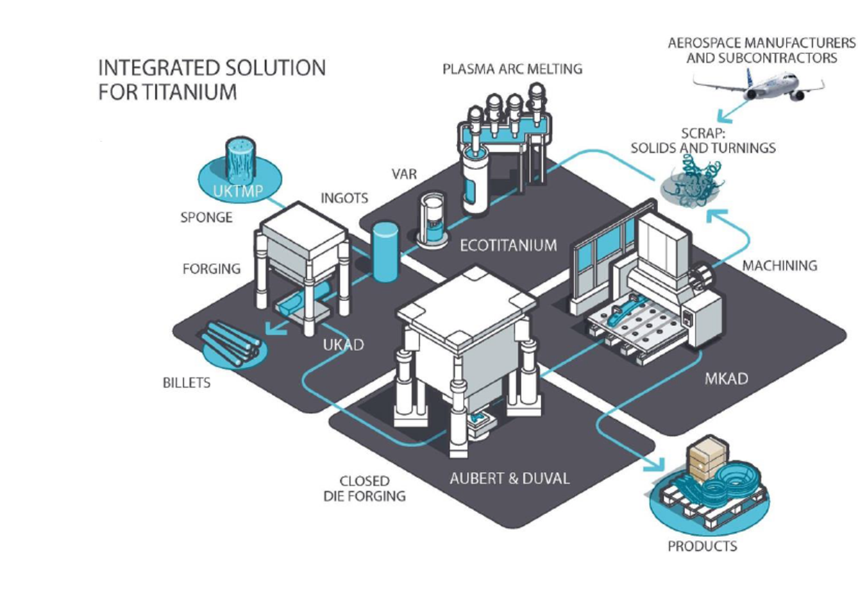
TITANIUM STREAM
UKAD- ECOTITANIUM PROPRIATARY INFORMATION, may not be used or disclosed to third party

Slide 6
2
UKAD
UKAD- ECOTITANIUM PROPRIATARY INFORMATION, may not be used or disclosed to third party

Slide 7


The Raison d’Etre of UKAD
The creation of UKAD was driven by :
  The increase of Ti material in airplane structures
  The UKTMP strategy with Ti downstream development,
  The Aubert et Duval strategy with Ti upstream development,
  The support of Airbus with a 10 years sales agreement,
  The French local authorities support,
UKAD- ECOTITANIUM PROPRIATARY INFORMATION, may not be used or disclosed to third party

Slide 8


The Foundation of UKAD
UKAD is a joint-venture which combines, in the titanium market, the strengths of 2 companies :
  Aubert & Duval
  UKTMP
UKTMP is a Kazakh registered company. Well known for its high level of Titanium sponge quality :
Ilmenite mining operation
Titanium slag production
Titanium tetrachloride and magnesium production
Titanium sponge production
Titanium melting facility
UKTMP plant in Kazakhstan
UKAD- ECOTITANIUM PROPRIATARY INFORMATION, may not be used or disclosed to third party

Slide 9












UKTMP in pictures
UKAD- ECOTITANIUM PROPRIATARY INFORMATION, may not be used or disclosed to third party

Slide 10
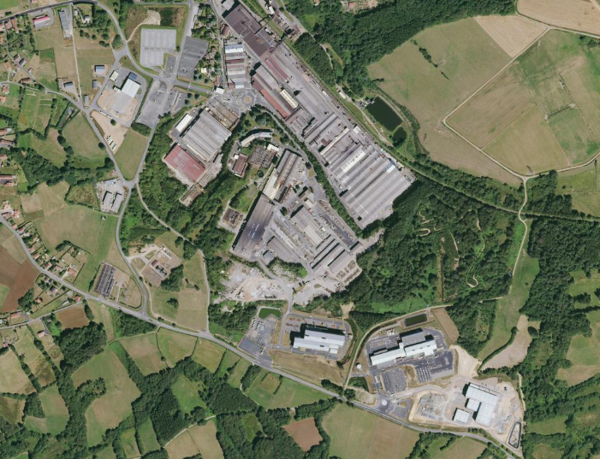
Location
AUBERT & DUVAL
UKAD
IV30
EcoTitanium
UKAD- ECOTITANIUM PROPRIATARY INFORMATION, may not be used or disclosed to third party

Slide 11


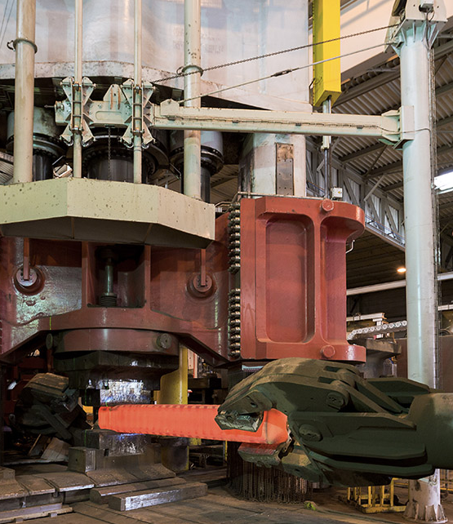




The Process of UKAD
Lingots
C
U
S
T
O
M
E
R
S
forging press
4,500 t.
N
D
T
*
or
➔ UKAD :
  Ingots from 7 (titanium) to 18 t
  Blooms and billets (round) from 85 to 450 mm in Ø and 4 to 6 m long, rectangular bars.
Operations subcontracted to Aubert & Duval
UKAD- ECOTITANIUM PROPRIATARY INFORMATION, may not be used or disclosed to third party

Slide 12


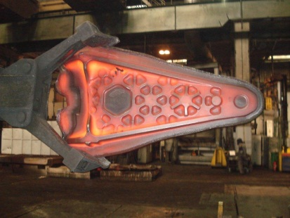





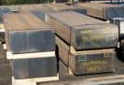
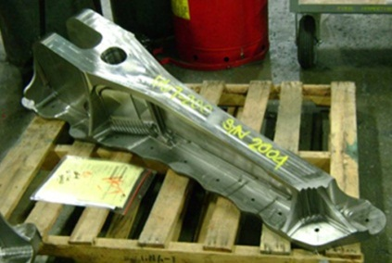




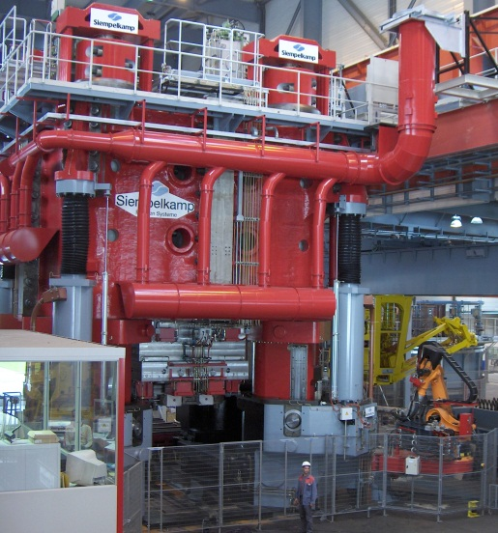


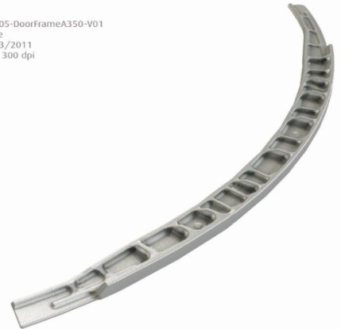


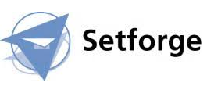







Worldwide Aeronautical Market
CUSTOMERS
UKTMP
Billets
Confidentiel
Ti Alloy Ingot
UKAD- ECOTITANIUM PROPRIATARY INFORMATION, may not be used or disclosed to third party

Slide 13



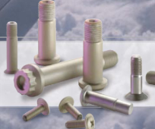
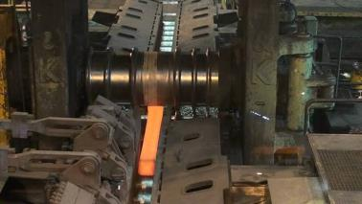





Fasteners and Medical Market
Aeronautical fastening market
UKTMP
Ingot ➔ Blooms ➔ Bars
CUSTOMERS
Confidentiel
Orthopedic Implants
Ti Alloy Ingot
Knee
Hip
UKAD- ECOTITANIUM PROPRIATARY INFORMATION, may not be used or disclosed to third party

Slide 14
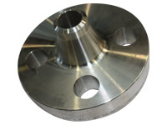
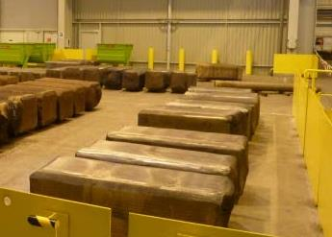
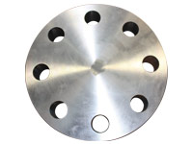
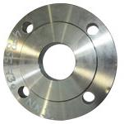
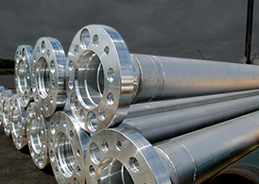

Oil and Gas, Industrial Market
UKTMP
CUSTOMERS
Ingot ➔ Blooms, Billettes
Welding Neck
Confidentiel
Ti CP or Ti Alloy Ingot
Covers and flanges
UKAD- ECOTITANIUM PROPRIATARY INFORMATION, may not be used or disclosed to third party

Slide 15
UKAD certifications
ISO 9001 and AS 9100, last approval Dec 2018
ISO 14 001 and OHSAS 18001, last approval Dec 2018
Ultra Sonic Nadcap Certification in Dec 2014, confirmed in 2015, 2016, 2018 and in Dec 2019.
Airbus :
  IPCA Jan 2013 « C »➔ IPCA+ 28 Jan 2016 « B »
UKAD delivers billets and bars in accordance with AMS 4928 and Ultra Sonic tested in accordance with AMS 2631.
UKAD- ECOTITANIUM PROPRIATARY INFORMATION, may not be used or disclosed to third party

Slide 16

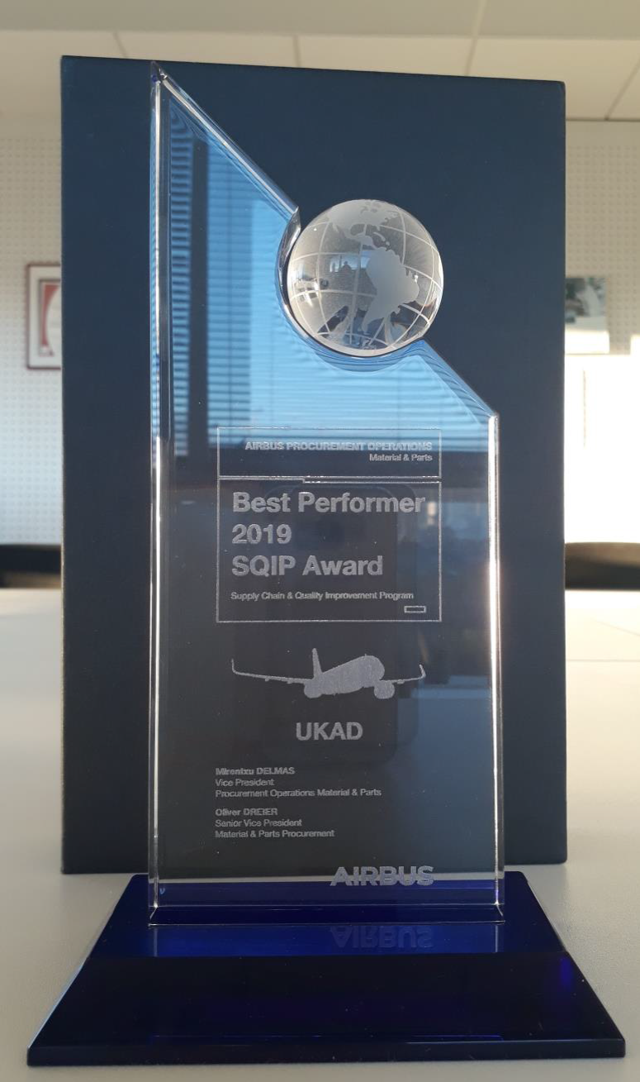
UKAD Awards
For three years running, UKAD was awarded by Airbus :
Best Improver Award 2014, 2015, 2018.
Best Performer Award 2019.
UKAD- ECOTITANIUM PROPRIATARY INFORMATION, may not be used or disclosed to third party

Slide 17
3
EcoTitanium
UKAD- ECOTITANIUM PROPRIATARY INFORMATION, may not be used or disclosed to third party

Slide 18
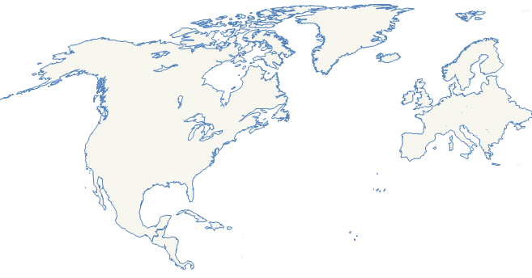

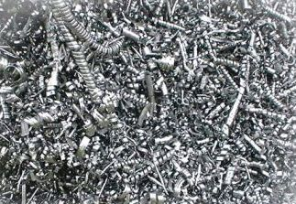

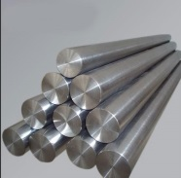
Why EcoTitanium
Scrap generated in Europe is a key for competitiveness of US titanium melters:
European titanium scrap is mainly exported to USA :
* 10500 tons en 2016
* 16 000 tons en 2018.
Europe
USA
US ingots are mainly produced from titanium scrap, which represents more than
60 % of the total consumption Scrap + Sponge.
.
UKAD- ECOTITANIUM PROPRIATARY INFORMATION, may not be used or disclosed to third party

Slide 19

Main Equipment : PAM-CHR
Plasma Arc Melting Furnace with Cold Hearth Refining System
Loading system for turnings briquets
Loading system for solids
Melting Chamber
Plasma melting is followed by VAR remelting in EcoTitanium facility.
All equipment available in Ecotitanium for preparation of melting and remelting, and sample collection for chemical analysis.
Electrodes erection chamber
UKAD- ECOTITANIUM PROPRIATARY INFORMATION, may not be used or disclosed to third party

Slide 20

PAM – CHR Principle
Hélium atmosphere
Plasma Torches
crucible
Scrap
Cold Hearth
Ingot
UKAD- ECOTITANIUM PROPRIATARY INFORMATION, may not be used or disclosed to third party

Slide 21
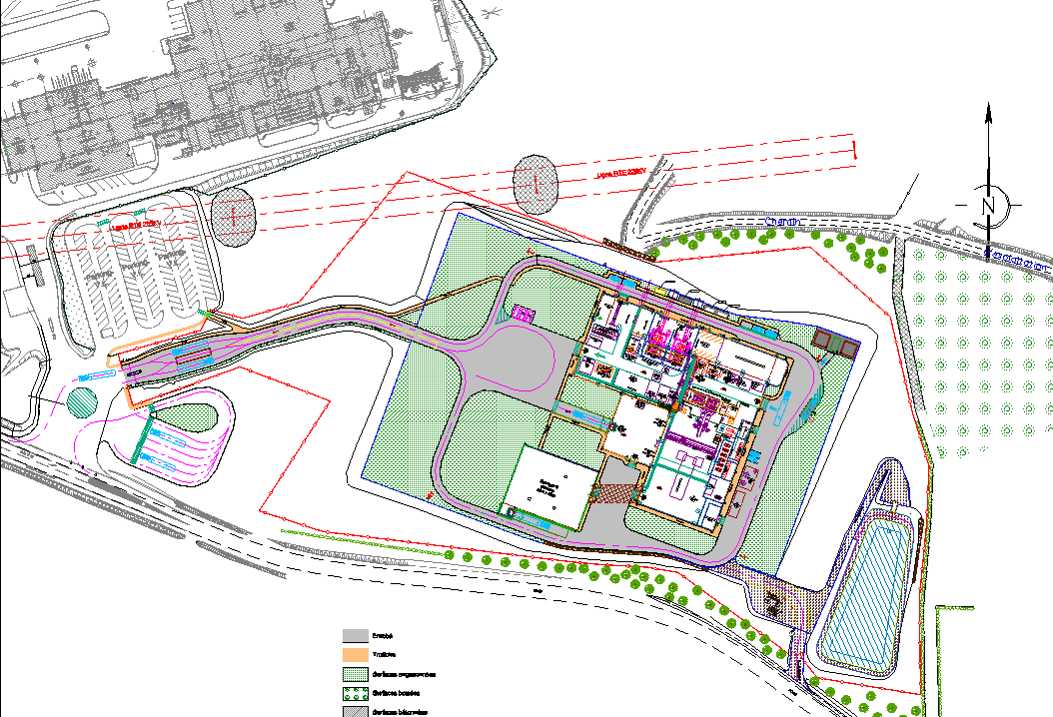
Layout & flow process
UKAD
Machining
Locaux techniques
VAR
Bureaux
Lingotières
Stock MP
Plasma
Stock MP
Locaux techniques
Charge preparation
Key points:
Sponges / turnings storage in a separated workshop ➔ fire risk management.
Lean manufacturing
UKAD- ECOTITANIUM PROPRIATARY INFORMATION, may not be used or disclosed to third party

Slide 22

Integrated solution for titanium
An open Solution for all UKAD Customers: The revert loop will be available for all UKAD’s customers (forgers, extruders), based on circular Economy.
UKAD- ECOTITANIUM PROPRIATARY INFORMATION, may not be used or disclosed to third party

Slide 23
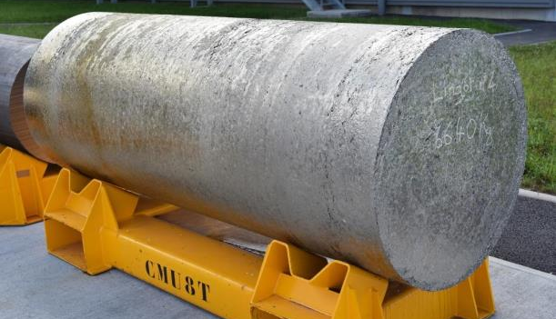



General roadmap
2010: Reflection and project structuring.
2015:
Building construction.
2017:
Production and qualification start-up.
2022:
Full maturity.
UKAD- ECOTITANIUM PROPRIATARY INFORMATION, may not be used or disclosed to third party

Slide 24
Patrick DELABORDE
patrick.delaborde@eramet.com
+ 33 4 73 33 46 11

