Slide 1
June 2019
UKAD Presentation

Slide 2









Safety Rules
In order to guarantee an enjoyable visit, thanks to follow these few safety rules in the production hall :
SAFETY
SHARED VIGILANCE
Wear personal protective equipment (helmet. eyewear, earplugs, safety shoes and reflective jacket).
Be careful at the handling devices and travelling forklifts.
Do not cross safety fences.
Do not touch products (danger of getting burned and/or cut).
If you see an hazardous situation, feel free to inform us.
QUALITY PRODUCT
Do not used source of tungsten pollution : ballpoint pen, filament lamp, drill tools…
ENVIRONMENTAL
Save energy (water and electricity).
If you see a leakage, please inform us ASAP.
EVACUATION
If you hear the emergency alert system, follow your guide to the meeting point situated near the entrance.
If you see an accident, please warn ASAP a first-aid worker. They are easy to recognize thanks to a green helmet.

Slide 3




Safety Rules
It is forbidden to take pictures .
Switch off your mobile devices.
It is forbidden to smoke in walking areas.
Using pen (or any other thing) containing tungsten is absolutely forbidden in the EcoTitanium shop. Only use EcoTitanium pen.

Slide 4
1
TITANIUM
STREAM
UKAD- ECOTITANIUM PROPRIATARY INFORMATION, may not be used or disclosed to third party

Slide 5
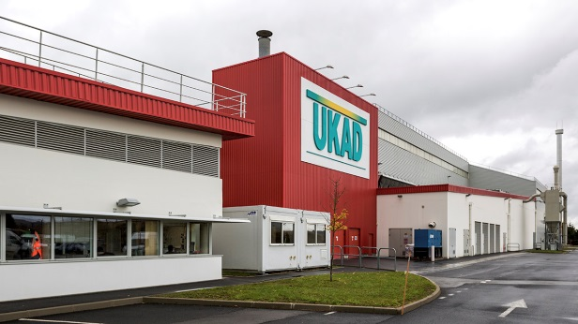
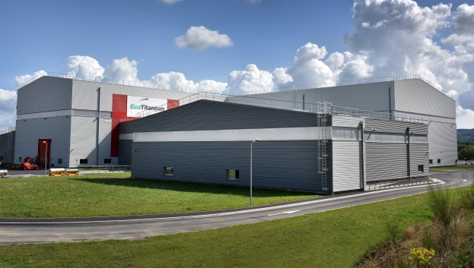



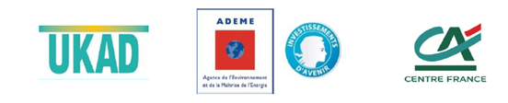
CREATION AND STAKES
Over the 2012/2020 period, global titanium demand is set to grow by more than 50% to total 100 Kt of ingots, mainly to meet the needs of the industry and aviation sectors.
The aeronautic market but also the medical, energy and defense markets should grow by 5% per year.
2011
2016
2017
UKAD, ADEME and Crédit Agricole Centre France inaugurated EcoTitanium, the first plant in Europe to produce aeronautical-grade titanium by recycling
ERAMET Group, its subsidiary Aubert & Duval and its partner UKTMP inaugurated UKAD forging plant
MECACHROME and
Aubert & Duval inaugurated MKAD, a joint venture specialised in machining and finishing aeronautical-grade titanium parts
UKAD- ECOTITANIUM PROPRIATARY INFORMATION, may not be used or disclosed to third party

Slide 6





SHAREHOLDERS committed in UKAD and EcoTitanium
UKTMP is listed on the Kazakhstan stock market. UKTMP produces high quality Titanium sponge from Kroll process and Titanium ingots using VAR furnaces since 2010.
It’s one of the world leaders in titanium sponge production.
Aubert & Duval, an ERAMET Group subsidiary, specialized in high value added metallurgy is a world leader in high performance steels, superalloys, titanium and aluminum.
Aubert & Duval designs and makes cutting-edge metallurgical solutions for aerospace, energy, motor racing, nuclear and medical sectors.
50%
50 %
44,8%
42,6%
12,6%
UKAD- ECOTITANIUM PROPRIATARY INFORMATION, may not be used or disclosed to third party

Slide 7
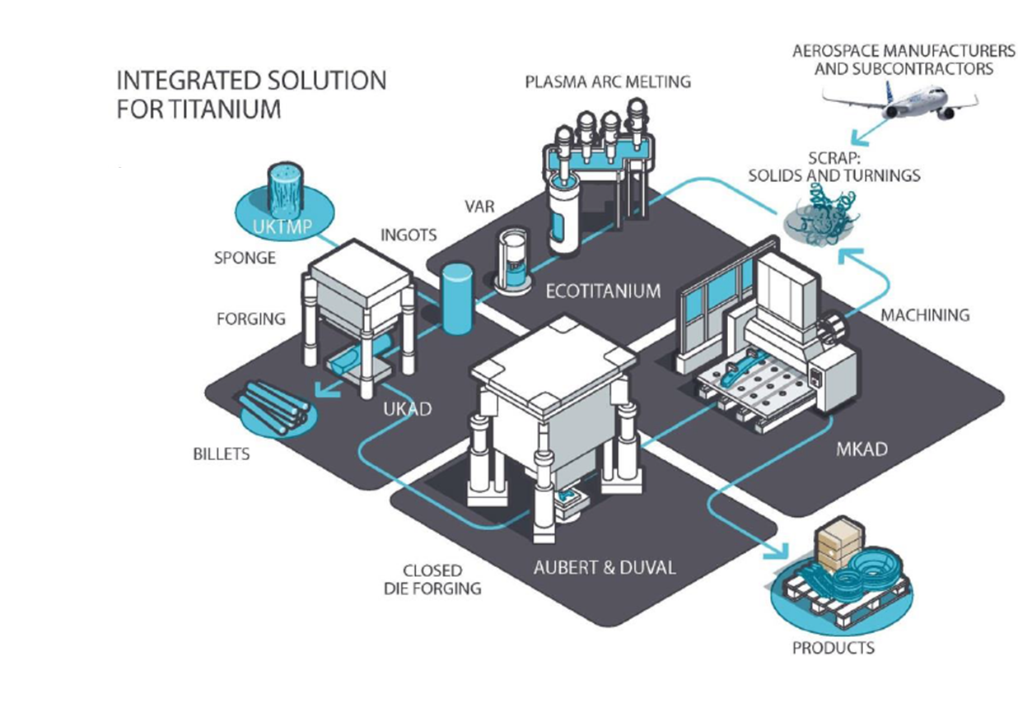
TITANIUM STREAM
UKAD- ECOTITANIUM PROPRIATARY INFORMATION, may not be used or disclosed to third party

Slide 8
2
UKAD
UKAD- ECOTITANIUM PROPRIATARY INFORMATION, may not be used or disclosed to third party

Slide 9


The Raison d’Etre of UKAD
The creation of UKAD was driven by :
  The increase of Ti material in airplane structures
  The UKTMP strategy with Ti downstream development,
  The Aubert et Duval strategy with Ti upstream development,
  The support of Airbus with a 10 years sales agreement,
  The French local authorities support,
UKAD- ECOTITANIUM PROPRIATARY INFORMATION, may not be used or disclosed to third party

Slide 10


The Foundation of UKAD
UKAD is a joint-venture which combines, in the titanium market, the strengths of 2 companies :
  Aubert & Duval
  UKTMP
UKTMP is a Kazakh registered company. Well known for its high level of Titanium sponge quality :
Ilmenite mining operation
Titanium slag production
Titanium tetrachloride and magnesium production
Titanium sponge production
Titanium melting facility
UKTMP plant in Kazakhstan
UKAD- ECOTITANIUM PROPRIATARY INFORMATION, may not be used or disclosed to third party

Slide 11












UKTMP in pictures
UKAD- ECOTITANIUM PROPRIATARY INFORMATION, may not be used or disclosed to third party

Slide 12
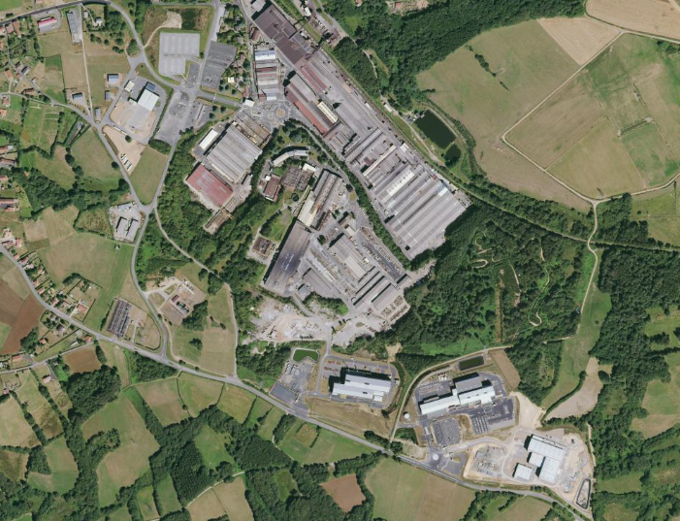
Location
AUBERT & DUVAL
UKAD
IV30
EcoTitanium
UKAD- ECOTITANIUM PROPRIATARY INFORMATION, may not be used or disclosed to third party

Slide 13


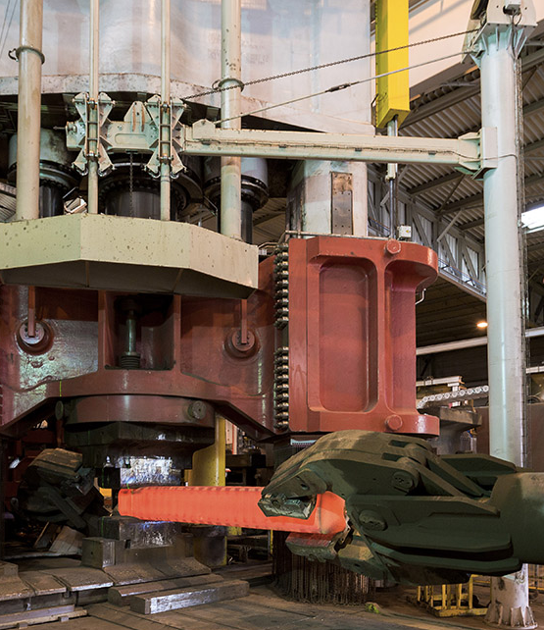




The Process of UKAD
Lingots
C
U
S
T
O
M
E
R
S
forging press
4,500 t.
N
D
T
*
or
➔ UKAD :
  Ingots from 7 (titanium) to 18 t
  Blooms and billets (round) from 85 to 450 mm in Ø and 4 to 6 m long, rectangular bars.
  Bars below 80 mm in 2019, allowed by new investment in Aubert et Duval.
  Rectangular shapes with Erasteel Champagnole plant.
Operations subcontracted to Aubert & Duval
UKAD- ECOTITANIUM PROPRIATARY INFORMATION, may not be used or disclosed to third party

Slide 14


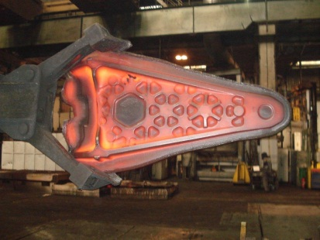




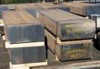
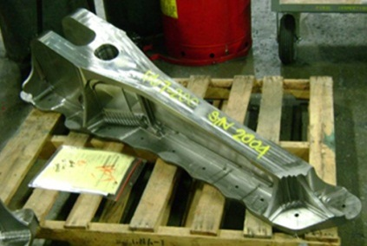




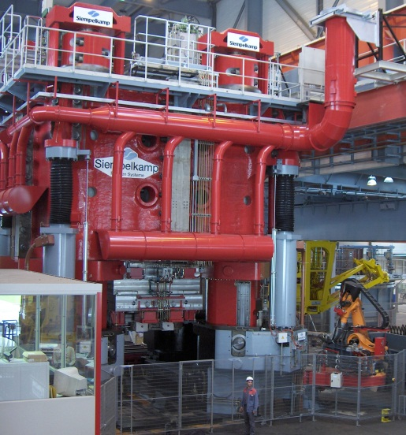


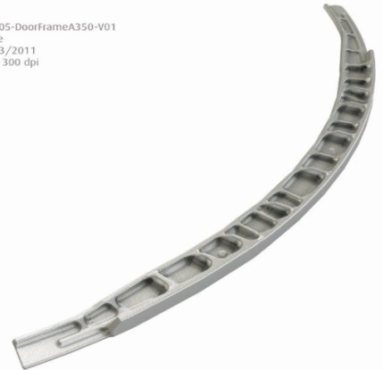

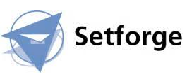







Worldwide Aeronautical Market
CUSTOMERS
UKTMP
Billets
Ti Alloy Ingot
UKAD- ECOTITANIUM PROPRIATARY INFORMATION, may not be used or disclosed to third party

Slide 15



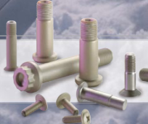
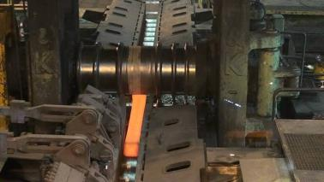





Fasteners and Medical Market
Aeronautical fastening market
UKTMP
Ingot ➔ Blooms ➔ Bars
CUSTOMERS
Orthopedic Implants
Ti Alloy Ingot
Knee
Hip
UKAD- ECOTITANIUM PROPRIATARY INFORMATION, may not be used or disclosed to third party

Slide 16
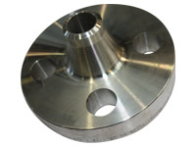
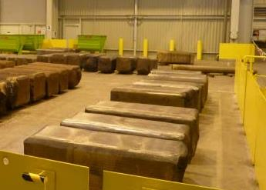
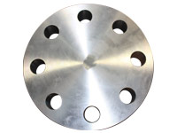
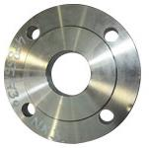
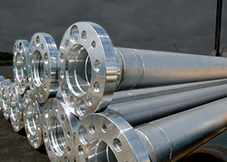

Oil and Gas, Industrial Market
UKTMP
CUSTOMERS
Ingot ➔ Blooms, Billettes
Welding Neck
Ti CP or Ti Alloy Ingot
Covers and flanges
UKAD- ECOTITANIUM PROPRIATARY INFORMATION, may not be used or disclosed to third party

Slide 17
Key Figures
Impact of the build-up of a strategic stock for our main customer.
Tons
UKAD- ECOTITANIUM PROPRIATARY INFORMATION, may not be used or disclosed to third party

Slide 18
UKAD certifications
ISO 9001 and AS 9100, last approval Dec 2018
ISO 14 001 and OHSAS 18001, last approval Dec 2018
Ultra Sonic Nadcap Certification in Dec 2014, confirmed in 2015, 2016 and in April 2018.
Airbus :
  IPCA Jan 2013 « C »➔ IPCA+ 28 Jan 2016 « B »
UKAD delivers billets and bars in accordance with AMS 4928 and Ultra Sonic tested in accordance with AMS 2631.
UKAD- ECOTITANIUM PROPRIATARY INFORMATION, may not be used or disclosed to third party

Slide 19

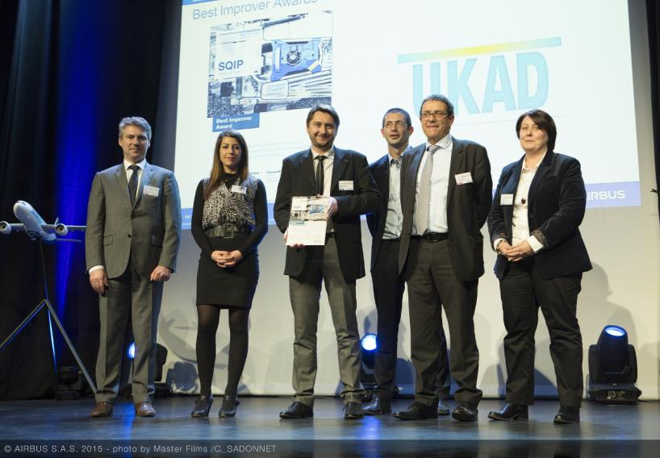
UKAD Awards
For three years running, UKAD was awarded by Airbus :
Best Improver Award 2014, 2015, 2018.
UKAD- ECOTITANIUM PROPRIATARY INFORMATION, may not be used or disclosed to third party

Slide 20
3
EcoTitanium
UKAD- ECOTITANIUM PROPRIATARY INFORMATION, may not be used or disclosed to third party

Slide 21
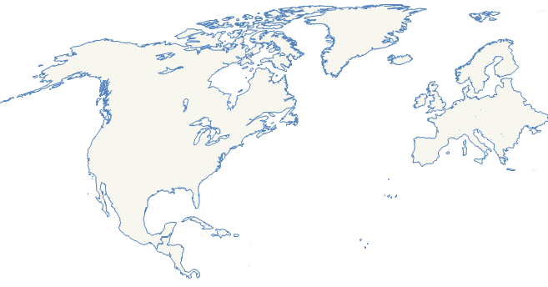

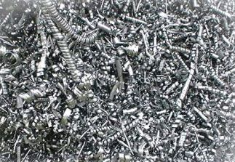

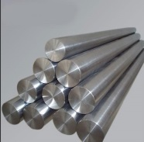
Why EcoTitanium
Scrap generated in Europe is a key for competitiveness of US titanium melters:
European titanium scrap is mainly exported to USA :
* 10500 tons en 2016
* 15300 tons en 2017.
Europe
USA
US ingots are mainly produced from titanium scrap, which represents more than
60 % of the total consumption Scrap + Sponge.
.
UKAD- ECOTITANIUM PROPRIATARY INFORMATION, may not be used or disclosed to third party

Slide 22

Main Equipment : PAM-CHR
Plasma Arc Melting Furnace with Cold Hearth Refining System
Loading system for turnings briquets
Loading system for solids
Melting Chamber
Plasma melting is followed by VAR remelting in EcoTitanium facility.
All equipment available in Ecotitanium for preparation of melting and remelting, and sample collection for chemical analysis.
Electrodes erection chamber
UKAD- ECOTITANIUM PROPRIATARY INFORMATION, may not be used or disclosed to third party

Slide 23

PAM – CHR Principle
Hélium atmosphere
Plasma Torches
crucible
Scrap
Cold Hearth
Ingot
UKAD- ECOTITANIUM PROPRIATARY INFORMATION, may not be used or disclosed to third party

Slide 24
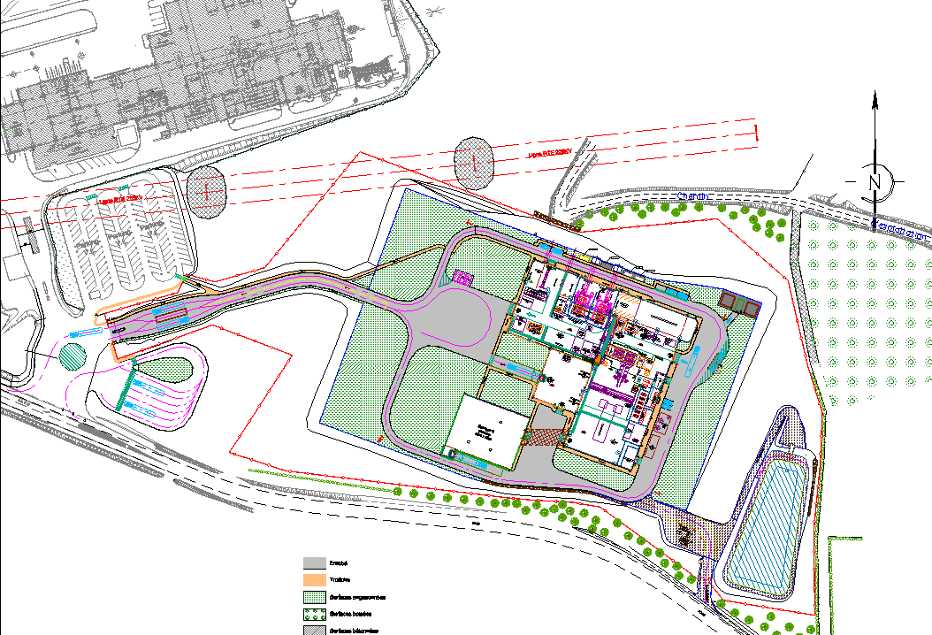
Layout & flow process
UKAD
Machining
Locaux techniques
VAR
Bureaux
Lingotières
Stock MP
Plasma
Stock MP
Locaux techniques
Charge preparation
Key points:
Sponges / turnings storage in a separated workshop ➔ fire risk management.
Lean manufacturing
UKAD- ECOTITANIUM PROPRIATARY INFORMATION, may not be used or disclosed to third party

Slide 25

Integrated solution for titanium
An open Solution for all UKAD Customers: The revert loop will be available for all UKAD’s customers (forgers, extruders), based on circular Economy.
UKAD- ECOTITANIUM PROPRIATARY INFORMATION, may not be used or disclosed to third party

Slide 26
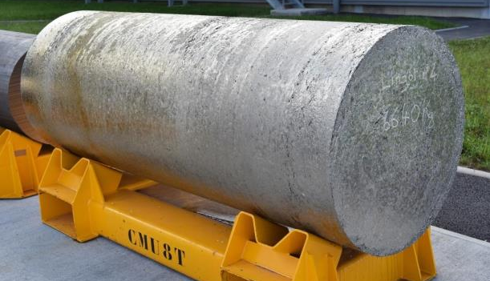



General roadmap
2010: Reflection and project structuring.
2015:
Building construction.
2017:
Production and qualification start-up.
2022:
Full maturity.
UKAD- ECOTITANIUM PROPRIATARY INFORMATION, may not be used or disclosed to third party

Slide 27
Patrick DELABORDE
patrick.delaborde@eramet-aubertduval.com
+ 33 4 73 33 46 11

