Slide 1


April 2018

Slide 2









Safety Rules
In order to guarantee an enjoyable visit, thanks to follow these few safety rules in the production hall :
SAFETY
SHARED VIGILANCE
Wear personal protective equipment (helmet. eyewear, earplugs, safety shoes and reflective jacket).
Be careful at the handling devices and travelling forklifts.
Do not cross safety fences.
Do not touch products (danger of getting burned and/or cut).
If you see an hazardous situation, feel free to inform us.
QUALITY PRODUCT
Do not used source of tungsten pollution : ballpoint pen, filament lamp, drill tools…
ENVIRONMENTAL
Save energy (water and electricity).
If you see a leakage, please inform us ASAP.
EVACUATION
If you hear the emergency alert system, follow your guide to the meeting point situated near the entrance.
If you see an accident, please warn ASAP a first-aid worker. They are easy to recognize thanks to a green helmet.

Slide 3




Safety Rules
It is forbidden to take pictures .
Switch off your mobile devices.
It is forbidden to smoke in walking areas.
Using pen (or any other thing) containing tungsten is absolutely forbidden in the EcoTitanium shop. Only use EcoTitanium pen.

Slide 4


1

Slide 5

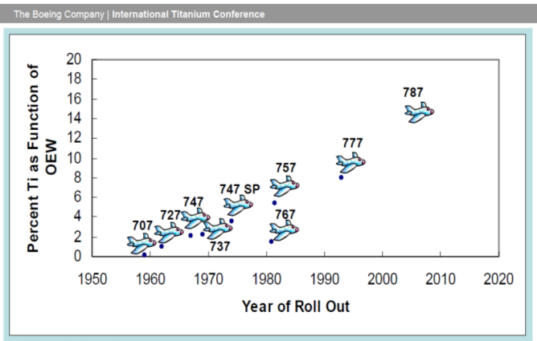




Birth of UKAD
The creation of UKAD was allowed by :
  The increase of Ti material in airplane structures

Slide 6
Birth of UKAD
The creation of UKAD was allowed by :
  The increase of Ti material in airplane structures
  The UKTMP strategy with Ti downstream development,
  The Aubert et Duval strategy with Ti upstream development,
  The strong support and commitment of Airbus with a 10 years sales agreement,
  The French local authorities support,

Slide 7



Birth of UKAD
UKAD is a joint-venture which combines, in the titanium market, the forces of 2 companies :
  Aubert & Duval
  UKTMP
UKTMP is a Kazakh registered company. Well known for its high level of Titanium sponge quality :
Ilmenite mining operation
Titanium slag production
Titanium tetrachloride and magnesium production
Titanium sponge production
Titanium melting facility
UKTMP plant in Kazakhstan

Slide 8












UKTMP in a few pictures

Slide 9
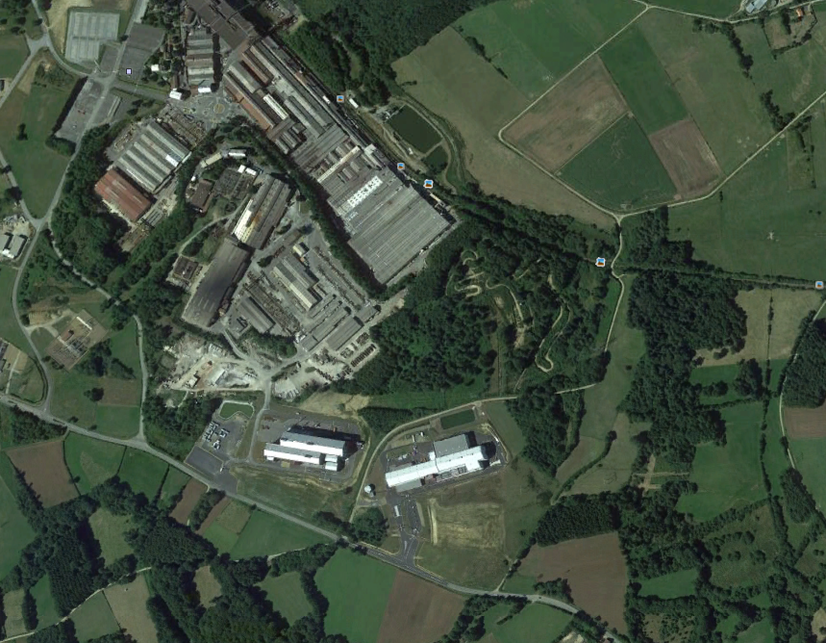
Location
AUBERT & DUVAL
UKAD
IV30
EcoTitanium
UKAD

Slide 10

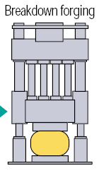




UKAD products
Lingots
C
U
S
T
O
M
E
R
S
forging press
4,500 t.
N
D
T
*
or
Operations subcontracted to Aubert & Duval
➔ UKAD :
  Ingots from 7 (titanium) to 18 t
  Blooms and billets from 85 to 450 mm in Ø and 4 to 6 m long
  Bars from 55 to 85 mm.

Slide 11


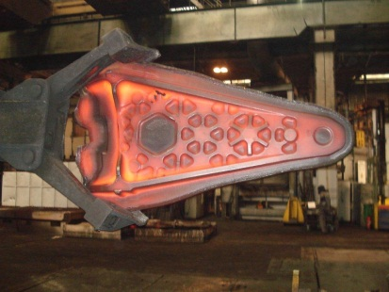




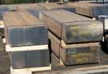
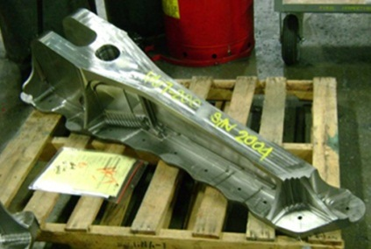




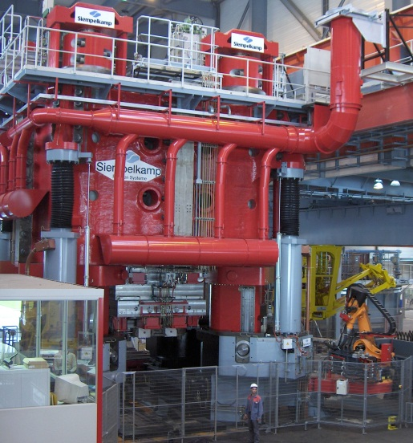

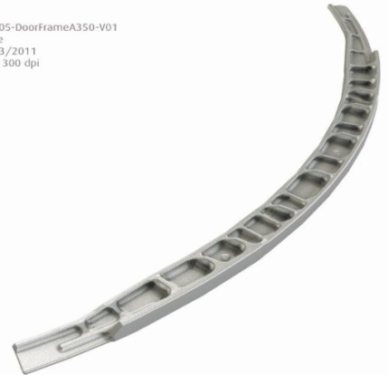






Worldwide Aeronautical Market
CUSTOMERS
UKTMP
Billets
Ti Alloy Ingot

Slide 12
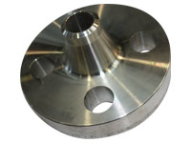
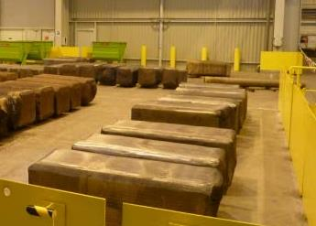
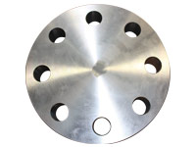
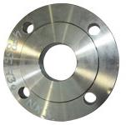
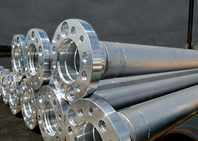

Oil and Gas, Corrosion Market
UKTMP
CUSTOMERS
Ingot ➔ Blooms, Billettes
Welding Neck
Ti CP or Ti Alloy Ingot
Covers and flanges

Slide 13



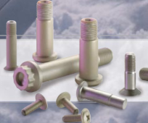
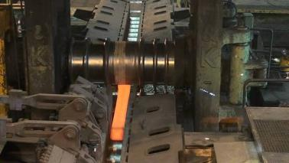





Fasteners and Medical Market
Aeronautical fastening market
UKTMP
Ingot ➔ Blooms ➔ Bars
CUSTOMERS
Orthopedic Implants
Ti Alloy Ingot
Knee
Hip

Slide 14
Key figure
Impact of the build-up of a strategic stock for our main customer.
Tons

Slide 15
UKAD Certification
ISO 9001 and AS 9100, last approval Feb 2018
ISO 14 001 and OHSAS 18001, last approval Fevb 2018
Ultra Sonic Nadcap Certification in Dec 2014, confirmed in Nov 2015 and in Dec 2016
Airbus :
  IPCA Janv 2013 « C »➔ IPCA+ 28 Janvier 2016 « B »
UKAD delivers billets and bars in accordance with AMS 4928 and Ultra Sonic tested in accordance with AMS 2631.

Slide 16

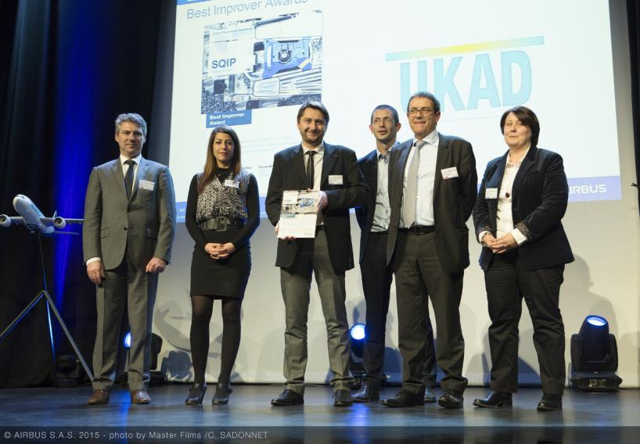
Awards
For the second year UKAD was awarded by Airbus :
Best Improver Award 2015 .

Slide 17

2

Slide 18
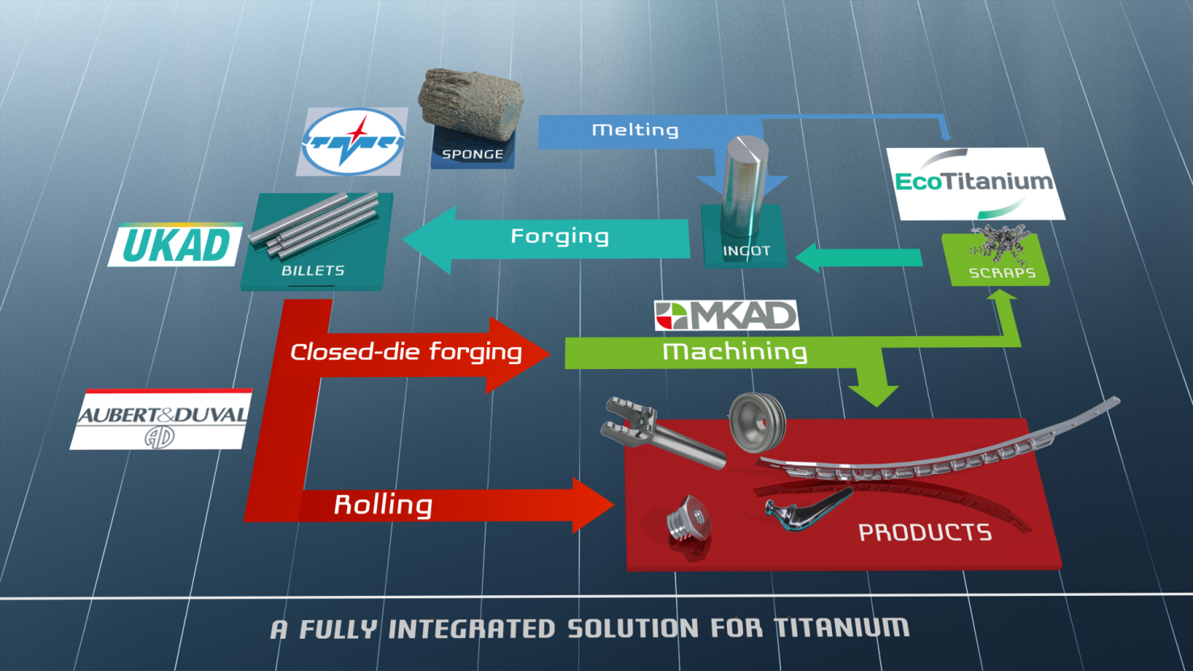
Integrated Titanium Solution
Partnerships form an integrated Titanium Solution :

Slide 19
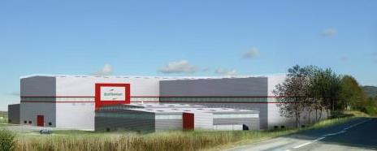
3

Slide 20



Scrap generation
Titanium closed die parts generate huge volume of scrap
Billet 200kg
Closed Die Part 150kg
Finished Part 20kg
Ratio Buy to Fly : 10

Slide 21
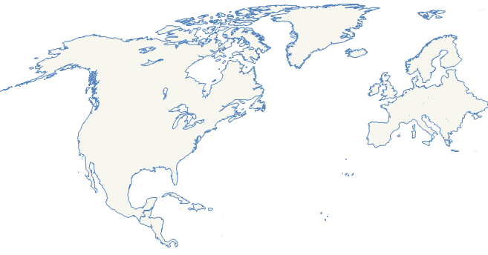

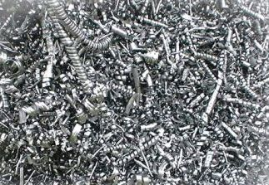

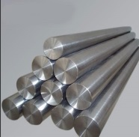
Scrap generated in Europe
Scrap generated in Europe is a key for competitiveness of US titanium melters
European titanium scrap is mainly exported to USA :
11 850 tons in 2015, 10 500 tons in 2016 and a record for 2017 with more than 11 400 tons in 3 quarters.
Europe
USA
Since 2014, US ingots are mainly produced from titanium scrap, which represents more than 60 % of the total consumption Scrap + Sponge.

Slide 22



Committed Shareholders in EcoTitanium
43.5 %
First facility in Europe for melting new Titanium Ingots by recycling, dedicated to aeronautical and high demanding markets in concept of Circular Economy.
49 M€ investment for the first step.
63 direct employees
7 000 m²
41.3 %
15.2 %

Slide 23

Main Equipment : PAM-CHR
Plasma Arc Melting Furnace with Cold Hearth Refining System
Loading system for turnings briquets
Loading system for solids
Melting Chamber
Plasma melting is followed by VAR remelting in EcoTitanium facility.
All equipment available in Ecotitanium for preparation of melting and remelting, and sample collection for chemical analysis.
Electrodes erection chamber

Slide 24

PAM – CHR Principle
Hélium atmosphere
Plasma Torches
crucible
Scrap
Cold Hearth
Ingot

Slide 25
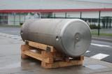



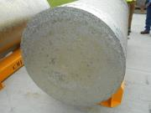
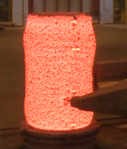
EcoTitanium Schedule
2010 : Reflection and project structuring
2015 :
Mai : Erection of the new plant next to UKAD
2017 :
Production startup
2022
Full maturity
First deliveries of Ingots according AMS 4928 : November 2017

Slide 26

An open Solution for all UKAD Customers
The revert loop is available for all UKAD’s customers (forgers, extruders,…), based on circular Economy.
EcoTitanium reserves a large part of its capacity for all forgers, customers, in the concept of circular economy.

Slide 27
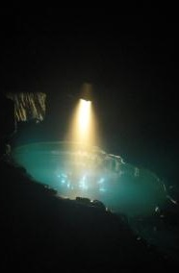
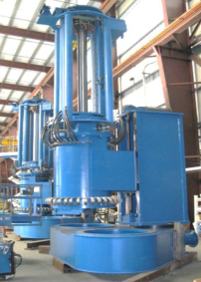
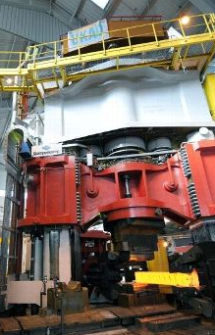
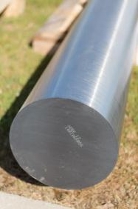
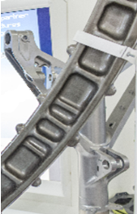
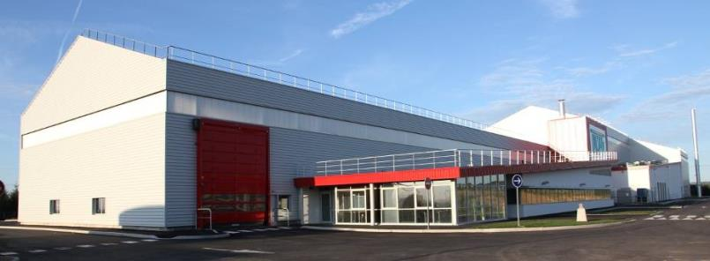
Thank you for your attention

