Slide 1
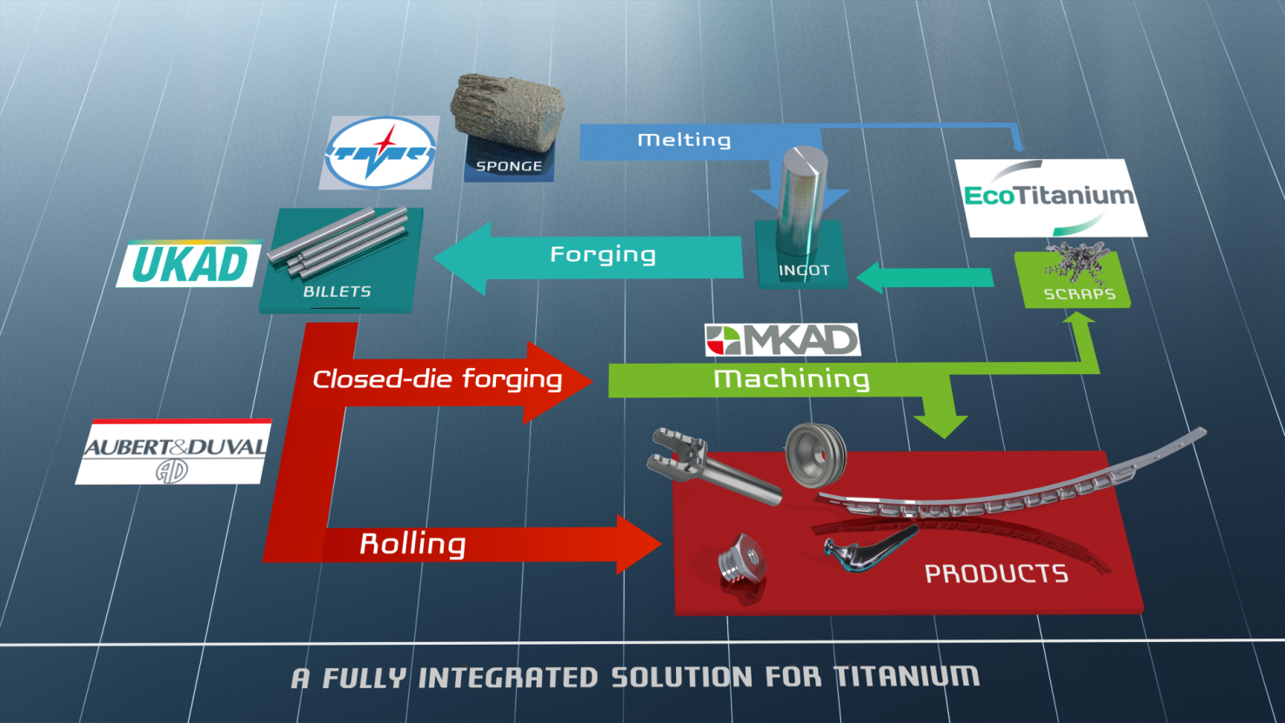
Partnerships form an integrated Titanium Solution

Slide 2




Production generates significant volume of scrap
Titanium closed die parts generate huge volume of scrap
Billet 200kg
Closed Die Part 150kg
Finished Part 20kg
Ratio Buy to Fly : 10

Slide 3

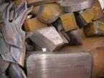
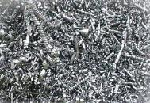
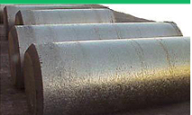
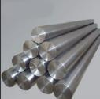
Scrap generated in Europe is a key for competitiveness of US titanium melters
European titanium scrap is mainly exported to USA : 9 500 tons in 2014, and 11 850 tons in 2015.
Europe
USA
US ingots were mainly produced from titanium scrap in 2014 and 2015, 63 % of the total consumption Scrap + Sponge.

Slide 4





Committed shareholders
43.5 %
41.3 %
15.2 %

Slide 5
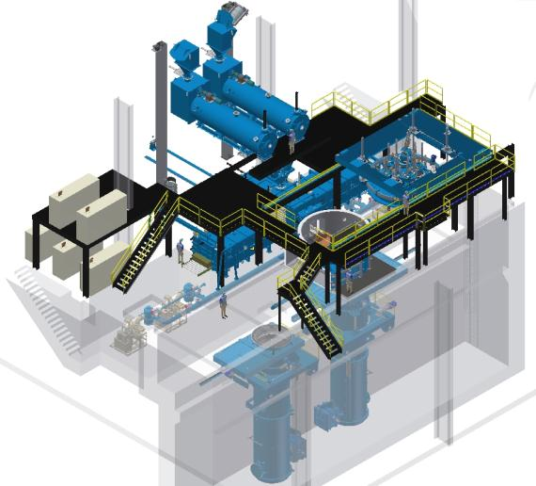
Main Equipment :
A Plasma Furnace Cold Hearth Refining
Loading system for turnings briquets
Loadind system for solids
Melting Chamber
Electrods erection chamber

Slide 6
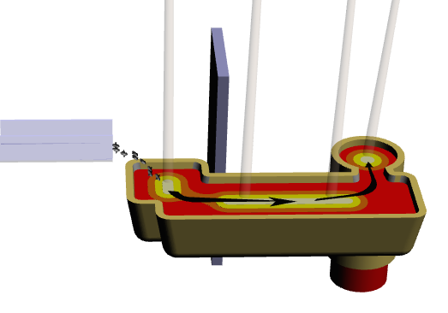
Principle
Principle of a PAMCHR furnace.
Helium
Torches Plasma
Anneau mouleur
Briquettes
Creuset Froid
Lingot
Melting 1700 °C
Notes:
RAR

Slide 7
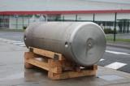
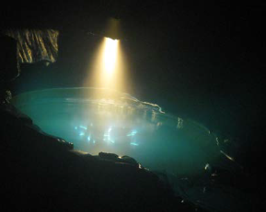
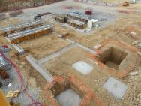

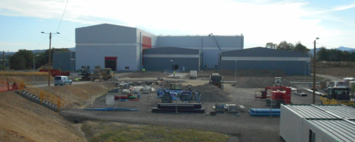
EcoTitanium planning
2010
2015
2017
2022
Full maturity
Production startup
First deliveries with Ingots according AMS 4928: November2017
Erection of the new plant next to UKAD
Reflection and project structuring

Slide 8
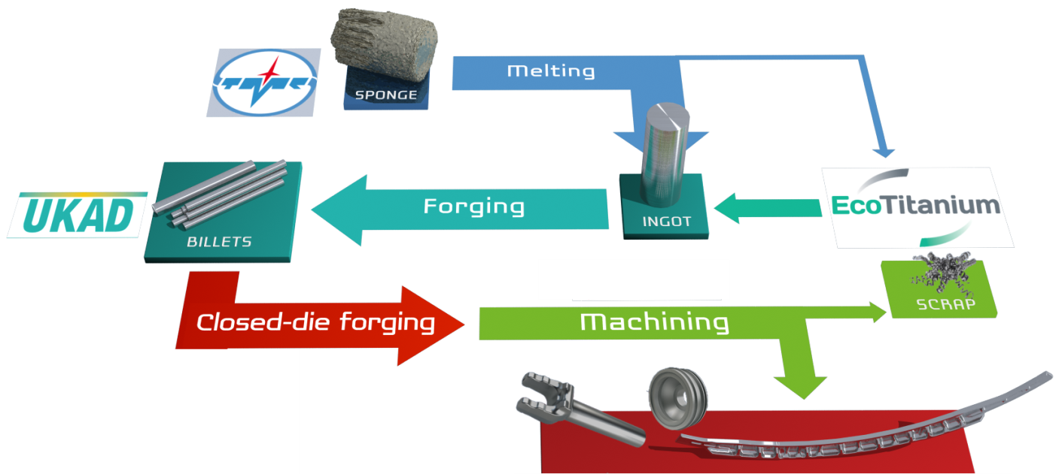
An open Solution for all UKAD customers
The revert loop will be available for all UKAD’s customers, based on circular Economy.
Notes:
RAR

Slide 9
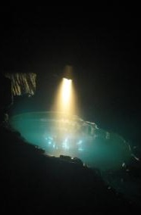
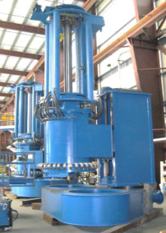
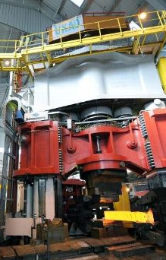
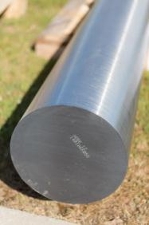
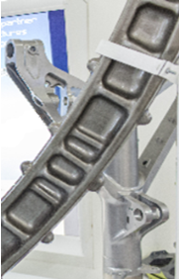
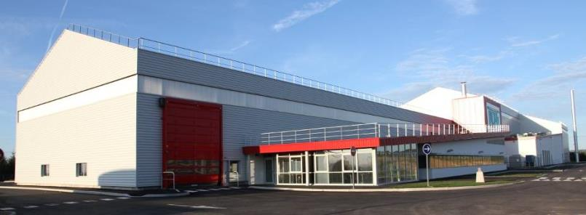
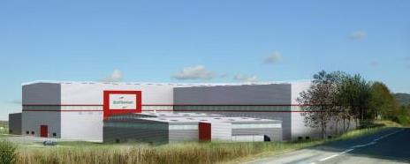
Thank you for your attention

