Slide 1




Sep 2016

Slide 2














VISITOR SAFETY RULES
Welcome to UKAD,
In order to guarantee an enjoyable visit, thanks to follow these few safety rules in the production hall :
If you see an accident, please warn ASAP a first-aid worker. They are easy to recognize thanks to a green helmet.
SAFETY
SHARED VIGILANCE
Wear personal protective equipment (helmet. eyewear, earplugs, safety footwear and reflective jacket)
Use green pedestrian ways painted on the floor.
Be careful at the handling devices and travelling cranes
Do not cross safety fences
Do not touch products (danger of getting burned and/or cut).
If you see an hazardous situation, feel free to inform us.
ENVIRONMENTAL
Save energy (water and electricity).
Sort your wastes.
If you see a leakage, please inform us ASAP
EVACUATION
It is forbidden to take pictures without any authorization,
Switch off your mobile devices.
If you hear the emergency alert system, follow your guide to the meeting point situated near the truck entrance.

Slide 3
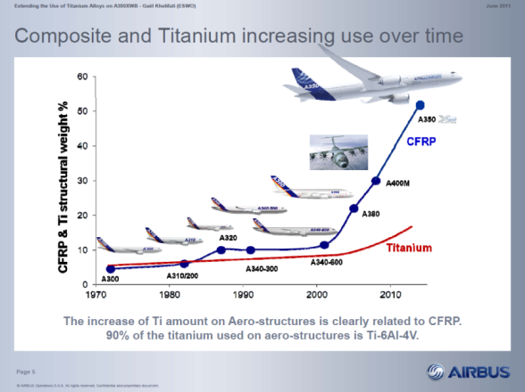
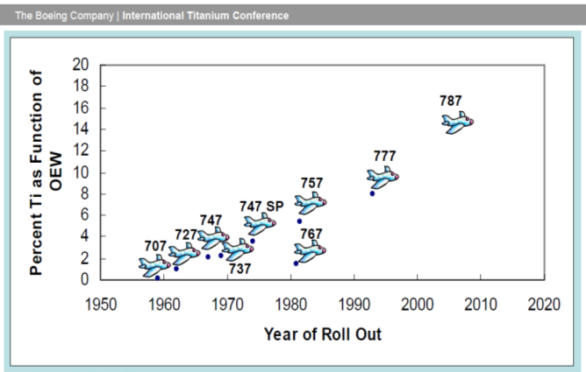



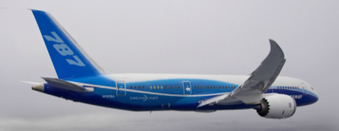
The creation of UKAD
The creation of UKAD was allowed by :
the increase of Ti material in airplane structures

Slide 4
The creation of UKAD
The creation of UKAD was allowed by :
the increase of Ti material in airplane structures
the UKTMP strategy with Ti downstream development
the Aubert et Duval strategy with Ti upstream development
the Airbus support with a 10 years sales agreement
the french local authorities support

Slide 5
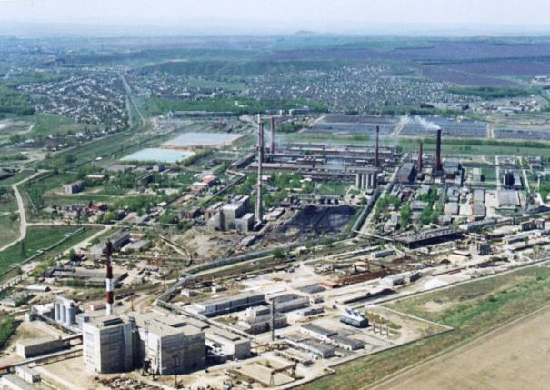
is a joint-venture which combines, in the titanium market, the forces of 2 companies :
  Aubert & Duval
  UKTMP
UKTMP is a Kazakh registered company. Well known for its high level of Titanium sponge quality :
Ilmenite mining operation
Titanium slag production
Titanium tetrachloride and magnesium production
Titanium sponge production
Titanium melting facility

Slide 6
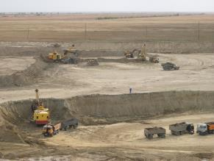
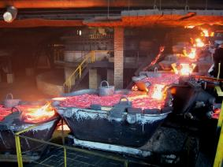
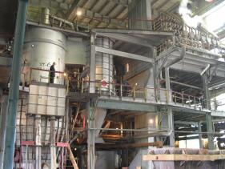
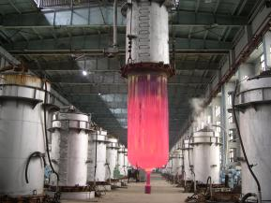
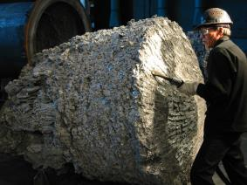
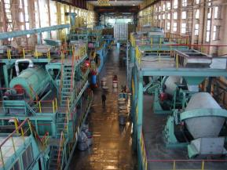
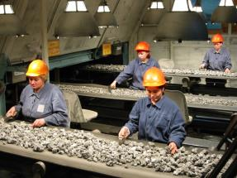
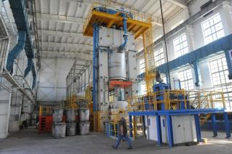
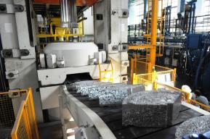
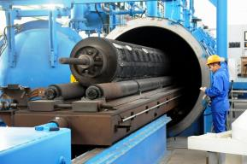
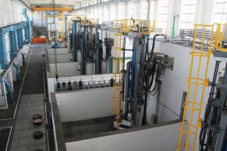
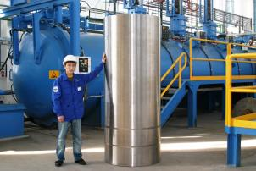
UKTMP in pictures

Slide 7
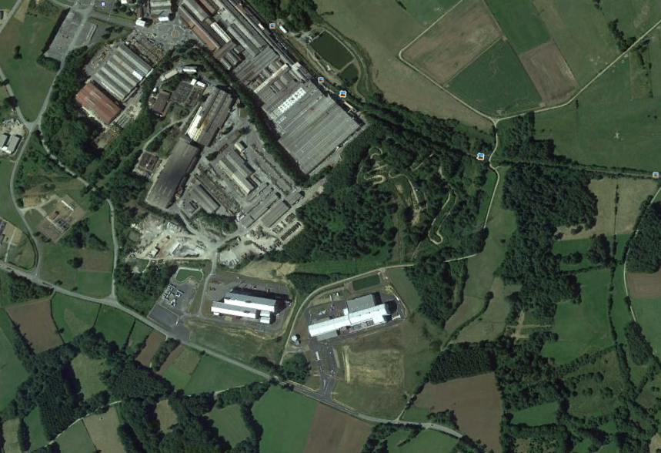
Situation UKAD / EcoTitanium
AUBERT & DUVAL
UKAD
IV30
EcoTitanium
Notes:
RAR

Slide 8
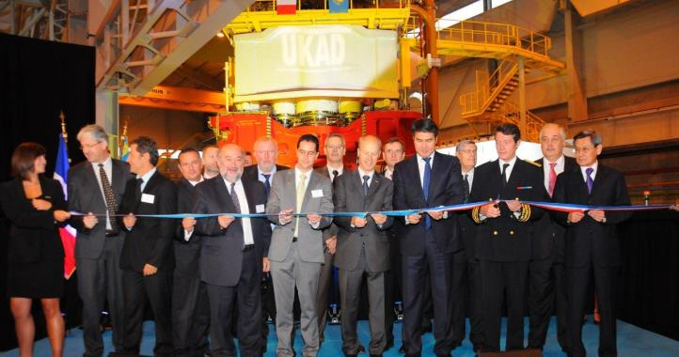
A quick project
26 months
10/04/09
Launch
project
17/10/09
Press
order
18/01/10
Start-up
construction
16/04/10
First
stone
15/11/10
Assembly
press
Juin 2011
1st blow
of press
Construction
Basic engineering
Detailed design
3 months
September 2011
Inauguration

Slide 9
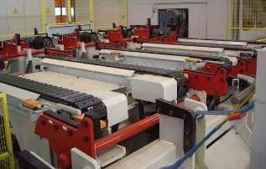
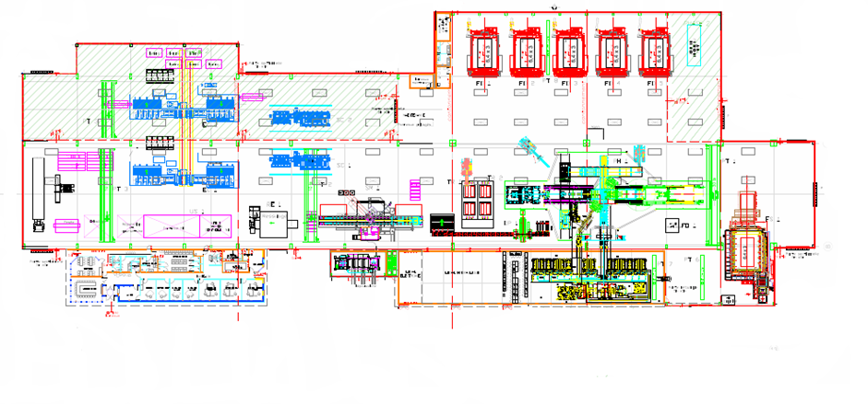
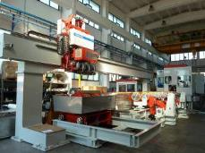
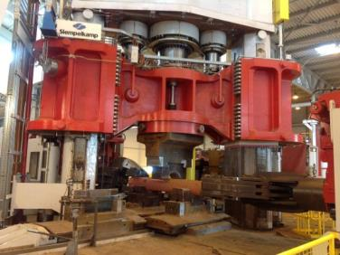
Layout
Stationary hearth furnaces
Peeling
Sawing
Forging
press
Grinding
Mobile hearth
furnaces
Ultrasonic

Slide 10

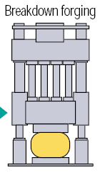



UKAD products
UKTMP
C
U
S
T
O
M
E
R
S
forging press
4,500 t.
N
D
T
*
or
or
➔ UKAD :
  Ingots from 7 (titanium) to 18 t
  Blooms and billets from 85 to 450 mm in Ø and 4 to 6 m long
  Bars from 55 to 85 mm
Operations subcontracted to Aubert & Duval
*Non destructive tests (automatic multi-element ultrasonic)

Slide 11

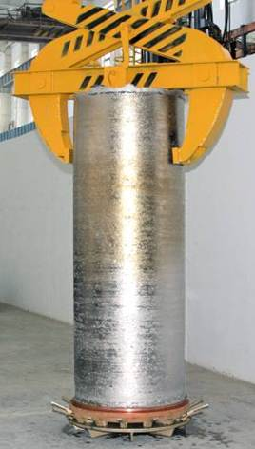
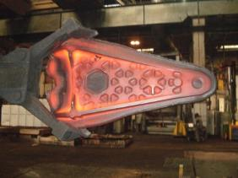

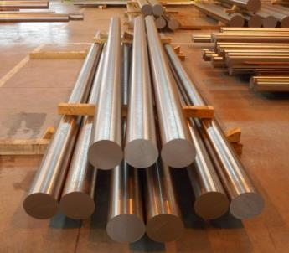


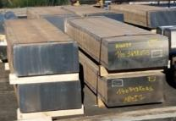
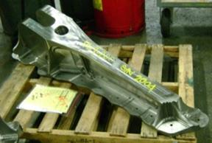





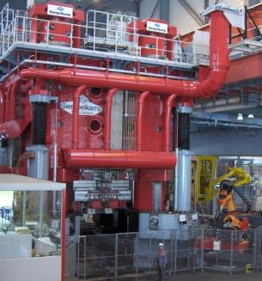
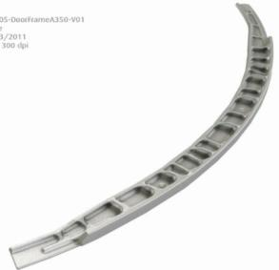




Worldwide Aeronautical Market
CUSTOMERS
UKTMP
Billets
Ti Alloy Ingot
Many other forgers in Europe (3), UK (1) and USA (3).

Slide 12






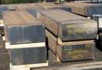




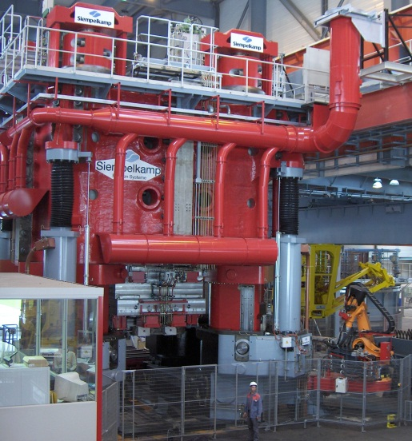

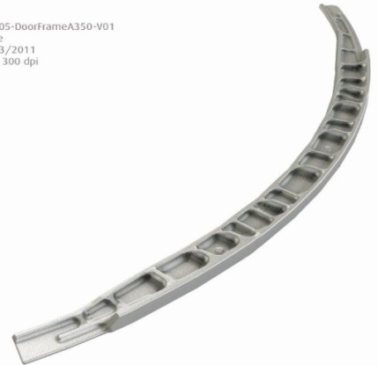





Worldwide Aeronautical Market
Confidentiel
CUSTOMERS
UKTMP
Billets
Ti Alloy Ingot

Slide 13
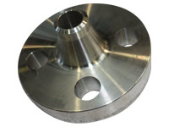
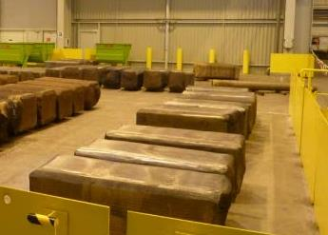
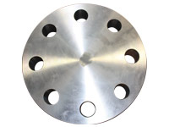
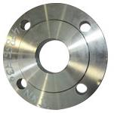
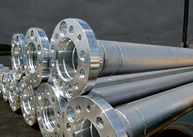
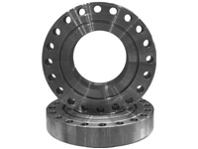
Oil and Gas (Corrosion) Market
UKTMP
CUSTOMERS
Ingot ➔ Blooms, Billettes
Welding Neck
Ti CP or Ti Alloy Ingot
Covers and flanges

Slide 14
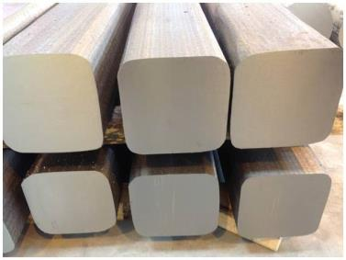
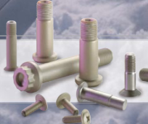
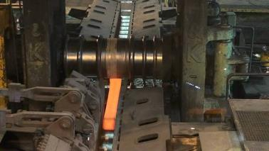
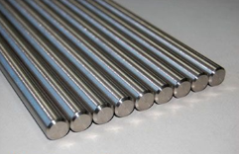


Fasteners and Medical Market
Aeronautical fastening market
UKTMP
CUSTOMERS
Ingot ➔ Blooms ➔ Bars
Orthopedic Implants
Ti Alloy Ingot
Knee
Hip

Slide 15
Key Figure
Tonnes
Notes:
CA 2013 18,6 M€
Budget 2014 1565 t 600 t taf Ca : 39 M€ 2015 2500 t 1100 t taf Ca 64 M€

Slide 16
Key Figure
Confidentiel
Millions €
Tonnes
Notes:
CA 2013 18,6 M€
Budget 2014 1565 t 600 t taf Ca : 39 M€ 2015 2500 t 1100 t taf Ca 64 M€

Slide 17
Certifications
ISO 9001 and AS 9100, last approval Dec 2015
ISO 14 001 and OHSAS 18001, last approval Dec 2015
Ultra Sonic Nadcap Certification in Dec 2014, confirmed in Nov 2015.
Airbus :
  IPCA Janv 2013 « C »➔ IPCA+ 28 Janvier 2016 « B »
Boeing :
  UKTMP has been formally qualified in August 2015.
UKAD delivers billets and bars in accordance with AMS 4928 and Ultra Sonic tested in accordance with AMS 2631.

Slide 18
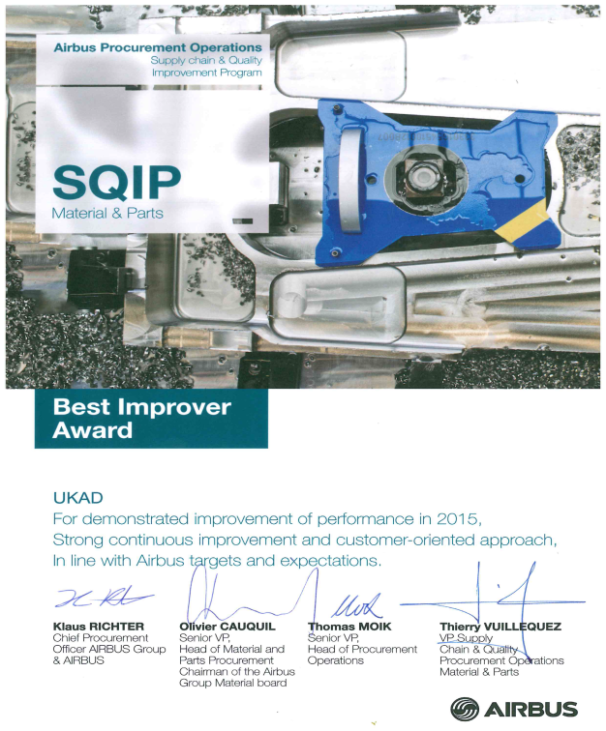
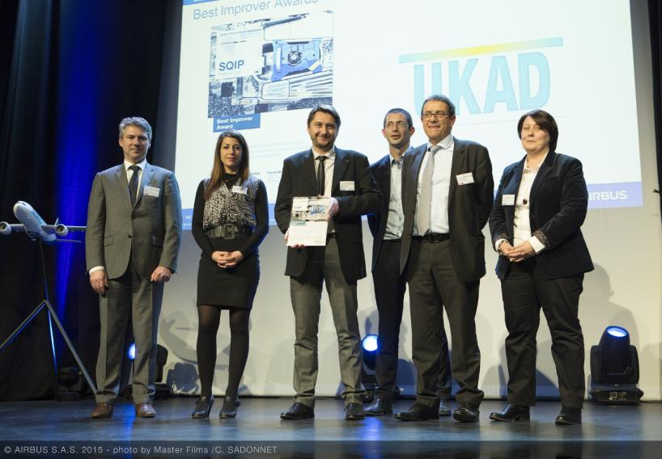
UKAD :
For the second year UKAD was awarded by Airbus :
Best Improver Award 2015 .

Slide 19
UKAD Organization
Sylvain Gehler, Specialty Metals Company SA , Chairman of the Board UKTMP, is the President of UKAD.
Direction Générale UKAD
Denis Hugelmann
Direction UKAD
Benoît Delvincourt
Direction Développement Commercial UKAD
Patrick Delaborde
Supply Chain
S Pouzol
X Delarbre
QHSE
M Cabano
Méthodes Qualité Produits
Yvon Le Collen
Fabrication
JC Nieto
Maintenance
F Grimal
Accueil / RH / Achats
C Verger
Etudes & Progrès
A Petitjean
2 tech.
2 tech.
1 engineer
1 tech. Métallurgie
1 tech QP
2 tech Méthodes
3 équipes
2 préparateurs
1 automaticien
2 mainteneurs postés
1 technicien
Contrat de prestations A&D
Labo
RH
SI
R&D
Achats
Gestion comptable
60 people

Slide 20



Our Expectations from Commercial Forces
Confidentiel
UKAD needs volumes in TA6V and Ti CP grade 2 or grade 1 :
In Ti64 :
Orders > 5 tons, or exceptionally 2 tons, with standard dimensions.
Specifications as qualified in aero or AMS4928, ASTM B348 or Equivalent.
Diameters 55 mm to 350 mm peeled, or blooms for forging / rolling.
Other dimensions to be discussed (Flat and square products)
UKAD will have to work with distributors for smallest quantities.
Very basic applications as corrosion with grade 5 is difficult, due to the quality of ingots (2xVAR) and their price.
Personal message from P Delaborde
In Ti CP, grade 2 or grade1 :
Orders > 5 tons
All applications, corrosion too.
Blooms or bars from 900 mm to 120 mm.
We work with big ingots 7 or 10 tons, with a competitive price for biggest dimensions.
Message from Lorella

Slide 21
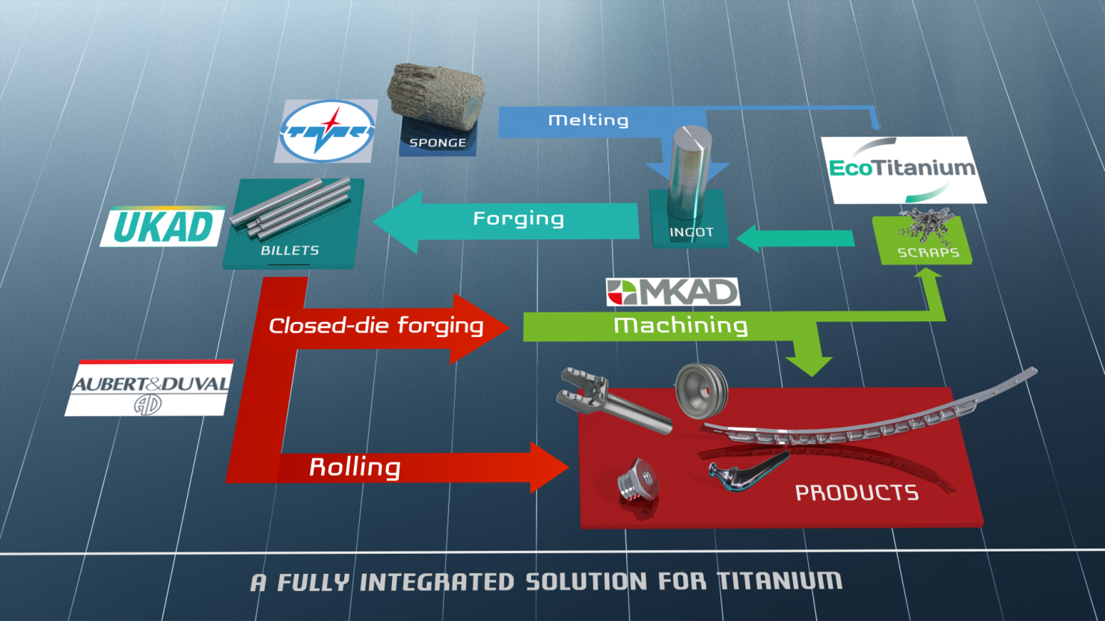
Partnerships form an integrated Titanium Solution

Slide 22




Production generates significant volume of scrap
Titanium closed die parts generate huge volume of scrap
Billet 200kg
Closed Die Part 150kg
Finished Part 20kg
Ratio Buy to Fly : 10

Slide 23

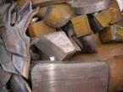
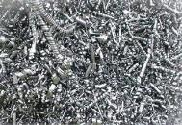
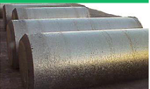
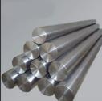
Scrap generated in Europe is a key for competitiveness of US titanium melters
European titanium scrap is mainly exported to USA : 9 500 tons in 2014
Europe
USA
US ingots were mainly produced from titanium scrap in 2014, 63 % of the total consumption Scrap + Sponge.

Slide 24



Committed shareholders
43.5 %
41.3 %
15.2 %

Slide 25

Main Equipment :
A Plasma Furnace Cold Hearth Refining
Loading system for turnings briquets
Loadind system for solids
Melting Chamber
Electrods erection chamber

Slide 26

Principle
Principle of a PAMCHR furnace.
Helium
Torches Plasma
Anneau mouleur
Briquettes
Creuset Froid
Lingot
Melting 1700 °C
Notes:
RAR

Slide 27





EcoTitanium planning
2010
2015
2017
2022
Full maturity
Production startup
First deliveries with Ingots according AMS 4928: November2017
Erection of the new plant next to UKAD
Reflection and project structuring

Slide 28

An open Solution for all UKAD customers
The revert loop will be available for all UKAD’s customers, based on circular Economy.
Notes:
RAR

Slide 29

Ecotitanium Business Plan
Confidentiel

Slide 30

EcoTitanium
Confidentiel
The qualification lead time in aeronautical market is very long (see UKAD deliveries).
Our goal is to access to volumes in Ti6-4 for less demanding market as corrosion, mechanical…
We need you now to identify customers, distributors in this field, with volumes and prices information.

Slide 31







Thank you for your attention

