Slide 1
Ecotitanium
July 2016

Slide 2
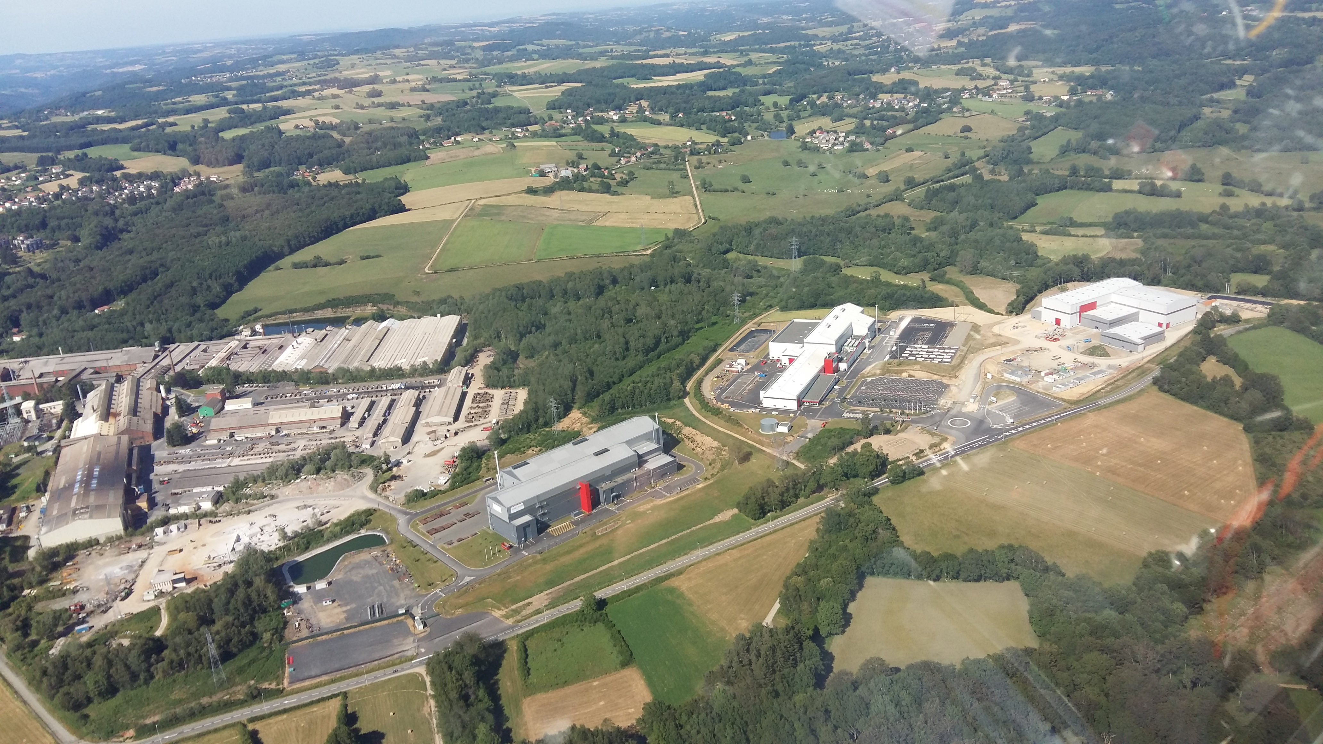
EcoTitanium
Location A&D / UKAD / EcoTitanium
EcoTitanium
UKAD
AUBERT & DUVAL
IV30

Slide 3
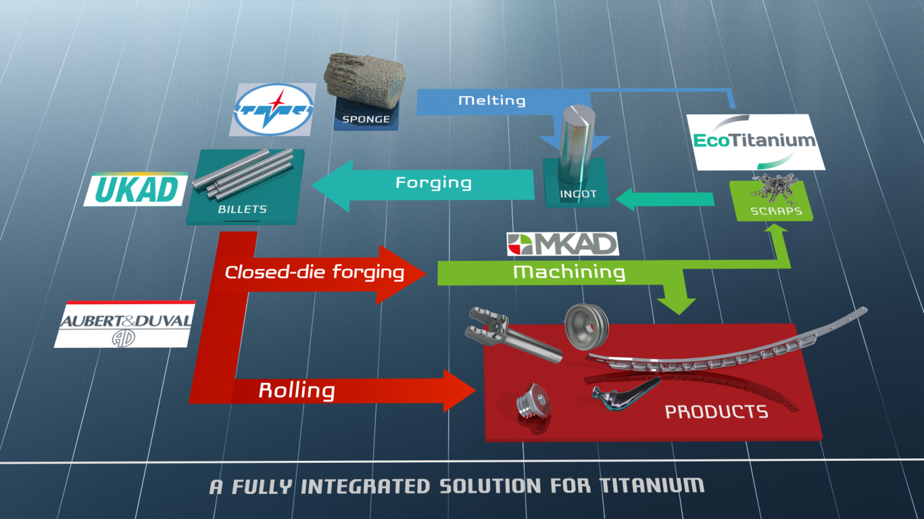
Partnerships form an integrated Titanium Solution

Slide 4



Production generates significant volume of scrap
Titanium closed die parts generate huge volume of scrap
Billet 200kg
Closed Die Part 150kg
Finished Part 20kg
Ratio Buy to Fly : 10

Slide 5


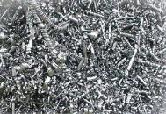

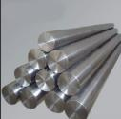
Scrap generated in Europe is a key for competitiveness of US titanium melters
European titanium scrap is mainly exported to USA : 11 850 tons in 2015
Europe
USA
US ingots were mainly produced from titanium scrap in 2014 and 2015, 63 % of the total consumption Scrap + Sponge.

Slide 6





Committed shareholders
43.5 %
41.3 %
15.2 %

Slide 7

Main Equipment :
A Plasma Furnace Cold Hearth Refining
Loading system for turnings briquets
Loadind system for solids
Melting Chamber
Electrods erection chamber

Slide 8

Principle
Principle of a PAMCHR furnace.
Helium
Torches Plasma
Anneau mouleur
Briquettes
Creuset Froid
Lingot
Melting 1700 °C
Notes:
RAR

Slide 9
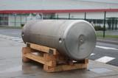



EcoTitanium general schedule
2010
2015
2017
2022
Full maturity
Production startup
Building construction
Reflection and project structuring

Slide 10

An open Solution for all UKAD customers
The revert loop will be available for all UKAD’s customers, based on circular Economy.
Notes:
RAR

Slide 11
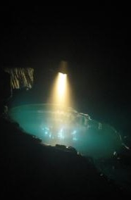
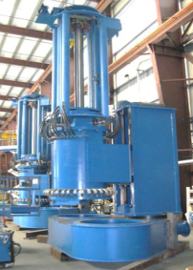
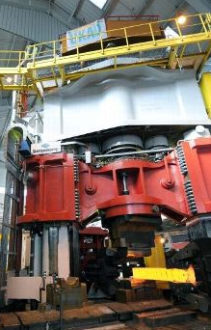
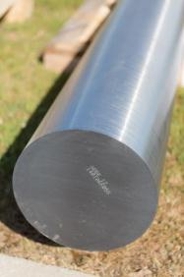
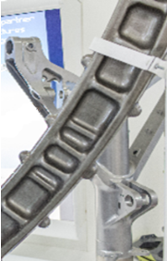
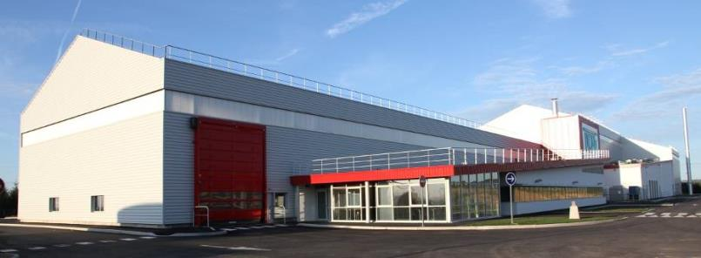
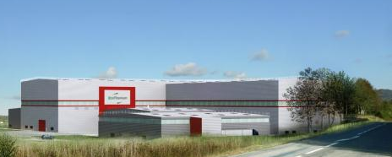
Thank you for your attention

