Slide 1




WELCOME to UKAD :
a Franco-Kazakh company
7th of june 2016

Slide 2
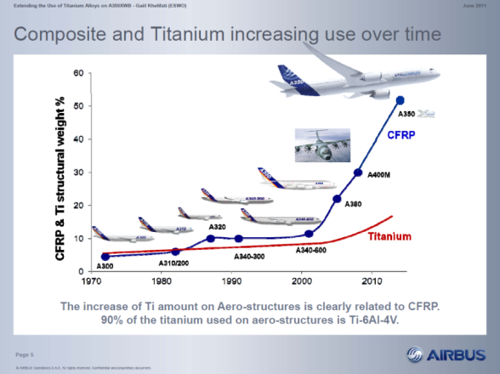
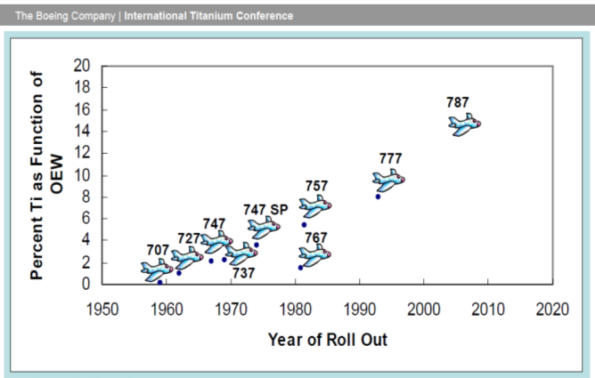



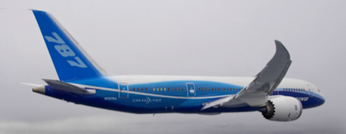
The creation of UKAD
The creation of UKAD was allowed by :
the increase of Ti material in airplane structures

Slide 3
The creation of UKAD
The creation of UKAD was allowed by :
the increase of Ti material in airplane structures
the UKTMP strategy with Ti downstream development
the Aubert et Duval strategy with Ti upstream development
the Airbus support with a 10 years sales agreement
the french local authorities support

Slide 4
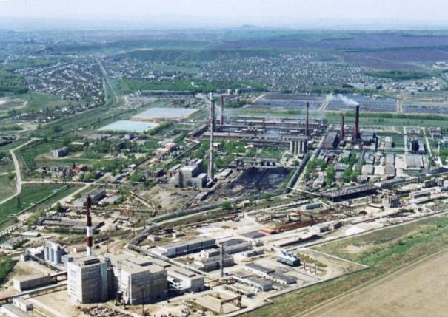
is a joint-venture which combines, in the titanium market, the forces of 2 companies :
  Aubert & Duval
  UKTMP
UKTMP is a Kazakh registered company. Well known for its high level of Titanium sponge quality :
Ilmenite mining operation
Titanium slag production
Titanium tetrachloride and magnesium production
Titanium sponge production
Titanium melting facility

Slide 5
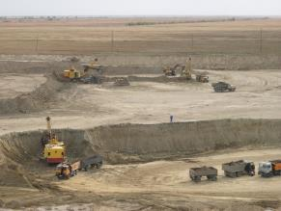
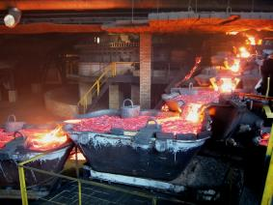
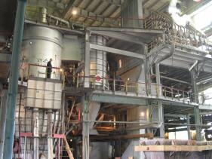
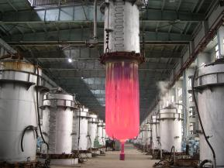
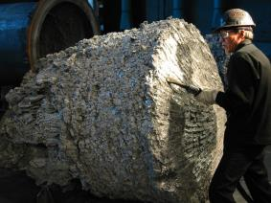
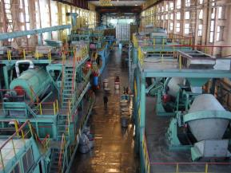
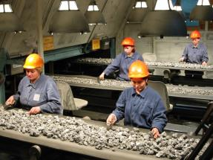
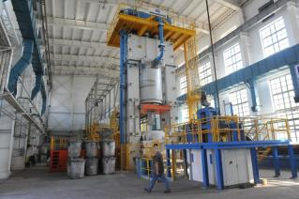
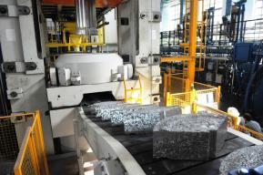
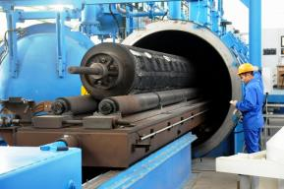
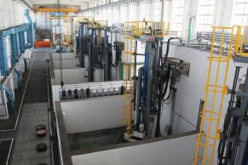
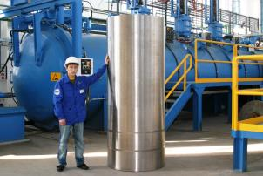
UKTMP in pictures

Slide 6
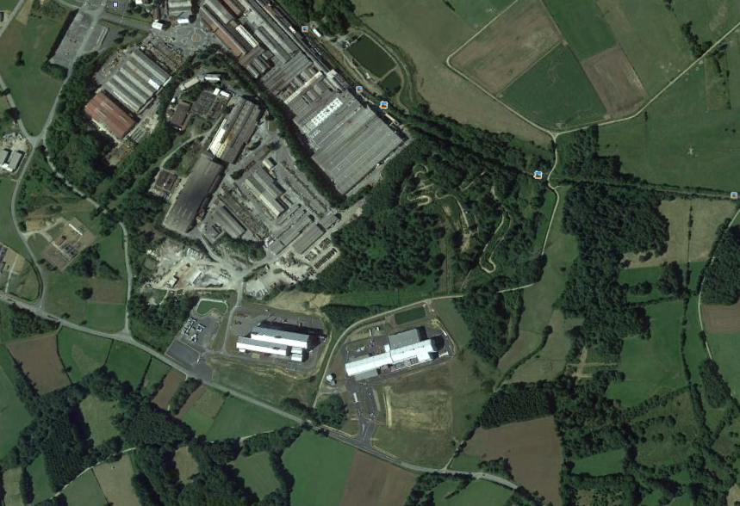
Situation UKAD / EcoTitanium
AUBERT & DUVAL
UKAD
IV30
EcoTitanium
Notes:
RAR

Slide 7
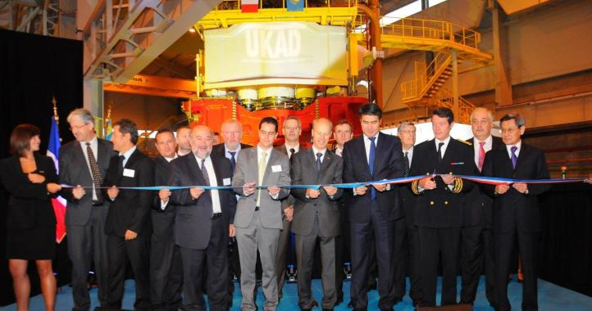
A quick project
26 months
10/04/09
Launch
project
17/10/09
Press
order
18/01/10
Start-up
construction
16/04/10
First
stone
15/11/10
Assembly
press
Juin 2011
1st blow
of press
Construction
Basic engineering
Detailed design
3 months
September 2011
Inauguration

Slide 8
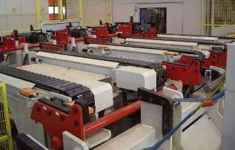
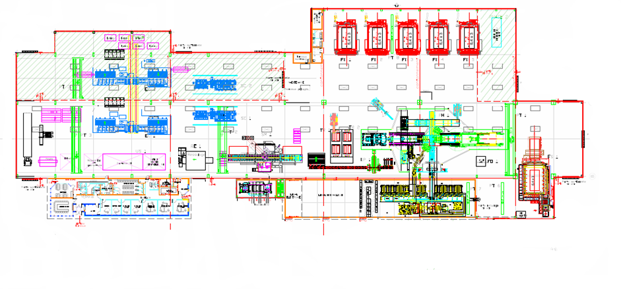
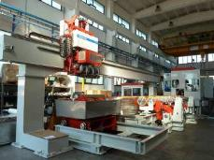
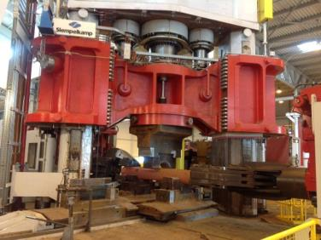
Layout
Stationary hearth furnaces
Peeling
Sawing
Forging
press
Grinding
Mobile hearth
furnaces
Ultrasonic

Slide 9

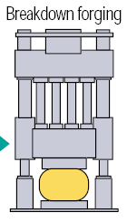



UKAD products
UKTMP
C
U
S
T
O
M
E
R
S
forging press
4,500 t.
N
D
T
*
or
or
➔ UKAD :
  Ingots from 7 (titanium) to 18 t
  Blooms and billets from 85 to 450 mm in Ø and 4 to 6 m long
  Bars from 55 to 85 mm
Operations subcontracted to Aubert & Duval
*Non destructive tests (automatic multi-element ultrasonic)

Slide 10

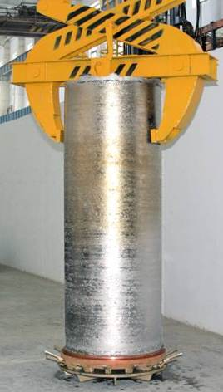
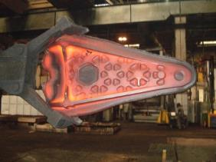

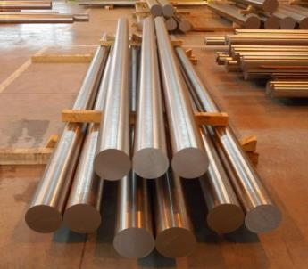


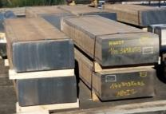
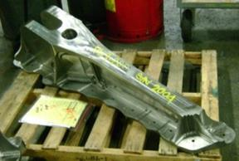





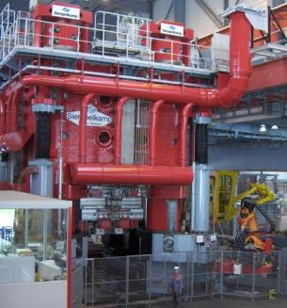
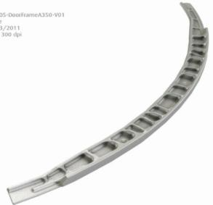
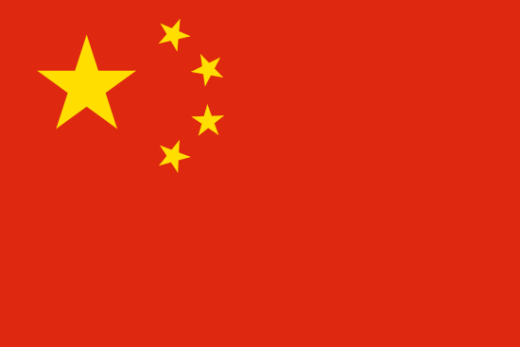




Worldwide Aeronautical Market
CUSTOMERS
UKTMP
Billets
Ti Alloy Ingot
+ many other forgers (USA, UK, Europe

Slide 11
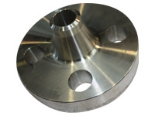
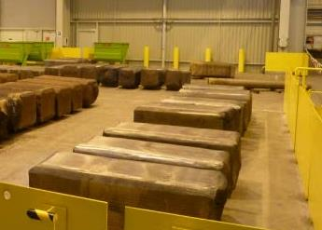
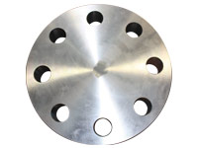
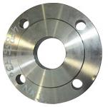
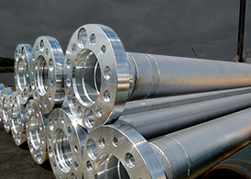
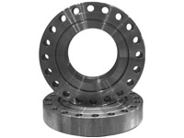
Oil and Gas (Corrosion) Market
UKTMP
CUSTOMERS
Ingot ➔ Blooms, Billettes
Welding Neck
Ti CP or Ti Alloy Ingot
Covers and flanges

Slide 12
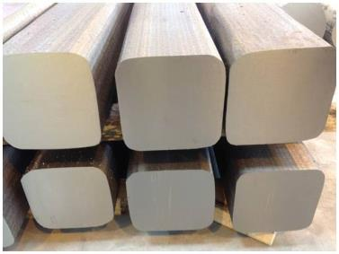

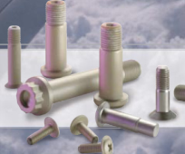
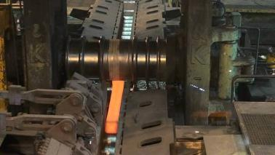
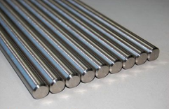


Fasteners and Medical Market
Aeronautical fastening market
UKTMP
CUSTOMERS
Ingot ➔ Blooms ➔ Bars
Orthopedic Implants
Ti Alloy Ingot
Knee
Hip

Slide 13
Key Figure
Millions €
Tonnes
Notes:
CA 2013 18,6 M€
Budget 2014 1565 t 600 t taf Ca : 39 M€ 2015 2500 t 1100 t taf Ca 64 M€

Slide 14
Certifications
ISO 9001 and AS 9100, last approval Dec 2015
ISO 14 001 and OHSAS 18001, last approval Dec 2015
Ultra Sonic Nadcap Certification in Dec 2014, confirmed in Nov 2015.
Airbus :
  IPCA Janv 2013 « C »➔ IPCA+ 28 Janvier 2016 « B »
Boeing :
  UKTMP has been formally qualified in August 2015.

Slide 15
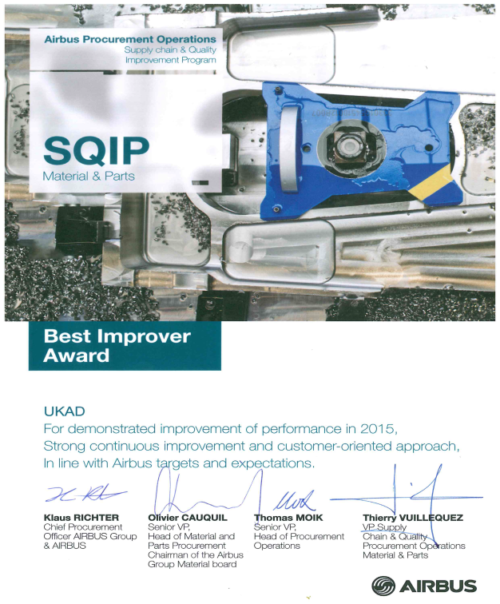
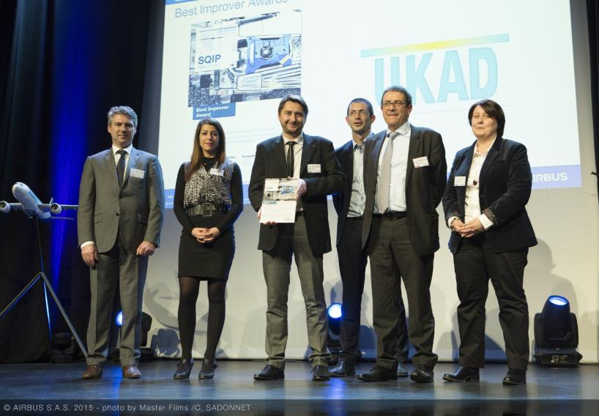
UKAD
For the second year UKAD was awarded by Airbus :
Best Improver Award 2015 .

Slide 16




Production generates significant volume of scrap
Titanium closed die parts generate huge volume of scrap
Billet 200kg
Closed Die Part 150kg
Finished Part 20kg
Ratio Buy to Fly : 10

Slide 17
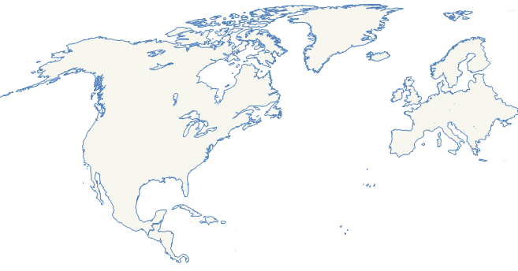
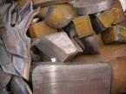
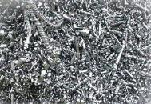
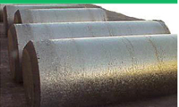
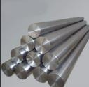
Scrap generated in Europe is a key for competitiveness of US titanium melters
European titanium scrap is mainly exported to USA : 9 500 tons in 2014
Europe
USA
US ingots were mainly produced from titanium scrap in 2014, 63 % of the total consumption Scrap + Sponge.

Slide 18


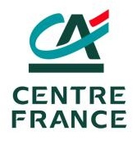
Committed shareholders
43.5 %
41.3 %
15.2 %

Slide 19
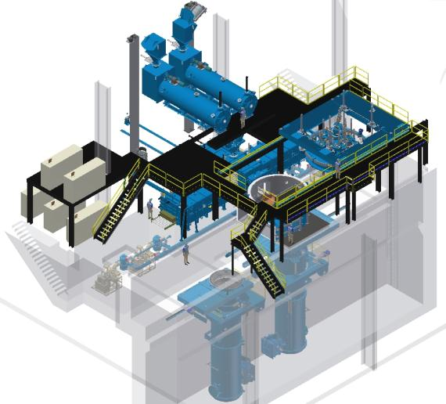
Main Equipment :
A Plasma Furnace Cold Hearth Refining
Loading system for turnings briquets
Loadind system for solids
Melting Chamber
Electrods erection chamber

Slide 20

Principle
Principle of a PAMCHR furnace.
Helium
Torches Plasma
Anneau mouleur
Briquettes
Creuset Froid
Lingot
Melting 1700 °C
Notes:
RAR

Slide 21




EcoTitanium planning
2010
2015
2017
2022
Full maturity
Production startup
Erection of the new plant next to UKAD
Reflection and project structuring

Slide 22

An open Solution for all UKAD customers
The revert loop will be available for all UKAD’s customers, based on circular Economy.
Notes:
RAR

Slide 23







Thank you for your attention

