Slide 1


UKAD
)

Slide 2
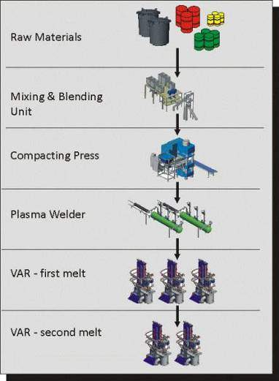
THE NEW UKTMP PROCESS
The ingots are melted in Kazakhstan in UKTMP facilities.
Raw materials are Sponges and Master alloys only (without scrap).
The mixing and blending unit allows an homogeneous mix of raw material in the right proportion of the alloy to melt.
UKTMP produces compacts with the press.
These compacts are assembled together and then welded in a dedicated Plasma welder to build an electrode
The electrode is melted in a Vacuum Arc Remelting furnace.
The ingot-electrode is remelted a second time in order to obtain the final ingot.

Slide 3
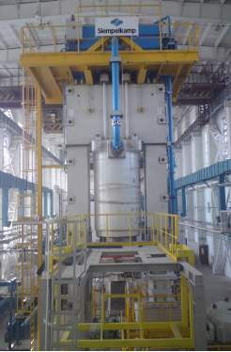
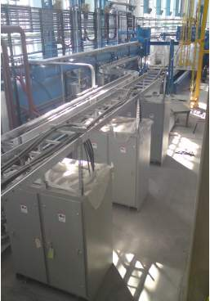
COMPACTION PRESS
PLASMA WELDING

Slide 4
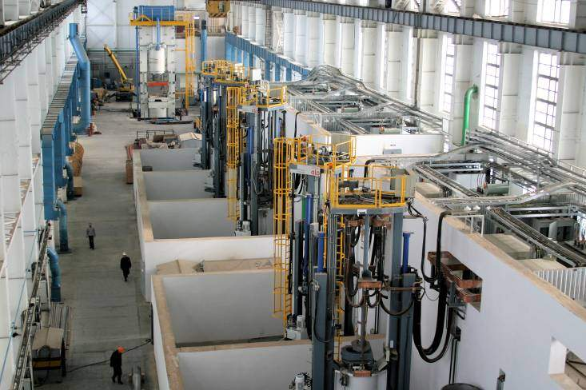
VAR FURNACES

Slide 5
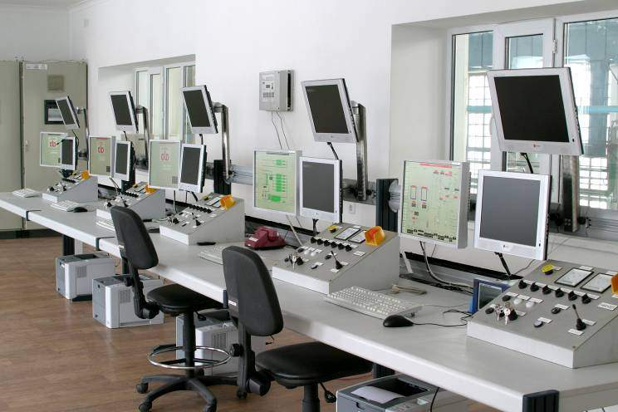
VAR FURNACES CONTROL ROOM

Slide 6
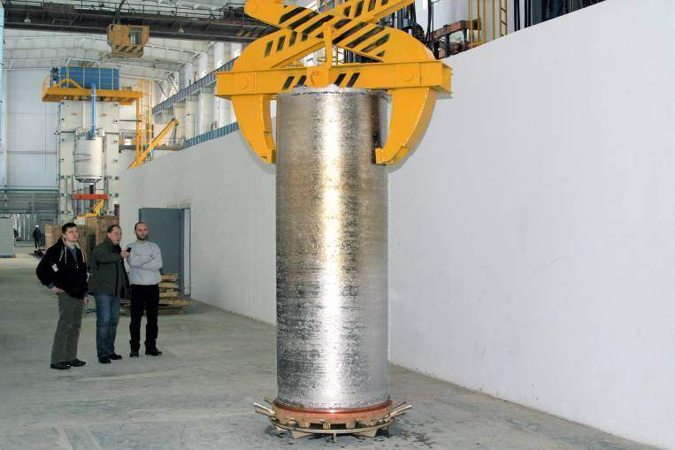
ONE OF THE FIRST INGOTS

