Slide 1

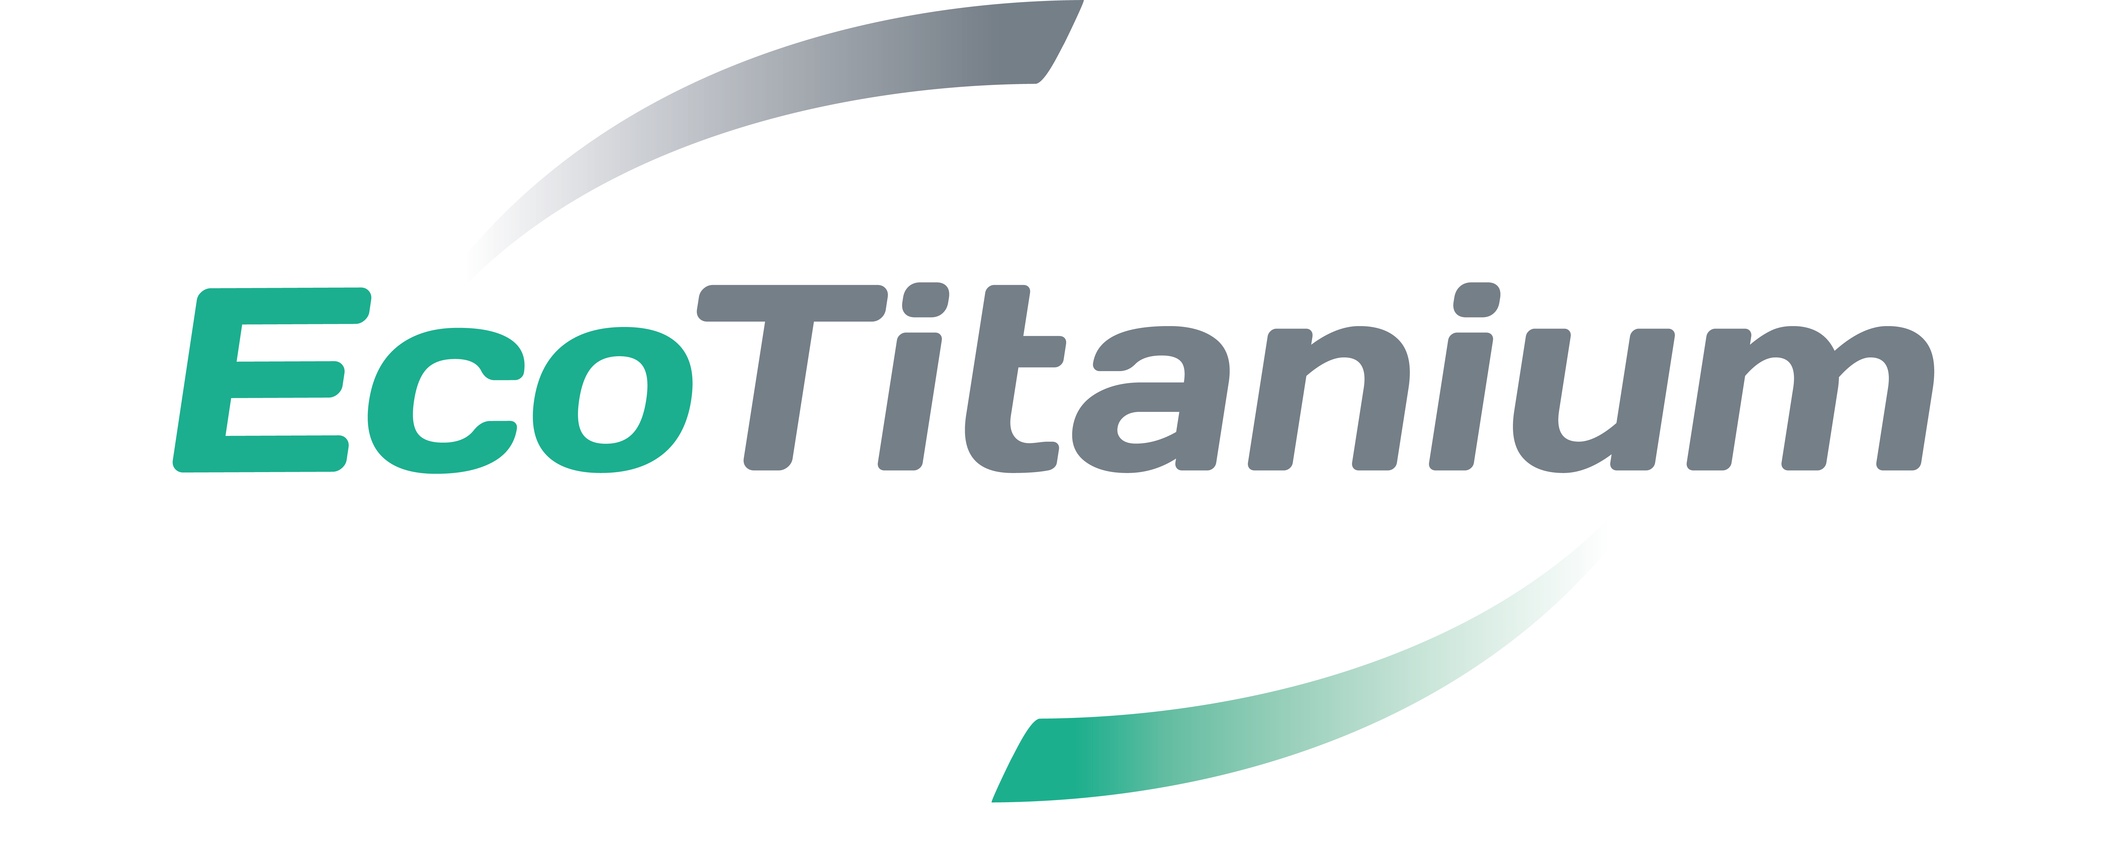
General Electric
Technical call
    22/06/2020
1

Slide 2
Agenda
Introduction
O1 – Development work for bar production
O2 – Ecotitanium process
O3 – R&D
2
GE meeting – 22/06/2020 Classification : confidential

Slide 3
01
Development work for bar production

Slide 4


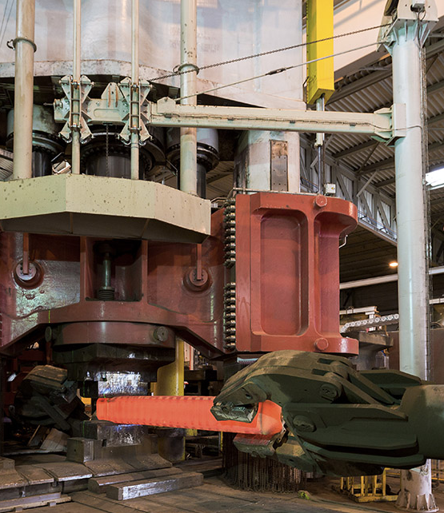




UKAD PROCESS
Personnaliser le titre
de la présentation
en bas de page
Personnaliser le bas de page
avec le menu « Insertion » /
« En-tête et pieds de page »
Ingots
C
U
S
T
O
M
E
R
S
forging press
4,500 t.
N
D
T
or
2 sources :
- UKTMP
- ECOTITANIUM
Operations subcontracted
to Aubert & Duval
➔ UKAD :
  Ingots from 7 (titanium) to 18 t
  Blooms and billets (round) from 80 to 430 mm in Ø and 4 to 6m long and rectangular bars.
4
GE meeting – 22/06/2020 Classification : confidential
4

Slide 5
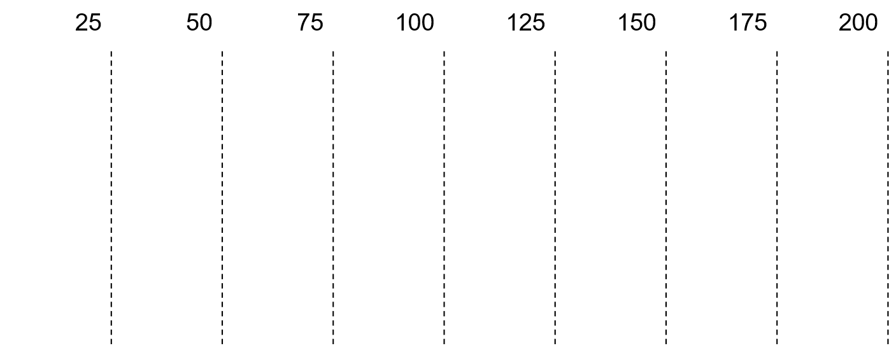
Process for titanium bars ( Ø20 mm – Ø200 mm )
Forging machine
Rolling (TRIO)
Rolling (LAMA)
    Experiences :
    TI 6-4 ELI Medical market Machining bars from Ø22 mm to Ø85 mm
    TI 6-4 Aeronautic application Bars according to AMS4928 ( 6 inches )
5
GE meeting – 22/06/2020 Classification : confidential

Slide 6
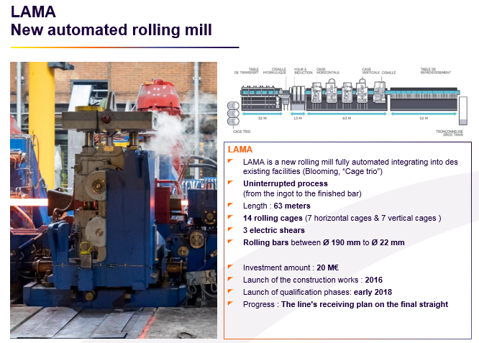
Aubert & Duval New rolling equipment
    Titanium Trials:
        Rolled diameters : Ø22, Ø55, Ø65 and Ø95 mm
    Qualifications:
        Qualification process to be launched with Airbus for ABS5453 and AIMS03-18-010
6
GE meeting – 22/06/2020 Classification : confidential

Slide 7
02
Ecotitanium process

Slide 8
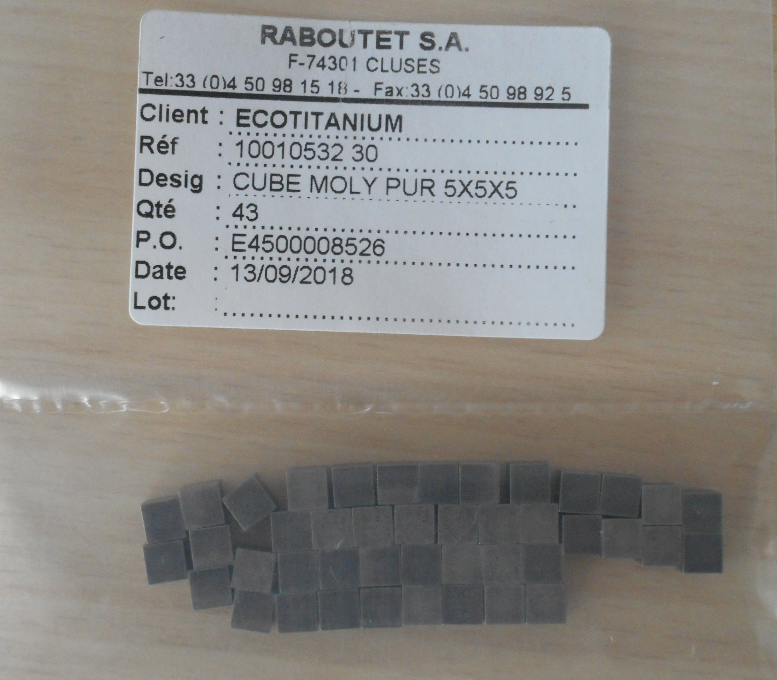
EcoTitanium
    Does EcoTitanium have a path to procure the necessary seeds for seeded heats in compliance with GE specification S-425?
        Nitrided sponge particles : Timet
        HDI provided by Raboutet
    What is the long term plan for sponge sources?
        Qualification of Toho as sponge sources
        Around 1 year for the complete qualification (analyses, audit, 3 tests lots).
UKAD- ECOTITANIUM PROPRIATARY INFORMATION, may not be used or disclosed to third party

Slide 9
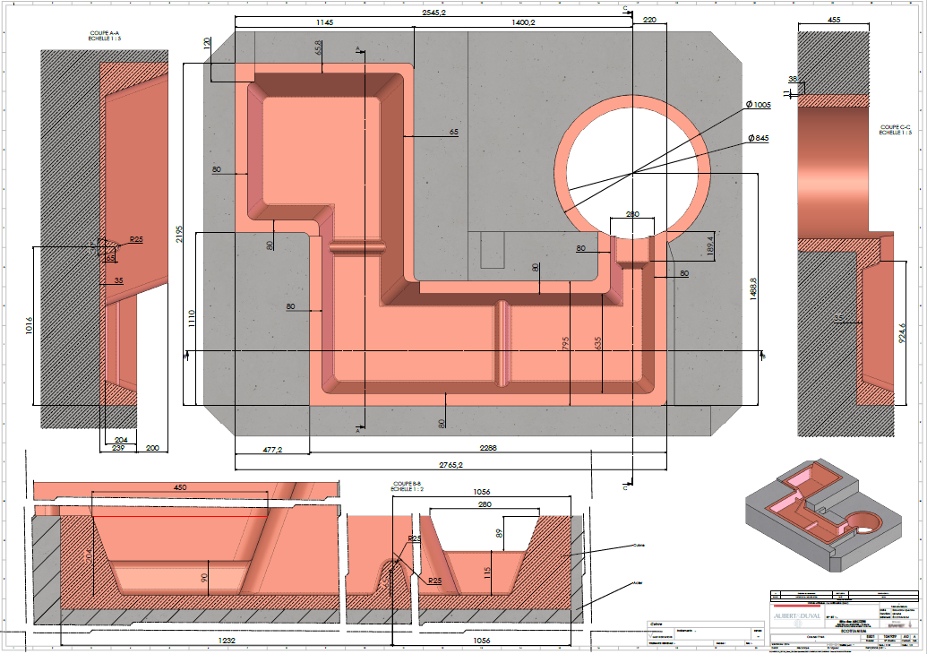
    Hearth design (basic layout and dimensions)
UKAD- ECOTITANIUM PROPRIATARY INFORMATION, may not be used or disclosed to third party

Slide 10
03
R&D

Slide 11
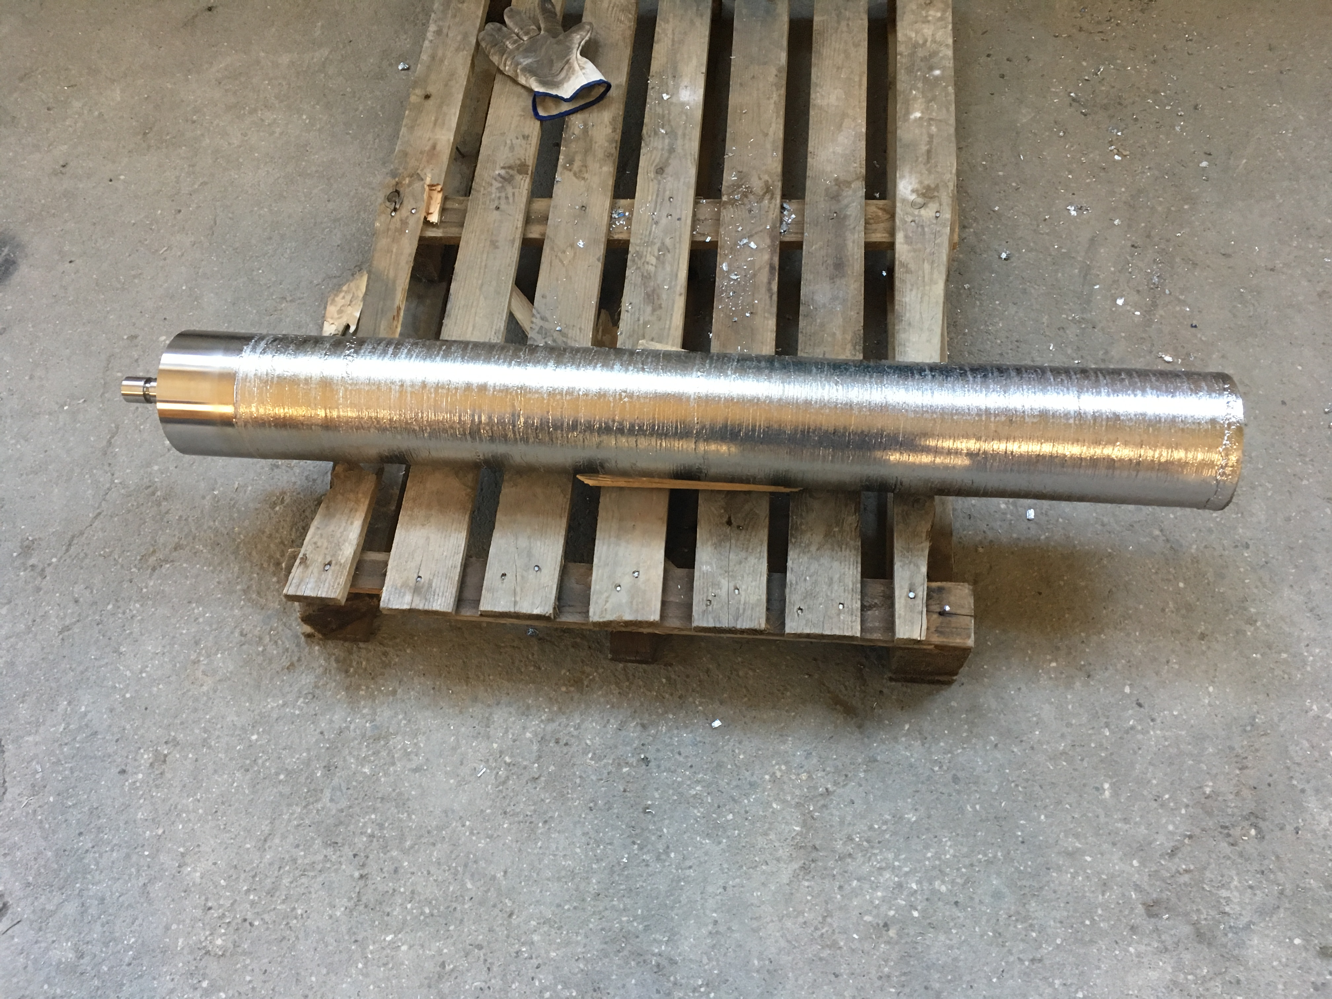
Premium Quality oriented R&D
Pilot scale study :
    Quantify the effect of torch parameters on liquid metal superheat and liquid pool size
    Define a protocol for residence time test
    Quantify the effect of melt rate and torch parameters on residence time
    Define a protocol HDI and LDI seeded test (melting and results analysis)
    Results available for modelling validation
Modelling tools developed :
    Solidification models for PAM electrode and VAR ingot¹ (SOLAR)
    CFD model of metal flow in PAM refining hearth (development on-going)
    Model used to bridge the gap between pilot scale melting and industrial furnace optimization
TA6V Pilot scale ingot (Φ150 mm, 100kg)
¹ E. Doridot, S. Hans , A. Jardy and J.-P. Bellot : Titanium 2019 Proceedings, Nantes, France, 2019

Slide 12
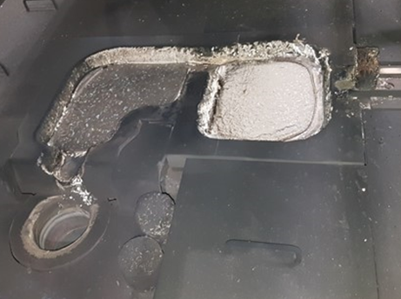
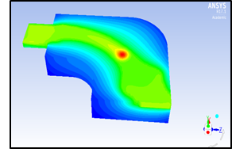
Premium Quality oriented R&D
CFD model is also focused on studying HDI/ LDI removal mechanism, objectives are :
    Link the pilot scale observations to industrial ones
    Predict the effect of operating parameters on residence time and defect removal at the pilot and industrial scale
Both projects are on going but first results highlight best pratices used for the standard production :
Frozen practice for torch current and pattern for the industrial furnace with maximized power and pool size to promote LDI dissolution
Upper limit for melt rate to avoid short residence time
Metafensch PAM furnace hearth
CFD model of the pilot PAM furnace : Temperature map at the surface of the refining hearth¹
¹ L. Décultot, A. Jardy, S. Hans, E. Doridot, J. Delfosse, F. Ruby-Meyer and J.-P. Bellot : LMPC 2019 Proceedings, Birmingham, UK, 2019

Slide 13
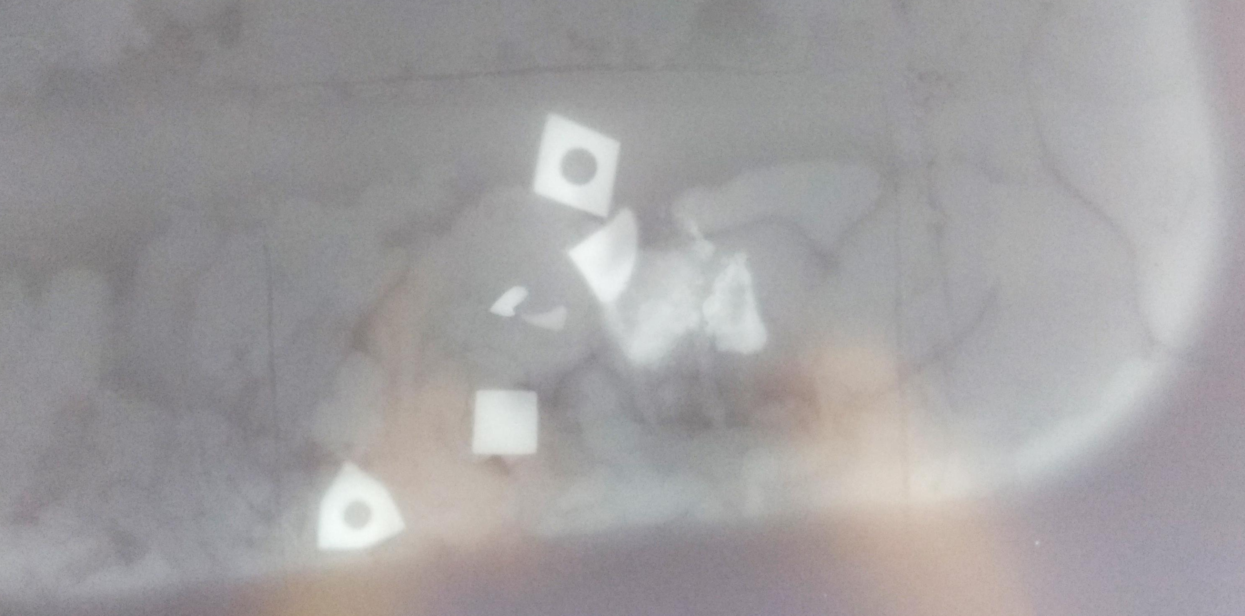
Pilot furnace HDI seeded test
WC cutting tools were added to the charge,
Remaining skull was XR inspected
All the cutting tools were found by XR inspection of skull just underneath the feeding ramp
RX image of melting hearth
30mm
HDI seeded test

Slide 14
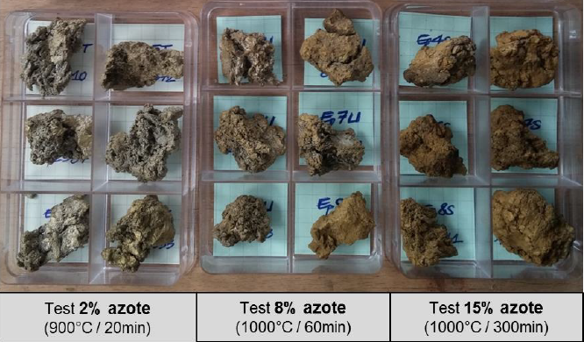
Pilot furnace LDI seeded test
LDI :
Nitrided sponge (laboratory scale) :
  3 levels of N% (checked with weight gain and destructive chemistry analysis)
  Experimental set-up is close to the Malley & Belchak’s publication (Standardizing Defects for Titanium seeding experiment)
  Ingot have been forged and UT inspection is on-going
Nitrided sponges

Slide 15
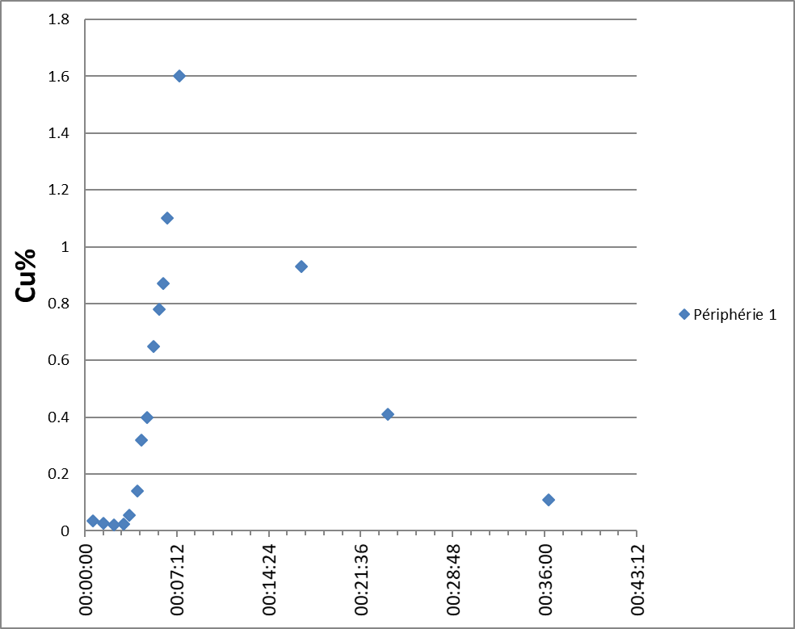
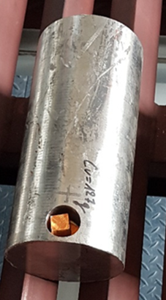
Pilot furnace : residence time test
Residence time distribution is experimentally determined by the addition of an inert tracing element :
- Tracing element concentration is measured on the electrode
- Concentration vs time is plotted

