Slide 1




September 2017
UKAD

Slide 2














VISITOR SAFETY RULES
Welcome to UKAD,
In order to guarantee an enjoyable visit, thanks to follow these few safety rules in the production hall :
If you see an accident, please warn ASAP a first-aid worker. They are easy to recognize thanks to a green helmet.
SAFETY
SHARED VIGILANCE
Wear personal protective equipment (helmet. eyewear, earplugs, safety footwear and reflective jacket)
Use green pedestrian ways painted on the floor.
Be careful at the handling devices and travelling cranes
Do not cross safety fences
Do not touch products (danger of getting burned and/or cut).
If you see an hazardous situation, feel free to inform us.
ENVIRONMENTAL
Save energy (water and electricity).
Sort your wastes.
If you see a leakage, please inform us ASAP
EVACUATION
It is forbidden to take pictures without any authorization,
Switch off your mobile devices.
If you hear the emergency alert system, follow your guide to the meeting point situated near the truck entrance.

Slide 3

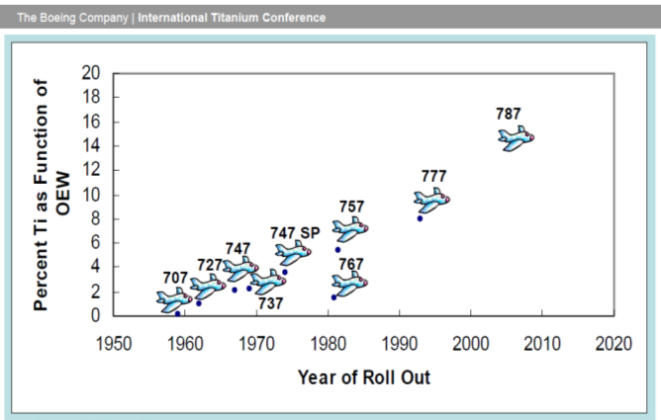



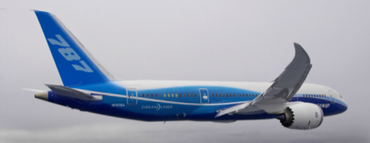
The creation of UKAD
The creation of UKAD was allowed by :
the increase of Ti material in airplane structures

Slide 4
The creation of UKAD
The creation of UKAD was allowed by :
the increase of Ti material in airplane structures
the UKTMP strategy with Ti downstream development
the Aubert et Duval strategy with Ti upstream development
the Airbus support with a 10 years sales agreement
the french local authorities support

Slide 5

is a joint-venture which combines, in the titanium market, the forces of 2 companies :
  Aubert & Duval
  UKTMP
UKTMP is a Kazakh registered company. Well known for its high level of Titanium sponge quality :
Ilmenite mining operation
Titanium slag production
Titanium tetrachloride and magnesium production
Titanium sponge production
Titanium melting facility

Slide 6












UKTMP in pictures

Slide 7
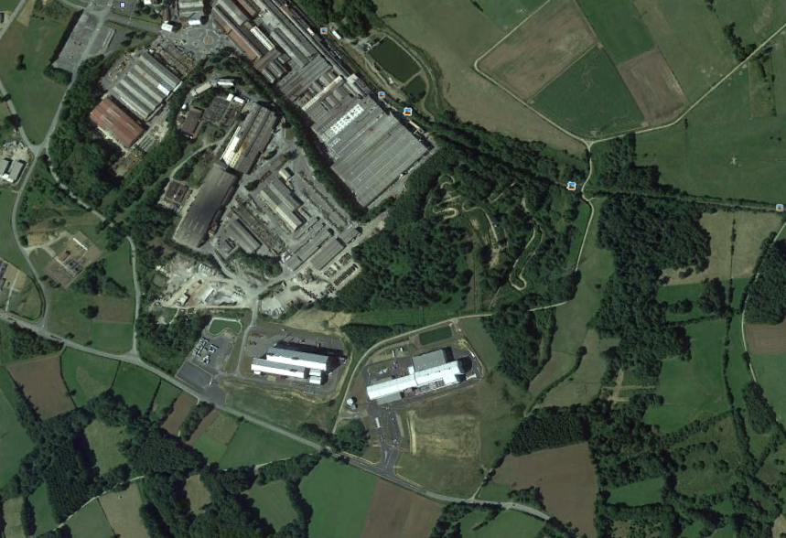
Situation UKAD / EcoTitanium
AUBERT & DUVAL
UKAD
IV30
EcoTitanium
Notes:
RAR

Slide 8
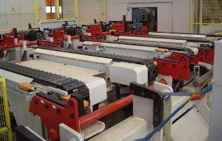
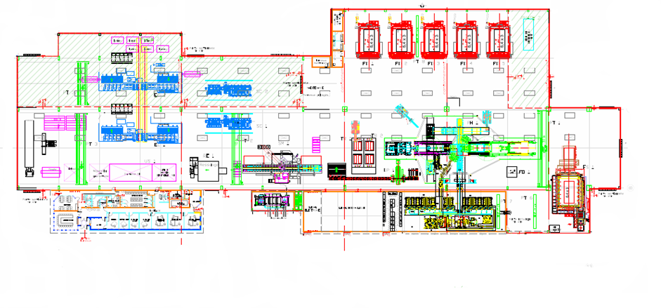
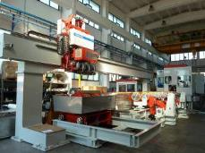
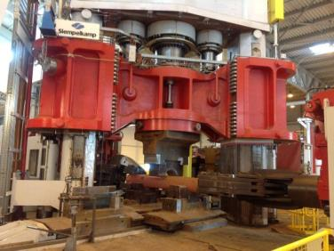
Layout
Stationary hearth furnaces
Peeling
Sawing
Forging
press
Grinding
Mobile hearth
furnaces
Ultrasonic

Slide 9

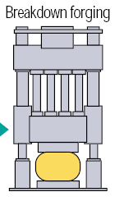



UKAD products
UKTMP
C
U
S
T
O
M
E
R
S
forging press
4,500 t.
N
D
T
*
or
or
➔ UKAD :
  Ingots from 7 (titanium) to 18 t
  Blooms and billets from 85 to 450 mm in Ø and 4 to 6 m long
  Bars from 55 to 85 mm
Operations subcontracted to Aubert & Duval
*Non destructive tests (automatic multi-element ultrasonic)

Slide 10


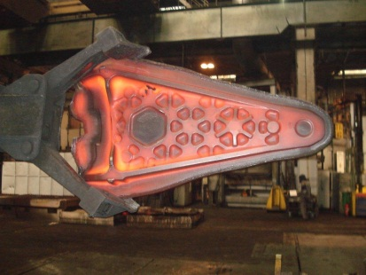




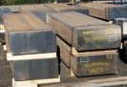
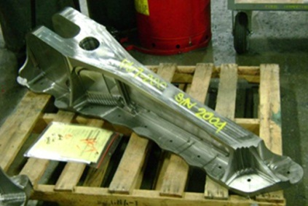




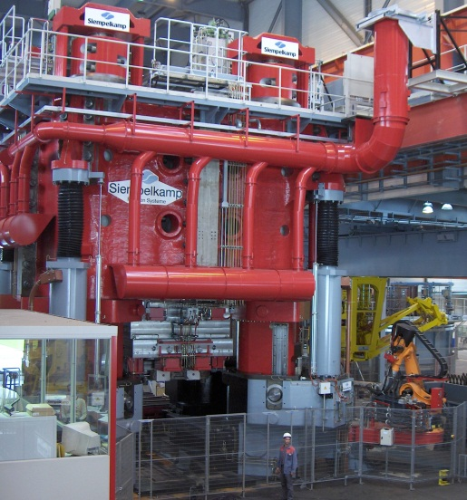

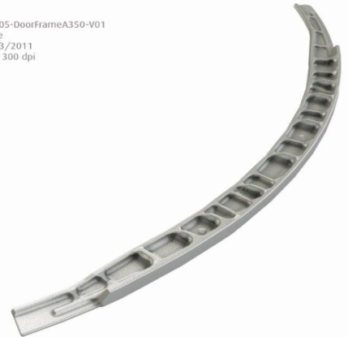







Worldwide Aeronautical Market
CUSTOMERS
UKTMP
Billets
Ti Alloy Ingot

Slide 11
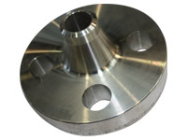
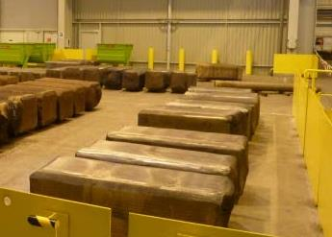
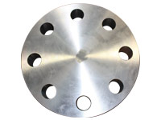
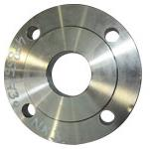
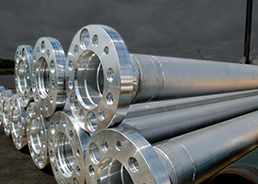

Oil and Gas (Corrosion) Market
UKTMP
CUSTOMERS
Ingot ➔ Blooms, Billettes
Welding Neck
Ti CP or Ti Alloy Ingot
Covers and flanges

Slide 12

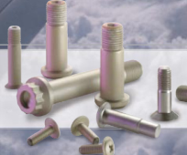


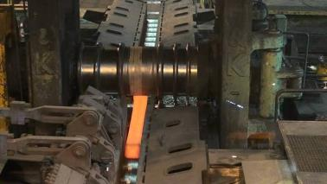





Fasteners and Medical Market
Aeronautical fastening market
UKTMP
CUSTOMERS
Ingot ➔ Blooms ➔ Bars
Orthopedic Implants
Ti Alloy Ingot
Knee
Hip

Slide 13
Key Figure
Confidential
Impact of the build-up of a strategic stock for our main customer.
Tons
Notes:
CA 2013 18,6 M€
Budget 2014 1565 t 600 t taf Ca : 39 M€ 2015 2500 t 1100 t taf Ca 64 M€

Slide 14
Certifications
ISO 9001 and AS 9100, last approval Nov 2016
ISO 14 001 and OHSAS 18001, last approval NOV 2016
Ultra Sonic Nadcap Certification in Dec 2014, confirmed in Nov 2015 and in Dec 2016
Airbus :
  IPCA Janv 2013 « C »➔ IPCA+ 28 Janvier 2016 « B »
Boeing :
  UKTMP has been formally qualified in August 2015.
UKAD delivers billets and bars in accordance with AMS 4928 and Ultra Sonic tested in accordance with AMS 2631.

Slide 15

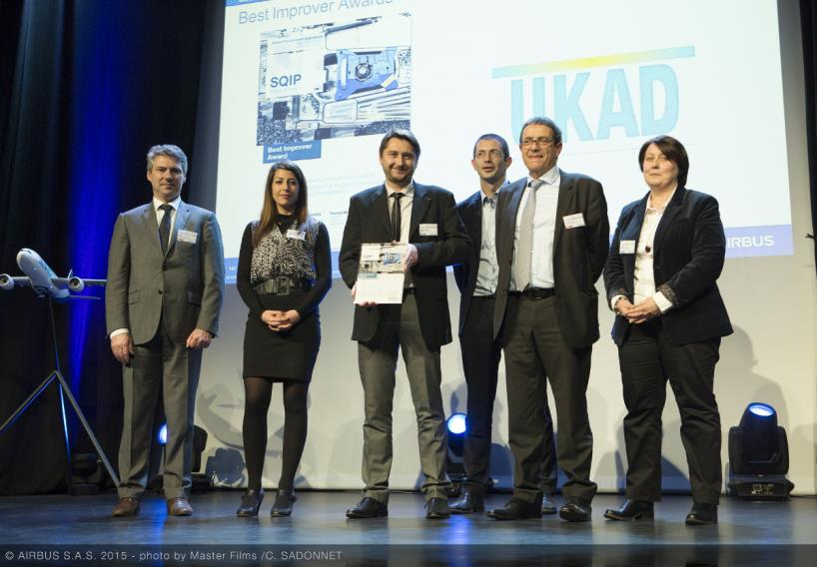
UKAD :
For the second year UKAD was awarded by Airbus :
Best Improver Award 2015 .

Slide 16
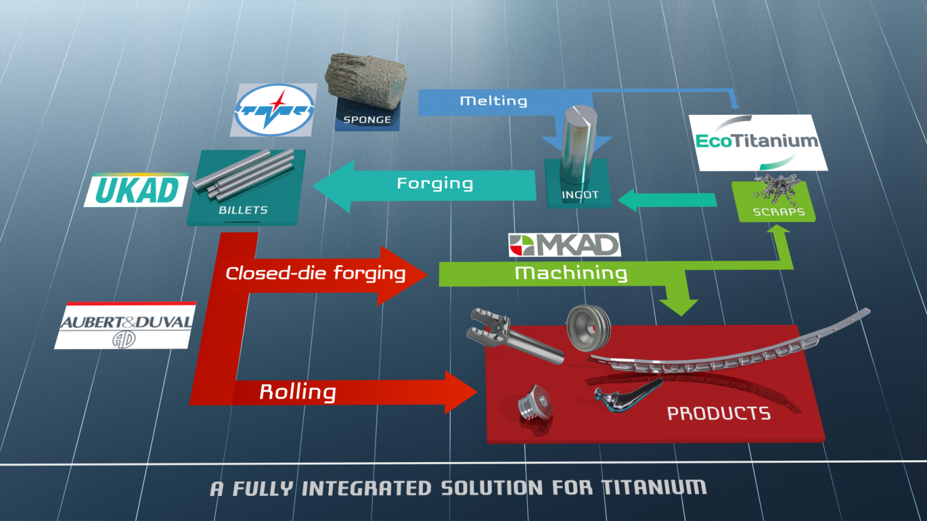
Partnerships form an integrated Titanium Solution

Slide 17
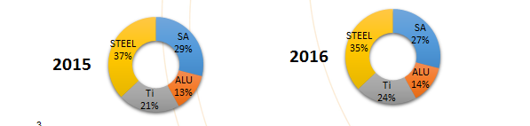
The share of Titanium in A&D sales
Titanium represents 24% of A&D sales in 2016
Coming from 18 % in 2014 and 21 % in 2015.

Slide 18




Production generates significant volume of scrap
Titanium closed die parts generate huge volume of scrap
Billet 200kg
Closed Die Part 150kg
Finished Part 20kg
Ratio Buy to Fly : 10

Slide 19
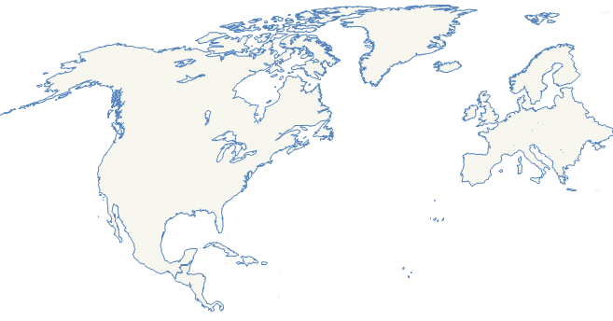

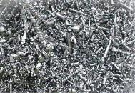

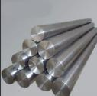
Scrap generated in Europe is a key for competitiveness of US titanium melters
European titanium scrap is mainly exported to USA : and 11 850 tons in 2015, 10 500 tons in 2016.
Europe
USA
US ingots were mainly produced from titanium scrap in 2014, 2015 and 2016, more than 60 % of the total consumption Scrap + Sponge.

Slide 20



Committed shareholders in EcoTitanium
43.5 %
First facility in Europe for melting new Titanium Ingots by recycling, dedicated to aeronautical and high demanding markets in concept of Circular Economy.
49 M€ investment for the first step.
63 direct employees
7 000 m²
41.3 %
15.2 %

Slide 21

Main Equipment :
A Plasma Furnace Cold Hearth Refining
Loading system for turnings briquets
Loadind system for solids
Melting Chamber
Plasma melting is followed by VAR remelting in EcoTitanium facility.
All equipment available in Ecotitanium for preparation of melting and remelting, and sample collection for chemical analysis.
Electrods erection chamber

Slide 22

Principle
Principle of a PAMCHR furnace.
Helium
Torches Plasma
Anneau mouleur
Briquettes
Creuset Froid
Lingot
Melting 1700 °C
Notes:
RAR

Slide 23
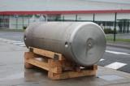

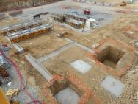

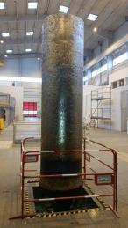
EcoTitanium planning
2010
2015
2017
2022
Full maturity
Production startup
Erection of the new plant next to UKAD
Reflection and project structuring
First deliveries of Ingots according AMS 4928 : December 2017

Slide 24

An open Solution for all UKAD Customers
The revert loop will be available for all UKAD’s customers (forgers, extruders,…), based on circular Economy.
EcoTitanium reserves a large part of its capacity for all forgers, in the concept of circular economy.
Notes:
RAR

Slide 25
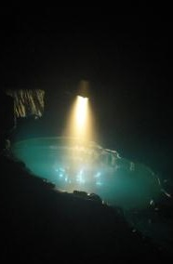
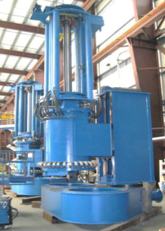
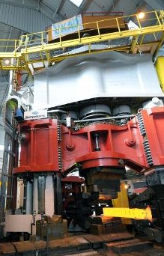
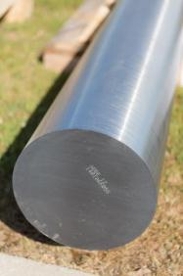
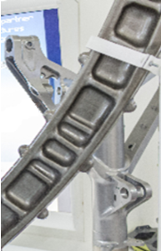
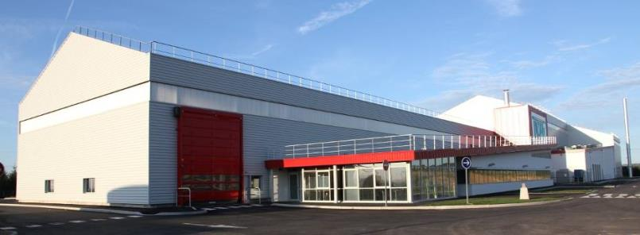
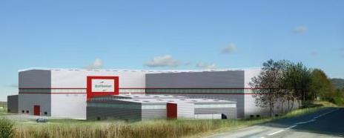
Thank you for your attention

